Slide 1
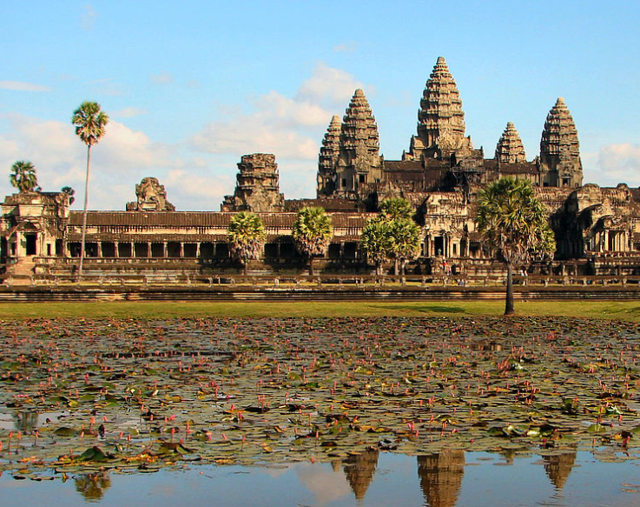
What do you like?

Slide 2
3-3 What do you like?
I like Angkor Wat.
I like Angkor Wat.
I like bananas.
I like bananas.
I like Siem Reap.
I like Siem Reap.
I like Phum Svay primary school.
I like Phum Svay primary school.

Slide 3
What do you like?
I like Angkor Wat.
Do you like Angkor Wat?
I like Siem Reap.
Do you like Siem Reap?
I like Phum Svay primary school.
Do you like Phum Svay primary school?
I like this school.

Slide 4
Interaction: Do you like Angkor Wat?
I like Angkor Wat.
What do you like?
I like Siem Reap.
What do you like?
I like Bananas.
What do you like?
I like Phum Svay primary school.
What do you like?

