Slide 1
H20Fruits

Slide 2
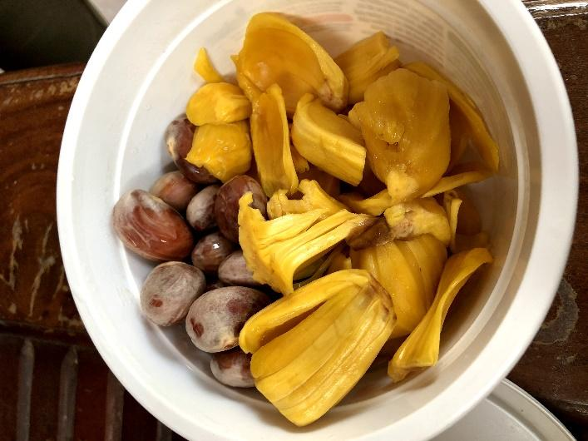
This picture shows jackfruit.
It tastes good.
We like it.
Do you want to try it?
Do you have this fruit in you country？

