Slide 1
H13 Food

Slide 2
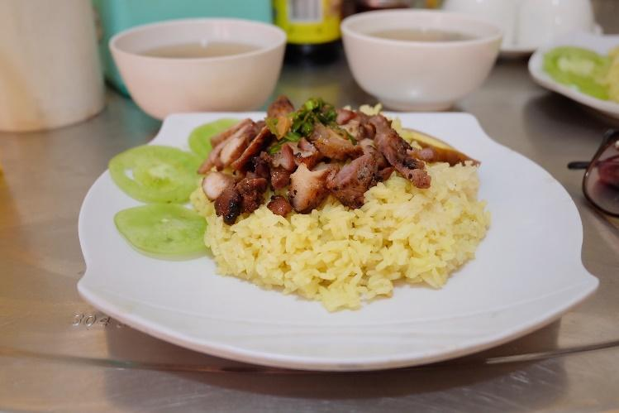
Do you know the name of this dish?
It is called “Bai sai churuk.”
It means rice with pork.
It is a popular breakfast in Cambodia.

