Slide 1
H14 Food

Slide 2
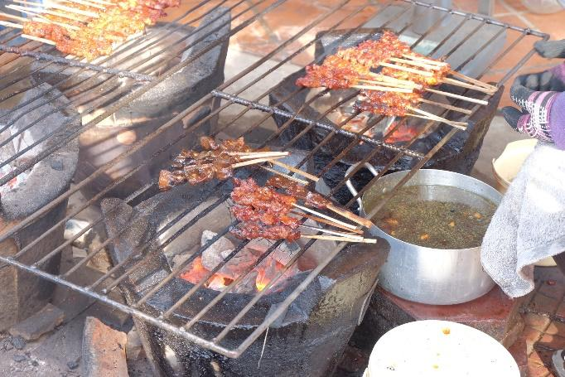
It looks yummy.
These are chicken sticks.
I like it very much.
It is grilled meat.
We eat these with vegetable filling.

