Slide 1
H15 Food

Slide 2
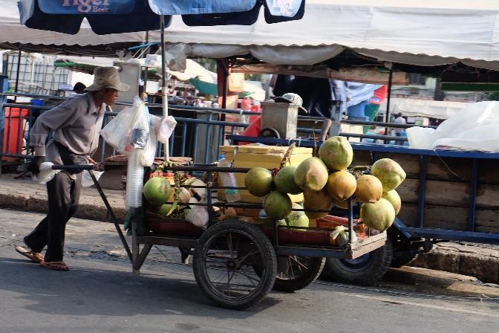
This is the coconut fruit shop.
They sell coconuts.
They make coconut juice.
Please come to Cambodia.
Please enjoy coconut juice.

