Slide 1
H19 Birthday

Slide 2
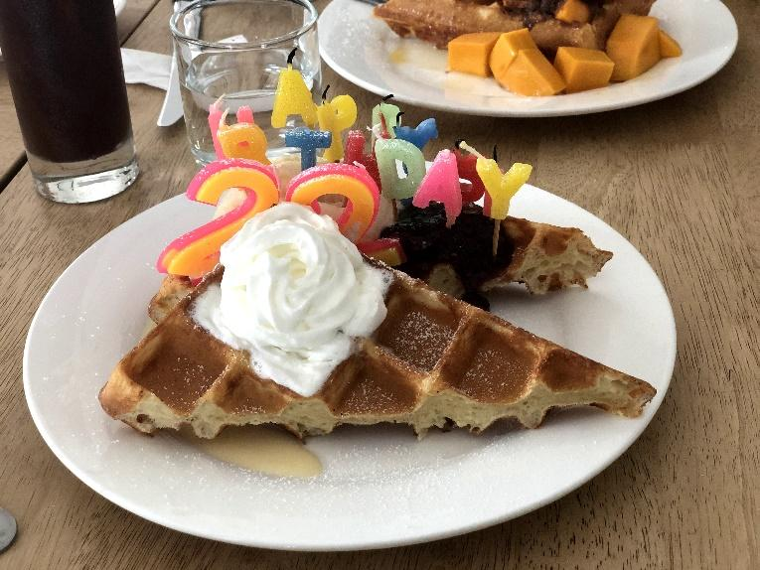
This picture shows the birthday cake.
When is your birthday？
This is a present from my friends.
We enjoyed my birthday together.

