Slide 1
H25 Fruits

Slide 2
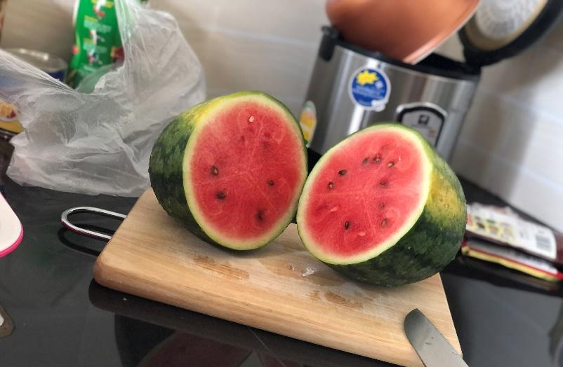
Please look at this picture.
this picture shows watermelon.
you can eat watermelon in Cambodia.
it is very sweet.

