Slide 1
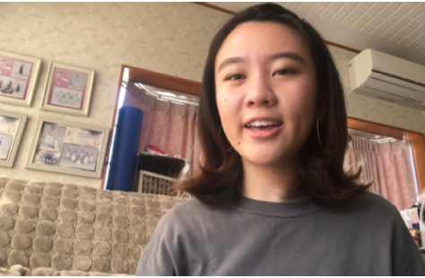
H6 Feelings

Slide 2
Let's express feelings
I am so happy to meet you.
We are so happy to meet you.
I like you.
I like Japanese food.
We welcome your visit.
I feel so sad.
I feel angry.

