Slide 1
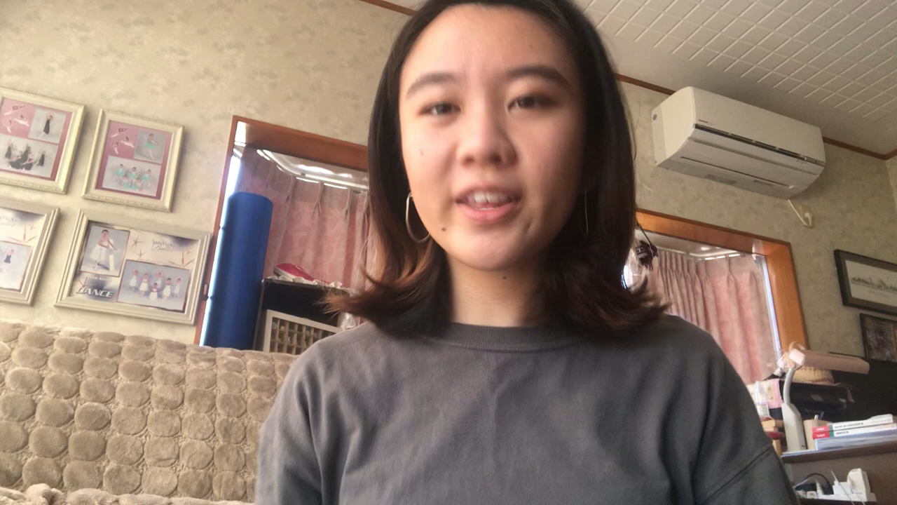
H1 Self-Introduction

Slide 2
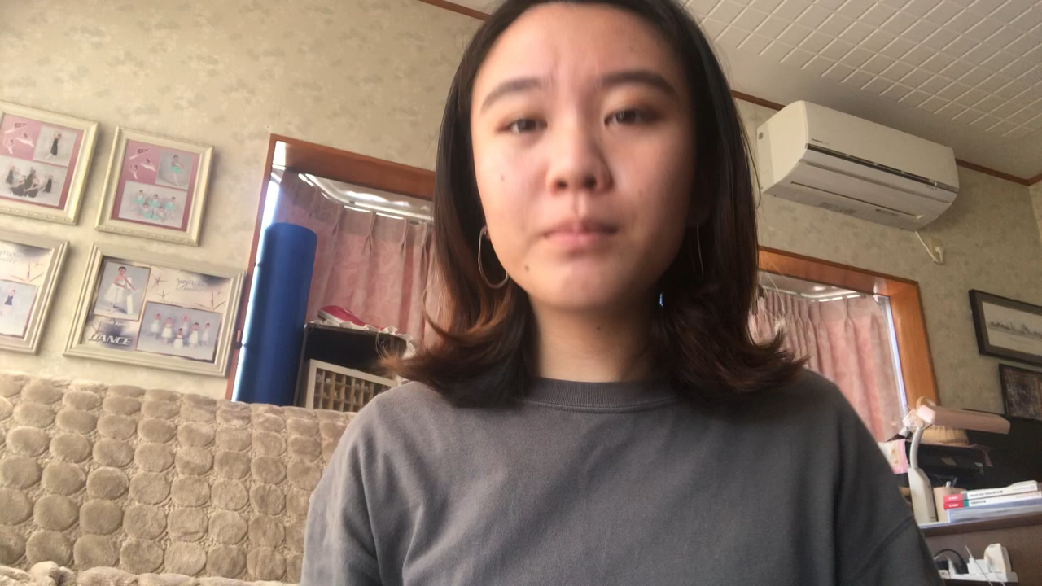
Hello, My name is Thida.
Nice to meet you.
What is your name?
Welcome to Cambodia!
Welcome to my school!

