Slide 1
H12 Fruits

Slide 2
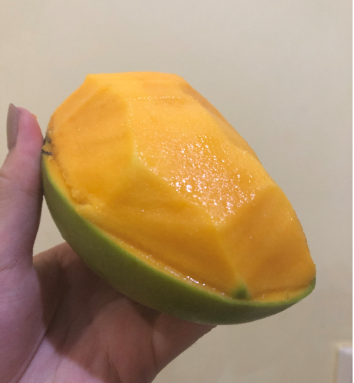
Do you like mangos?
Its color is yellow.
April and May is the best season for sweet mangoes.
I love mangoes.
It tastes good!

