Slide 1
H16 Vehicles

Slide 2
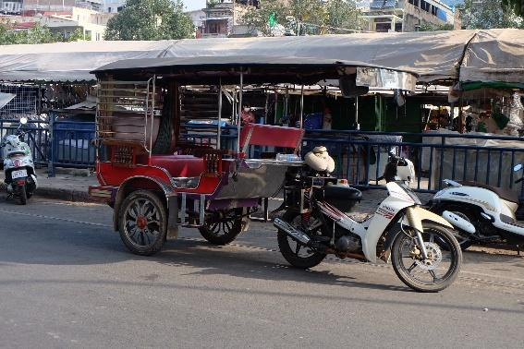
Please look at the Tuk tuk.
Many people use the Tuk tuk.
It is nice and convenient.
You can see many Tuk tuk in Cambodia.

