Slide 1
H17 food2

Slide 2
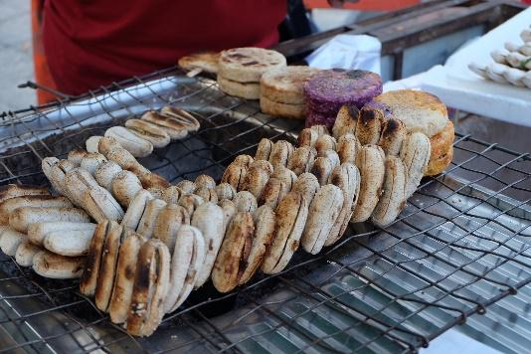
This photo shows Baked Banana.
We can see this in many places.
I ate this in Phnom Penh with my best friend.

