Slide 1
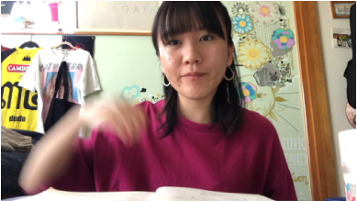
H18 Flowers

Slide 2
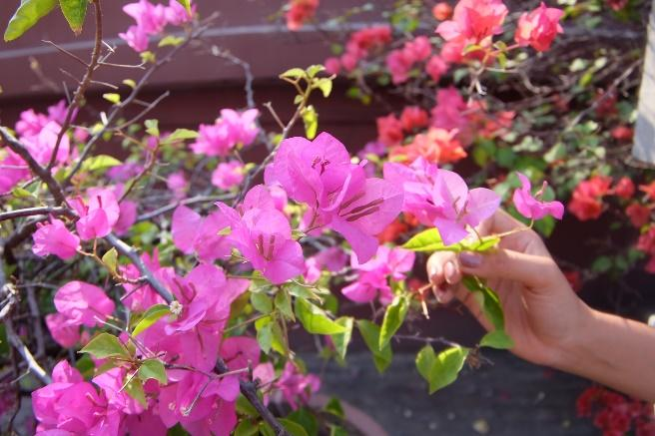
Do you know the name of this flower?
It is called “bougainvillea” in English.
I love the color of it.
Cambodia has many beautiful flowers.
They all look beautiful.

