Slide 1
H2 Colors

Slide 2
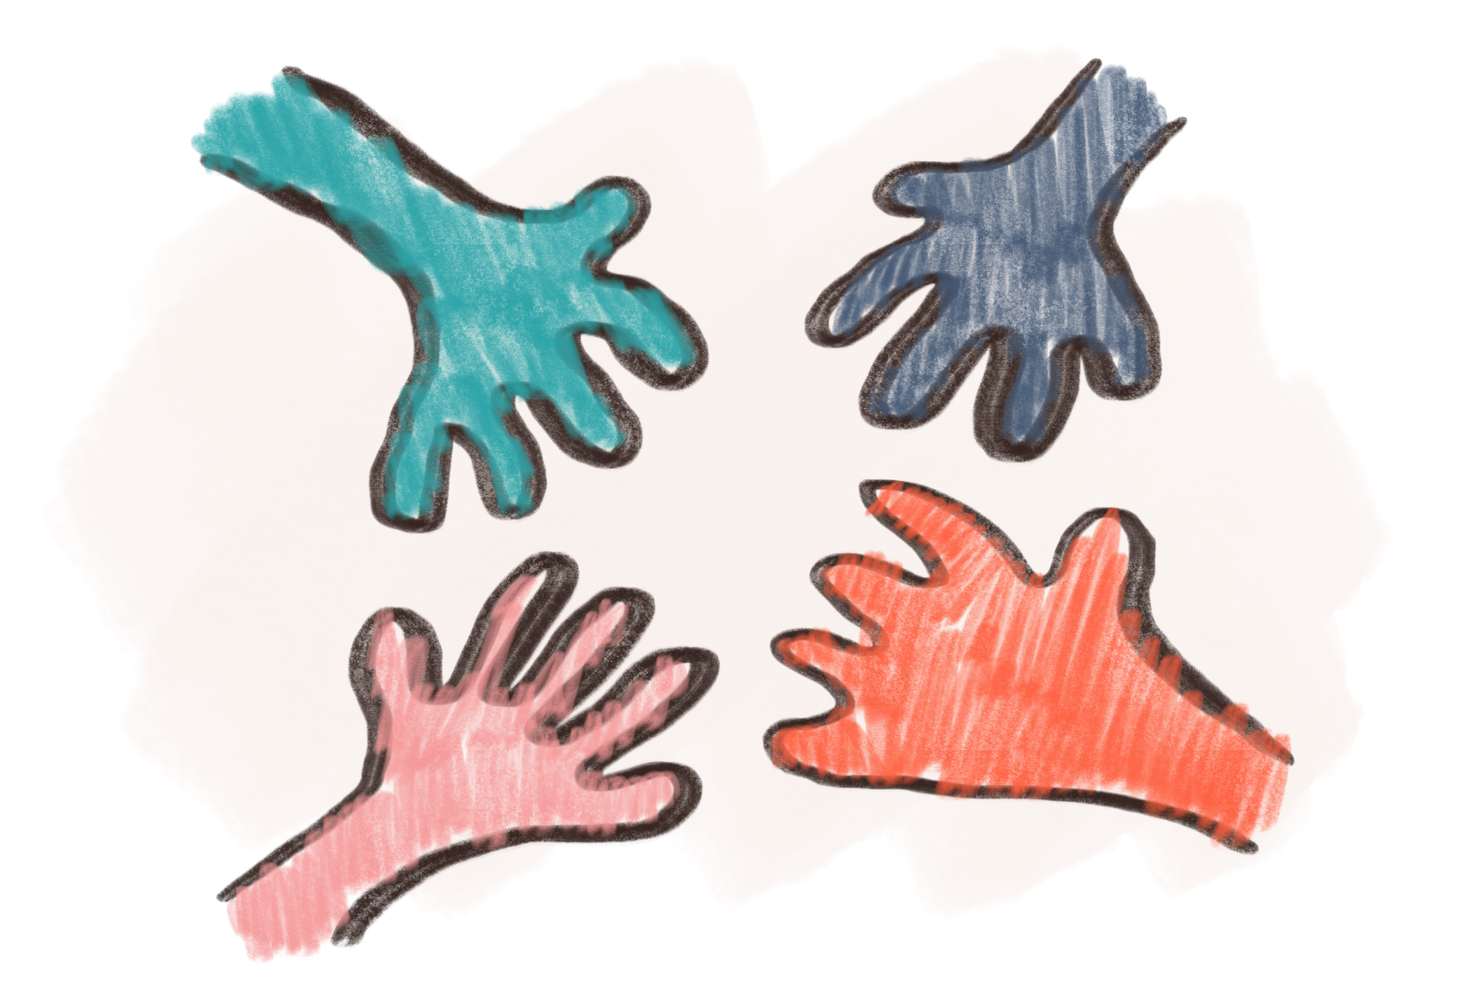
Let’s practice saying colors
What color do you like?
I like blue.
Blue , Red, Green, Orange, Yellow
I like this green bag.
I like this little green bag.

