Slide 1
H23 Culture

Slide 2
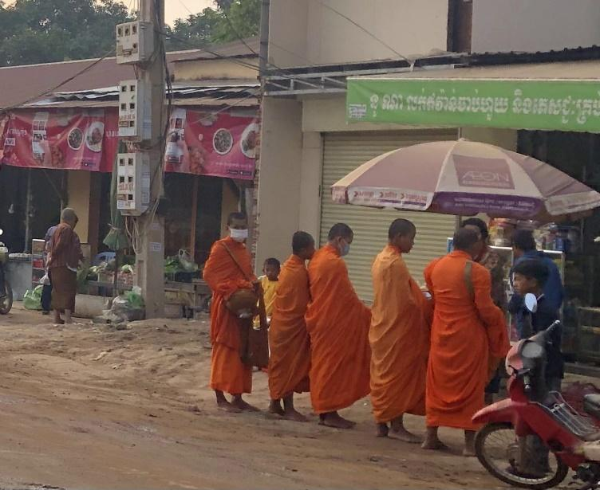
Please look at this picture.
Many Cambodian are Buddhist.
They live with people.
They do Buddhist training.
How about your country?

