Slide 1
H24 Breakfast

Slide 2
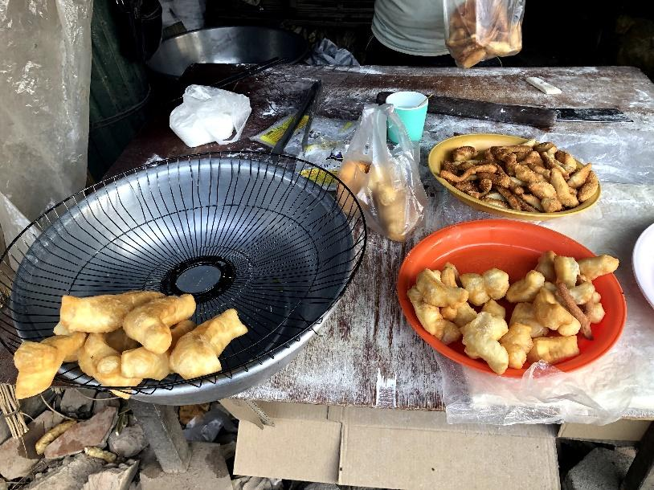
This picture shows my favorite Cambodian breakfast.
It is “Fried bread.”
I eat it twice a week.
You can find this shop in
every town.
prices are about 20 cents.

