Slide 1
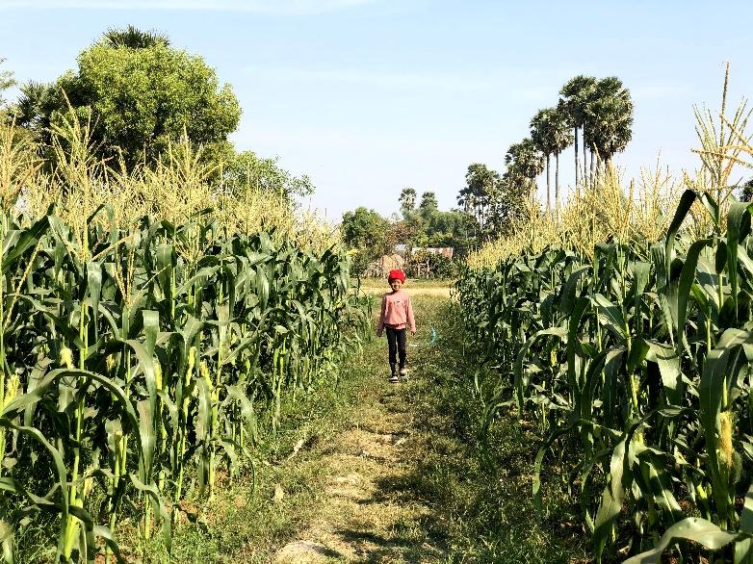
H26 View

Slide 2
This picture shows sweet corn in Cambodia.
Sweet corn is tall.
Sweet corn field is so wide.
we like sweet corn.
we drink corn soup.
My father likes sweet corn.

