Slide 1
H21 Fruits Lime

Slide 2
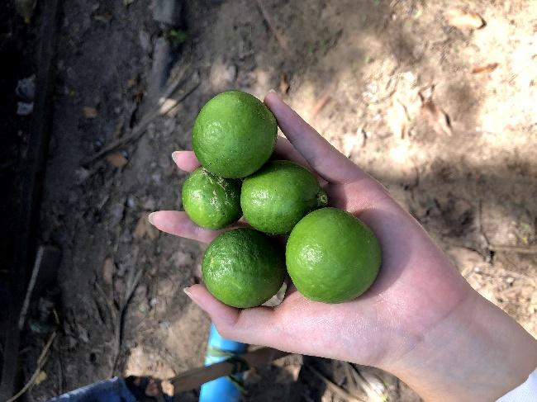
This picture shows a fruit called Lime.
People in Cambodia love this one.
In your country , do you have the same fruit?

