Slide 1
What animal do you like? 5-1

Slide 2
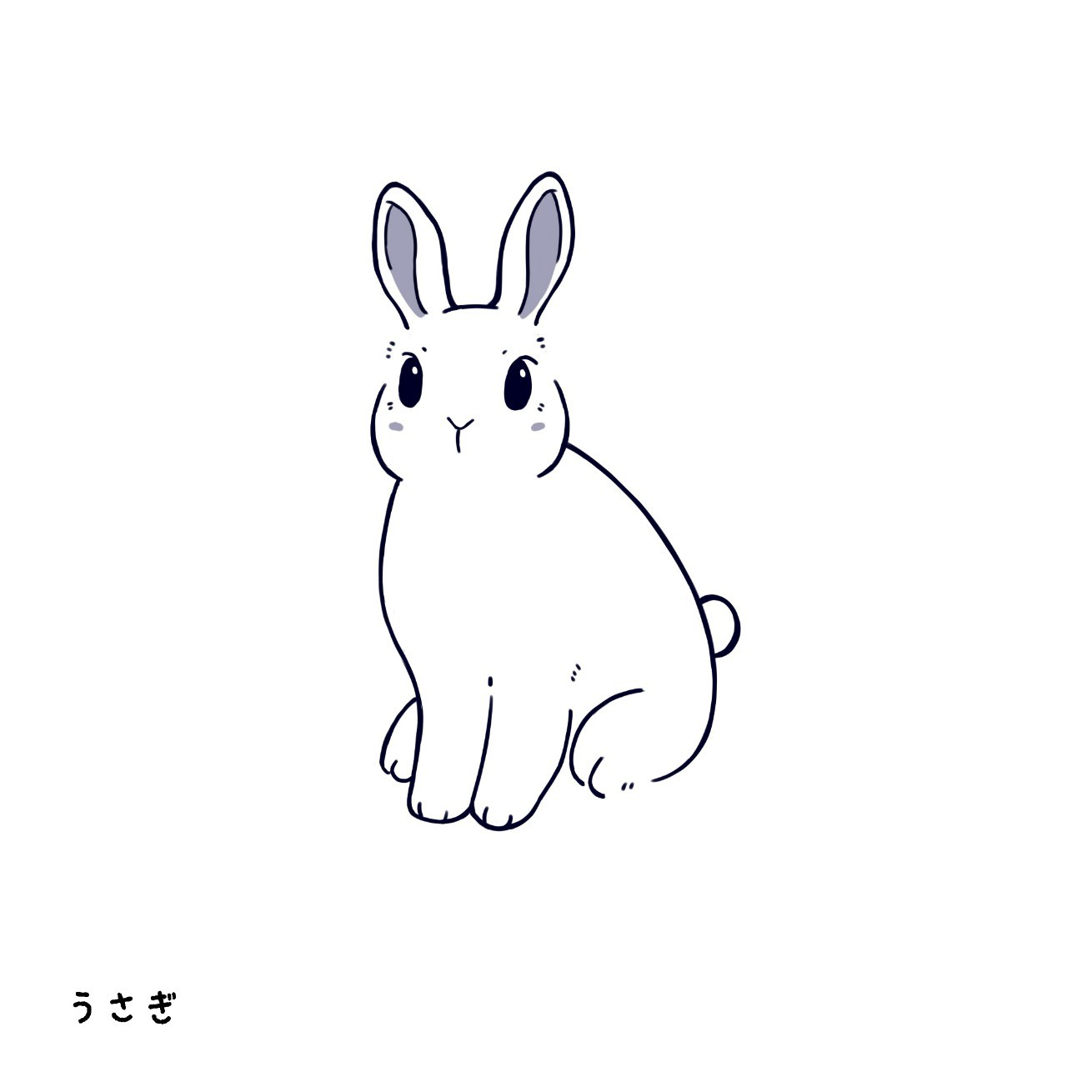
Rabbits
What animal do I like?

Slide 3
Foxes
What animal do I like?

Slide 4
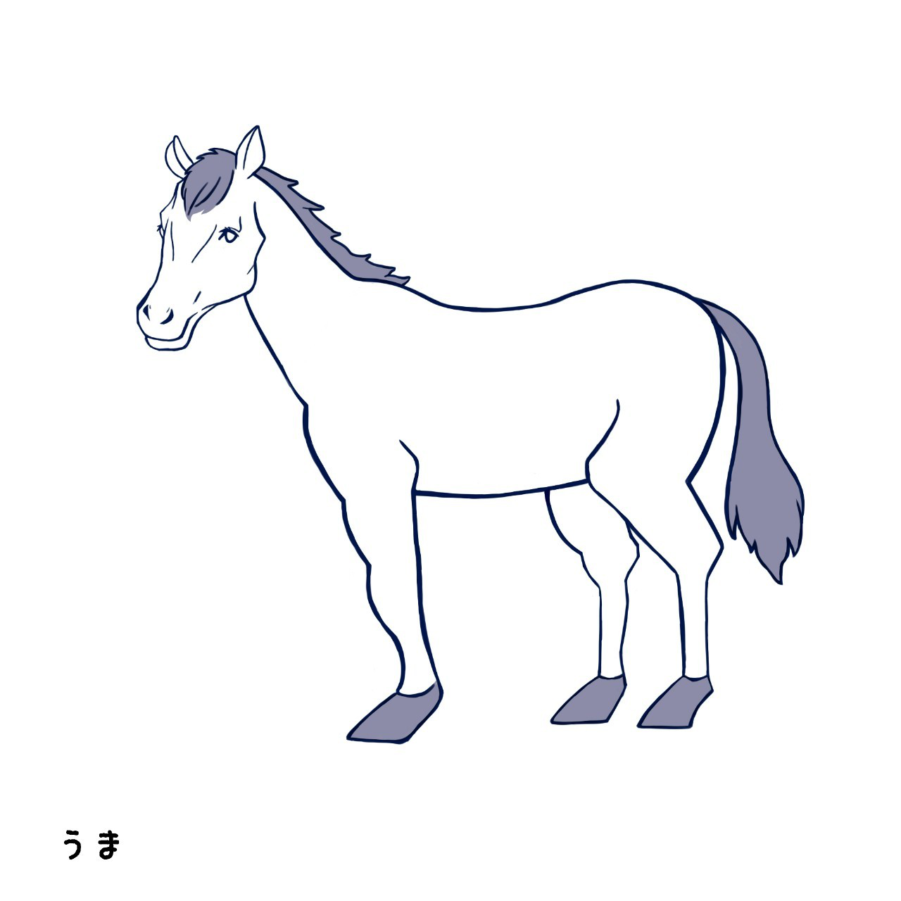
Horses
What animal do I like?

Slide 5
What animal do you like?
What animal do you like?
What animal do you like?
Do you like rabbits?
Do you like rabbits?
I like rabbits.
I like rabbits.

Slide 6
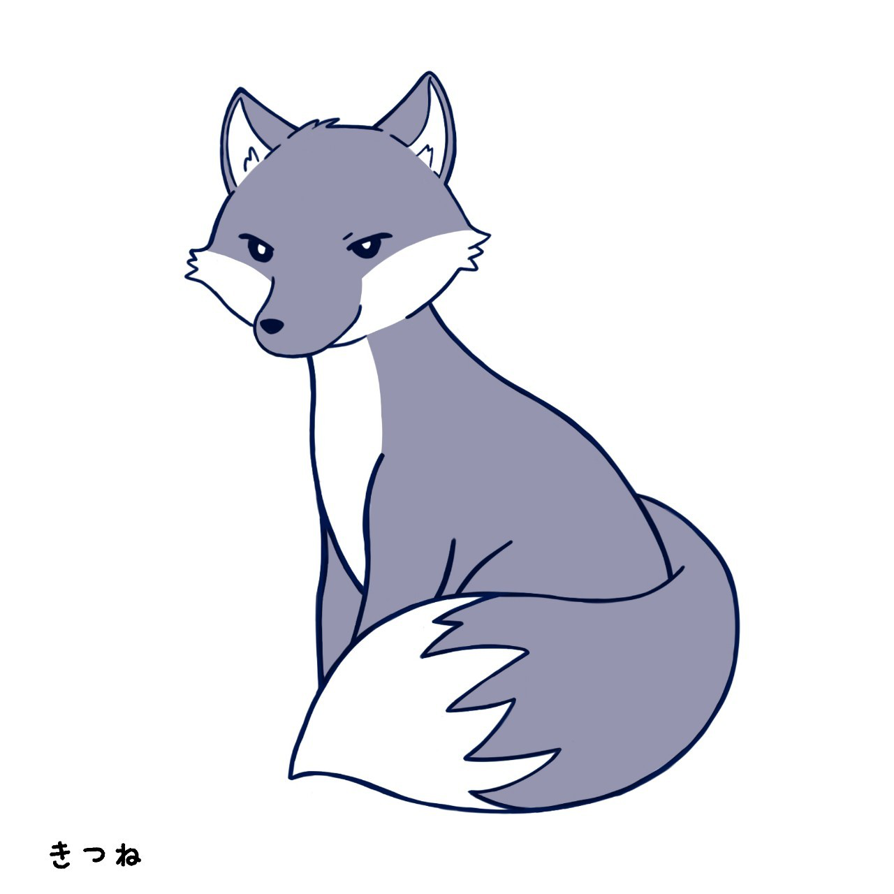
What animal do you like?
What animal do you like?
What animal do you like?
Do you like foxes?
Do you like foxes?
I like foxes.
I like foxes.

Slide 7
What animal do you like?
What animal do you like?
What animal do you like?
Do you like horses?
Do you like horses?
I like horses.
I like horses.
That’s all. Thank you.

Slide 8
Interaction: What animal do you like? Repeat 2 or 3 times, in order. : four persons activity
A
What animal do you like?
I like foxes.
What animal do you like?
D
B
I like rabbits.
What animal do you like?
I like horses.
What animal do you like?
C

