Slide 1

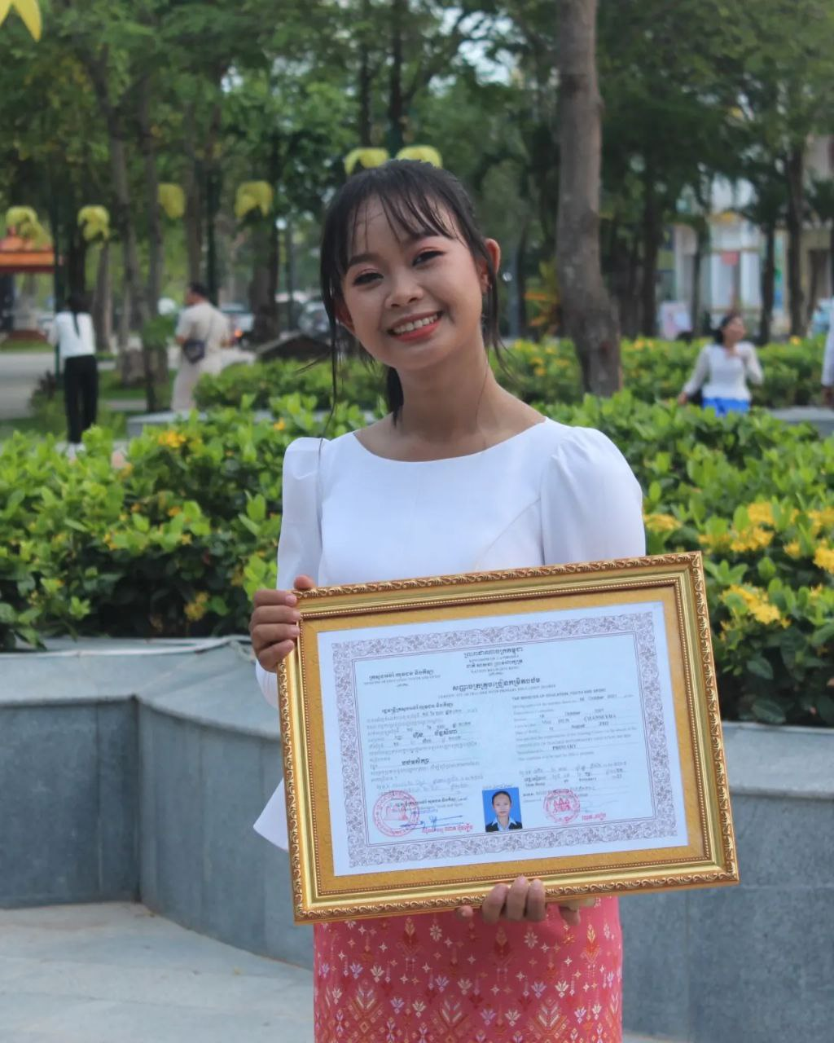
English grade 6
Chapter 1 Time and activities
Unit 2 Telling the time
What time is it now?
Student’s book Page 12 13

Slide 2


Time
ពេលវេលា

Slide 3

Clock
នាឡិកា

Slide 4
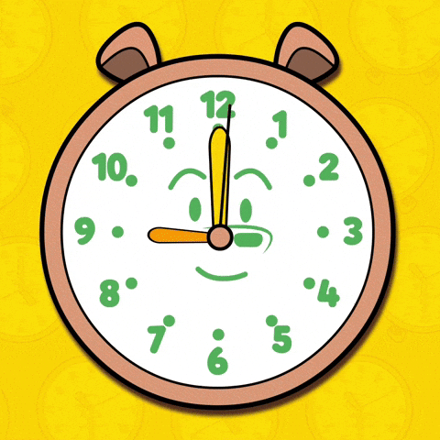
O’Clock
ម៉ោង

Slide 5

Listen and repeat
What time is it now?
តើពេលនេះម៉ោងប៉ុន្មាន?

Slide 6

Listen and repeat
It’s 7 o’clock.
ពេលនេះម៉ោង ៧

Slide 7


Pair work
What time is it now?
It’s 7 o’clock.

Slide 8



Group work
1
What time is it now?
It’s ………. o’clock.
What time is it now?
4
It’s 2 o’clock.
What time is it now?
2
It’s ………. o’clock.
What time is it now?
3

Slide 9


By Hun chanseyha

