Slide 1

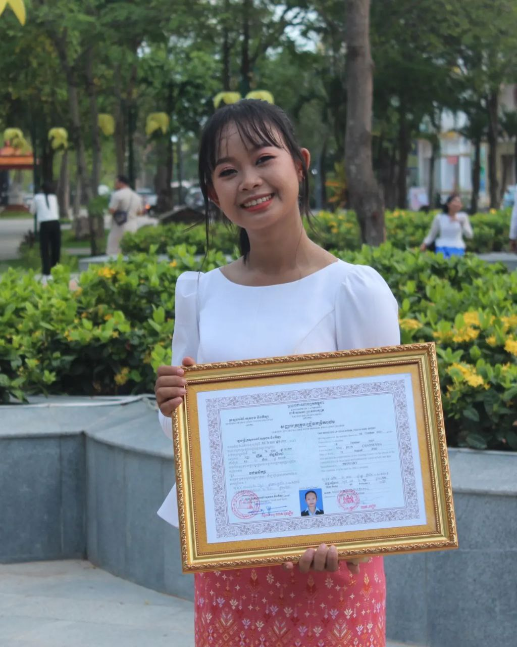
English grade 6
Chapter 3 My body
Unit 1 My head
How many eyes do you have?

Slide 2


Eye
ភ្នែក

Slide 3
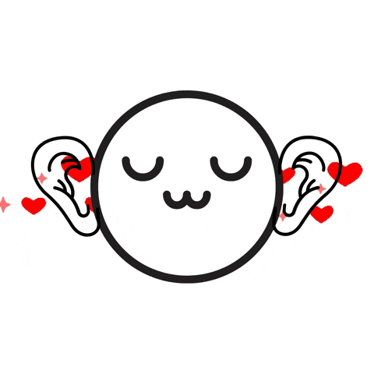
Ear
ត្រចៀក

Slide 4
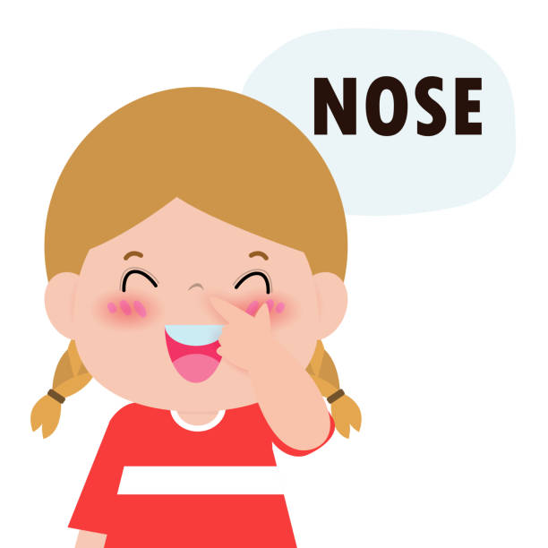
Nose
ច្រមុះ

Slide 5
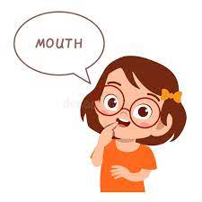
Mouth
មាត់

Slide 6
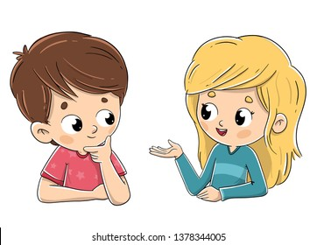
Listen and repeat
How many eyes do you have?
តើអ្នកមានភ្នែកប៉ុន្មាន?

Slide 7
Listen and repeat
I have two eyes.
ខ្ញុំមានភ្នែក ២

Slide 8
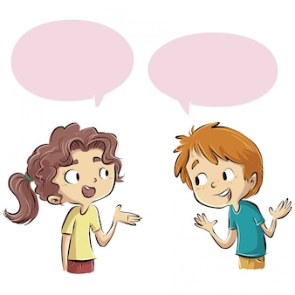
Pair work
How many eyes do you have?
I have two eyes.

Slide 9
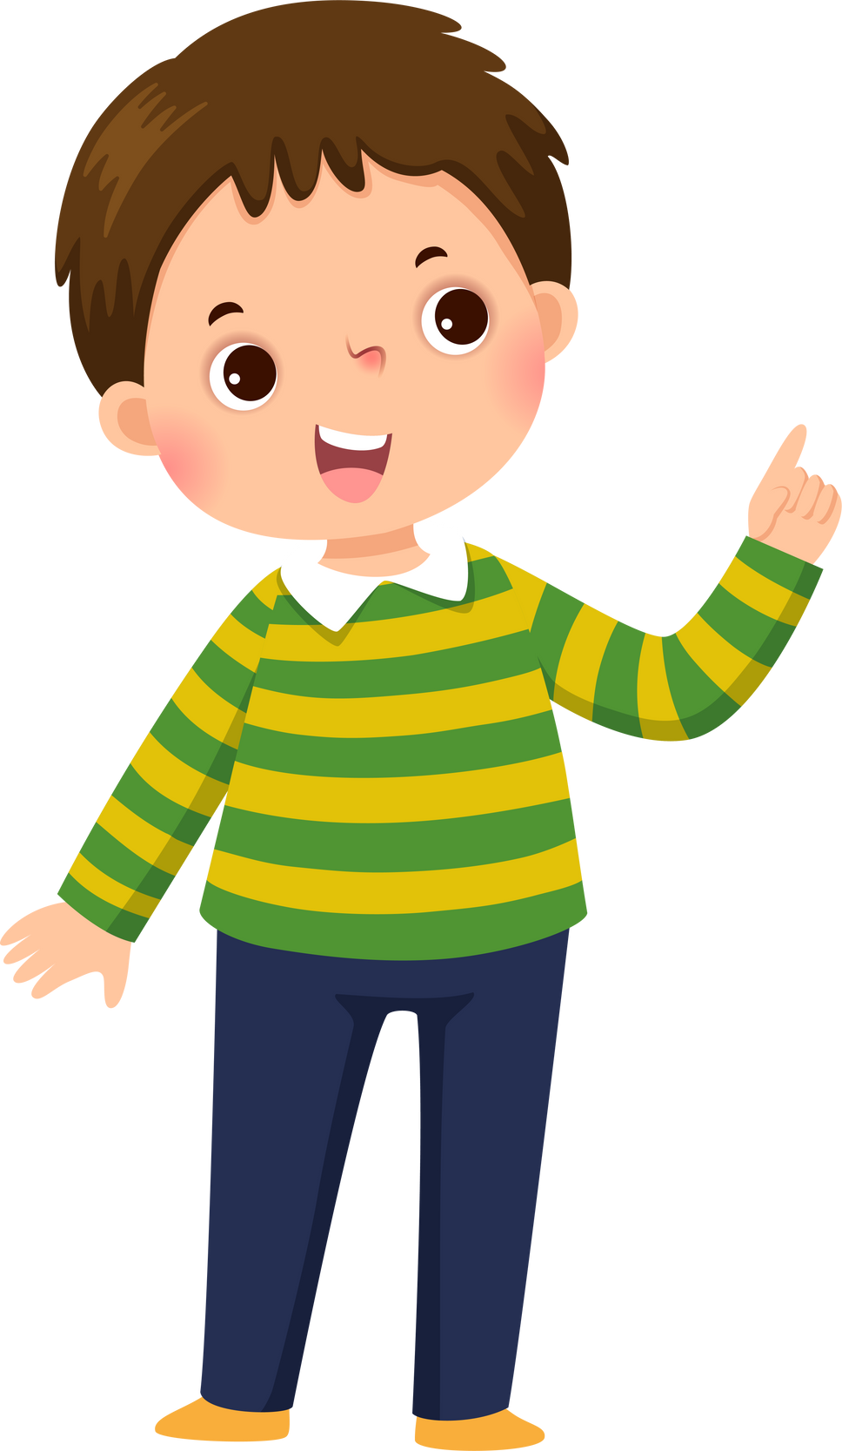

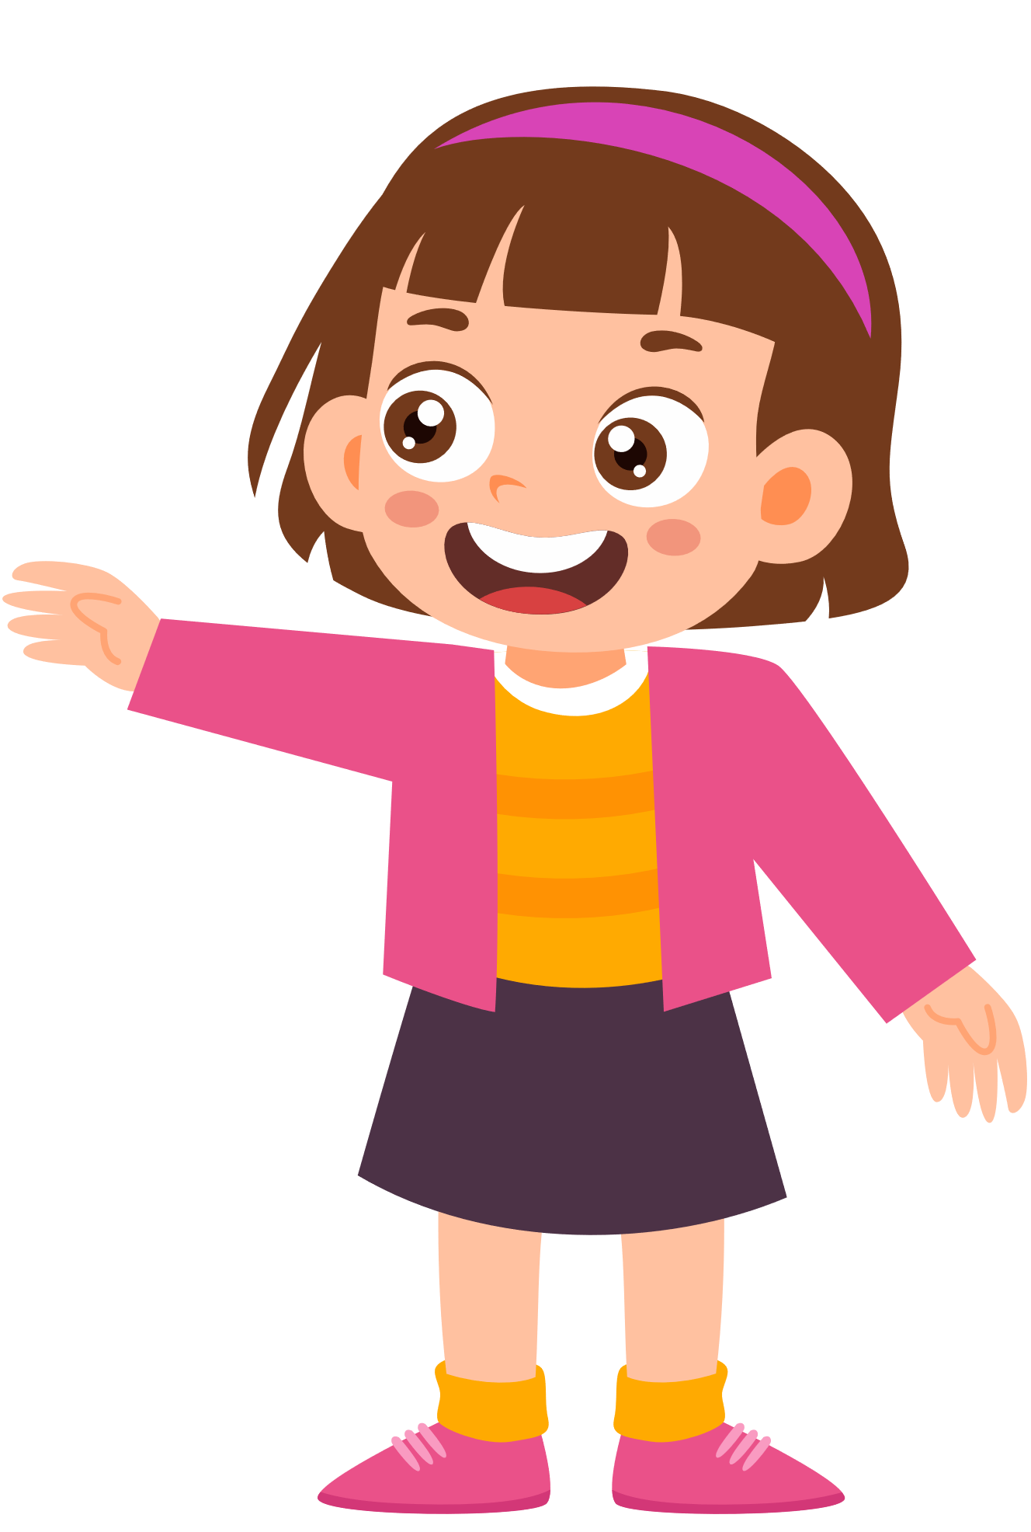
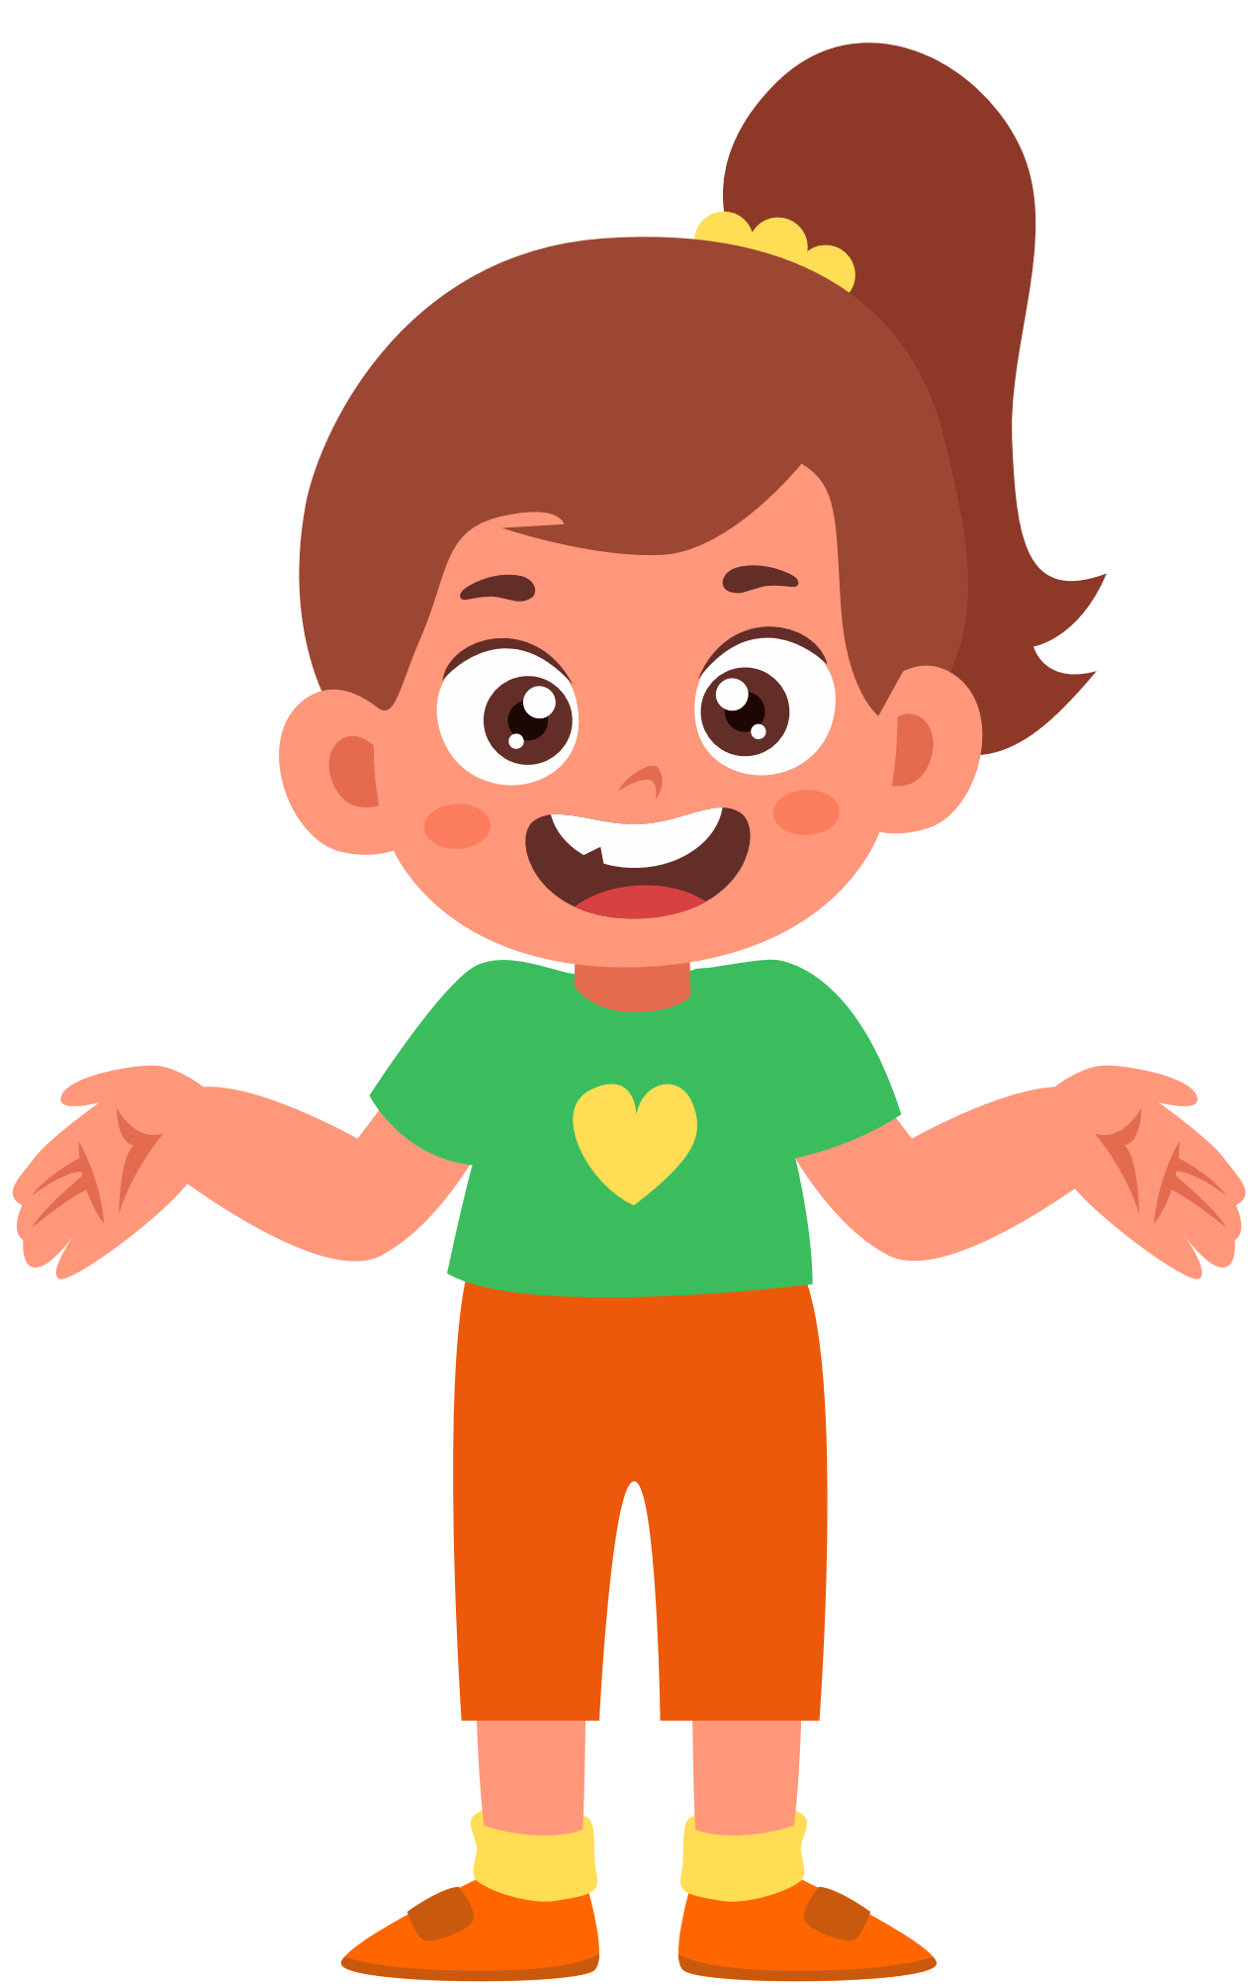
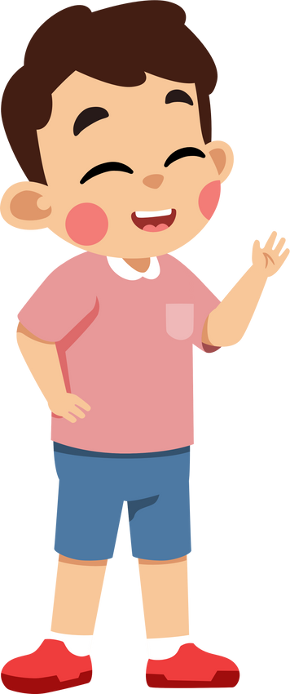
Group work
Eyes Ears Mouth Nose Cheek
1
How many eyes do you have?
I have …………...
How many …….. do you have?
4
I have two eyes.
How many ears do you have?
2
I have …………….
How many ………. do you have?
3

Slide 10


By Hun chanseyha

