Slide 1

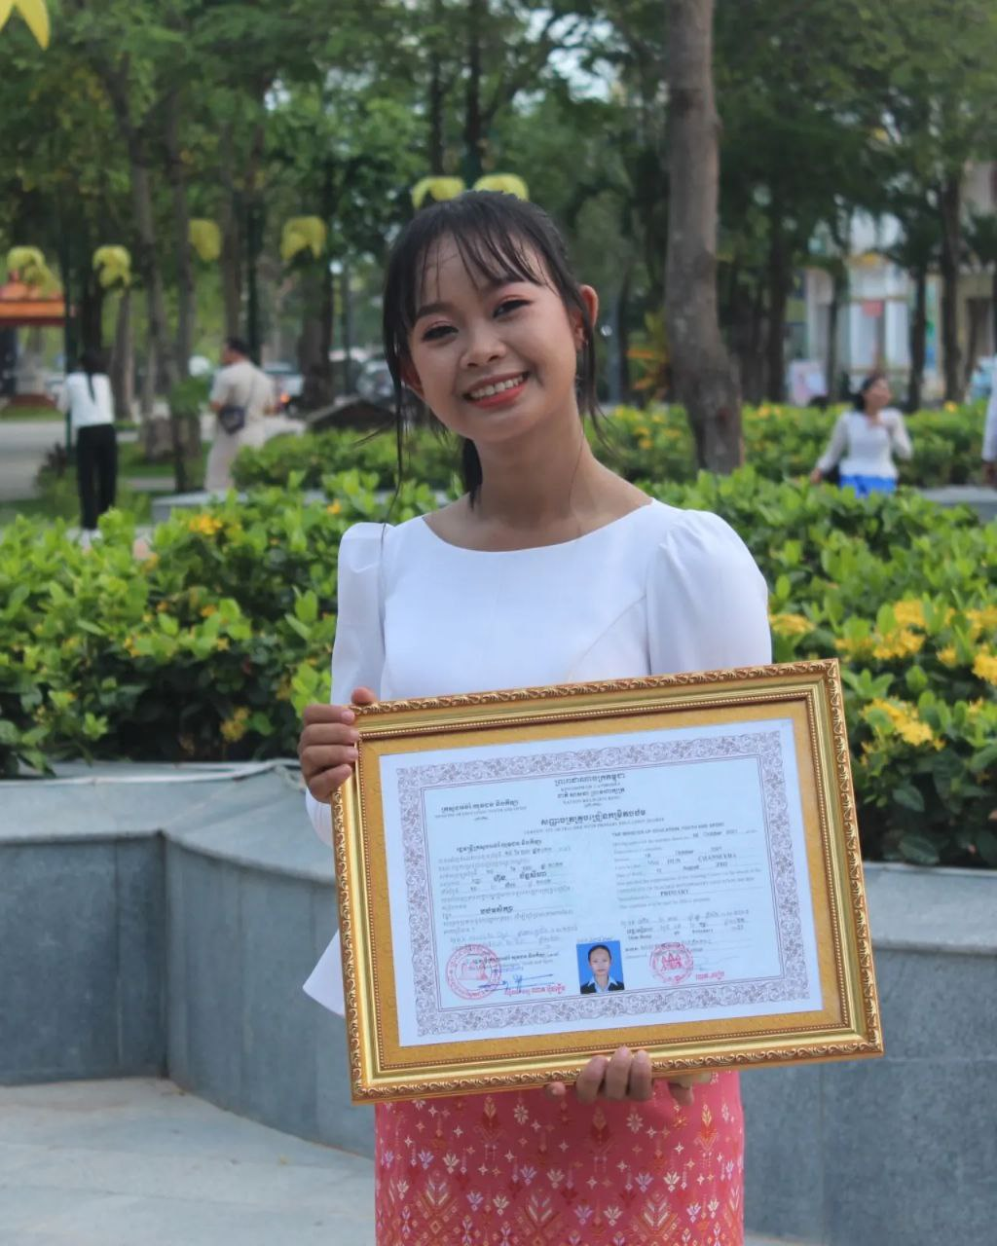
English grade 6
Chapter 3 My Body
Unit 2 My aims And Legs
What is this?

Slide 2
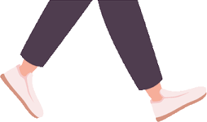

Leg
ជើង

Slide 3
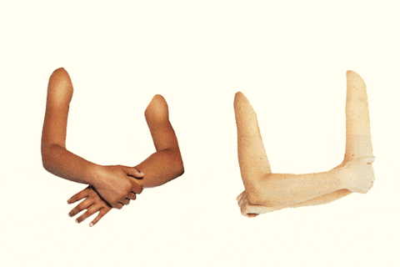
Arm
ដៃ

Slide 4

Left
ខាងឆ្វេង

Slide 5

Right
ខាងស្ដាំ

Slide 6
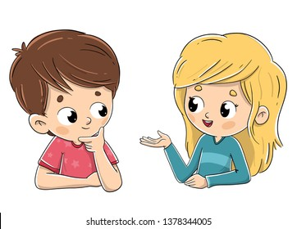
Listen and repeat
What is this?
តើនេះជាអ្វី?

Slide 7
Listen and repeat
This is my left arm.
នេះជាដៃឆ្វេងរបស់ខ្ញុំ។

Slide 8
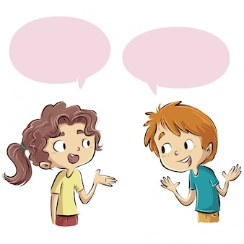
Pair work
What is this?
This is my left arm.

Slide 9
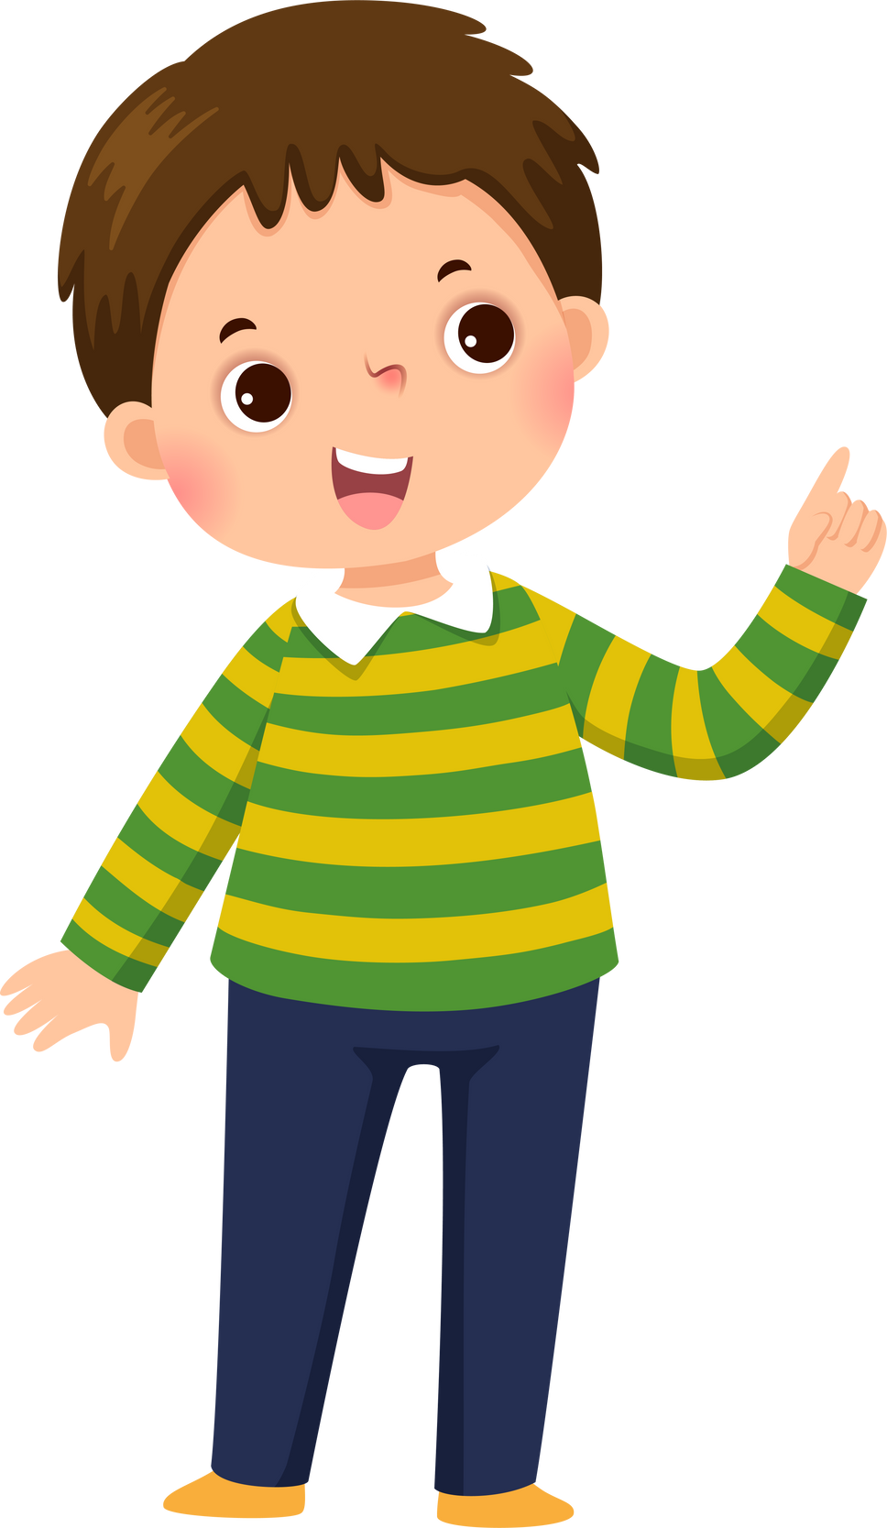

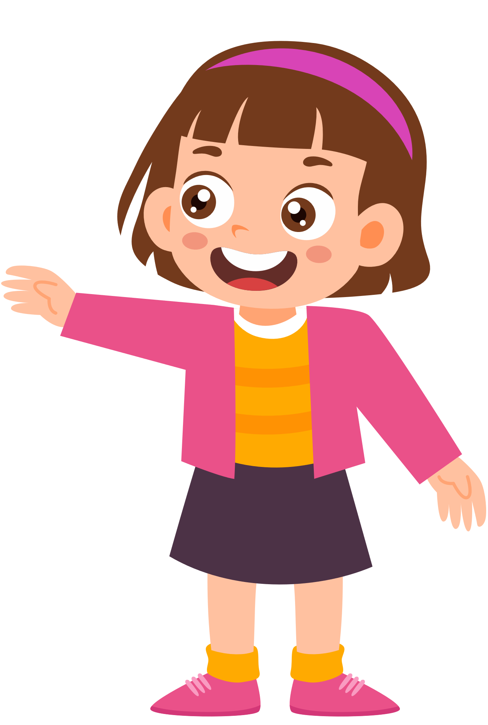
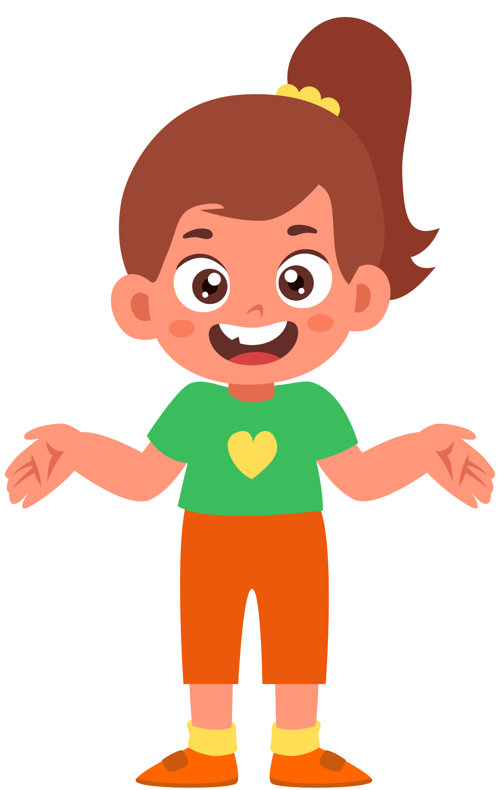
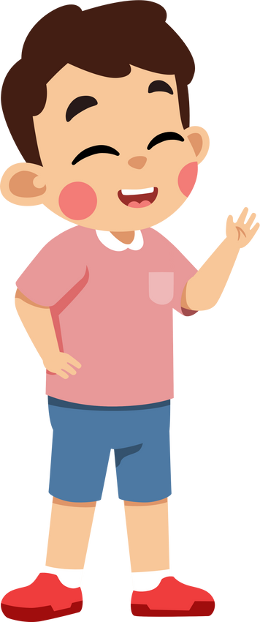
Group work
Arm hand leg foot knee left right
1
What is this?
This is my ……. ……….
What is this?
4
This is my left arm.
What is this?
2
This is my ……. ……….
What is this?
3

Slide 10


By Hun chanseyha

