Slide 1

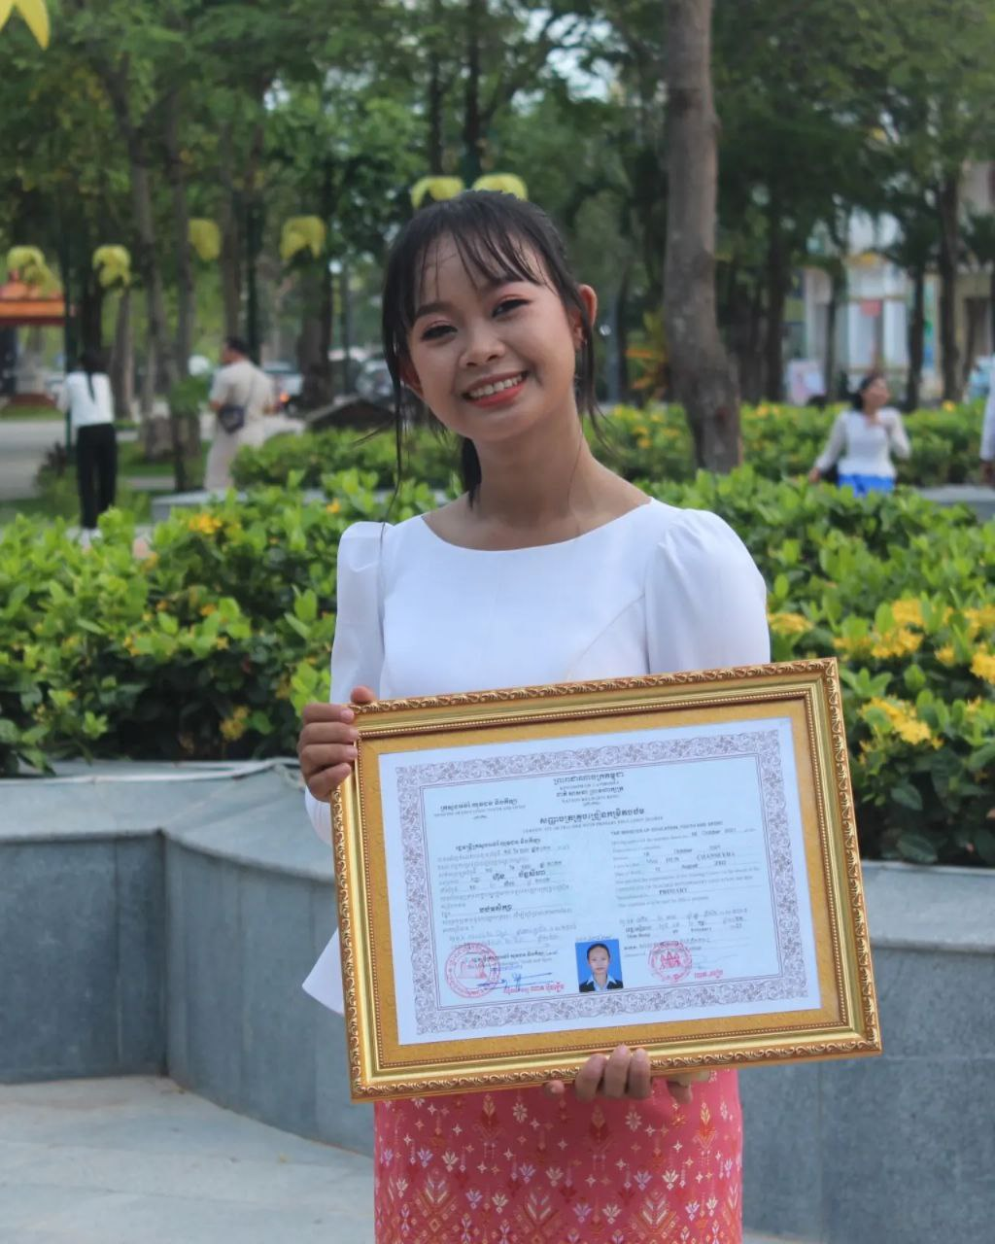
English grade 6
Chapter 3 My Body
Unit 2 My arms And Legs
What are these?

Slide 2


Finger
ម្រាមដៃ

Slide 3
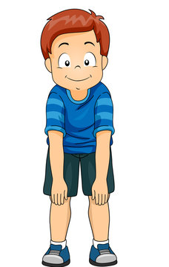
knee
ជង្គង់

Slide 4
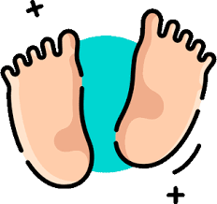
Foot > feet
ប្រអប់ជើង

Slide 5
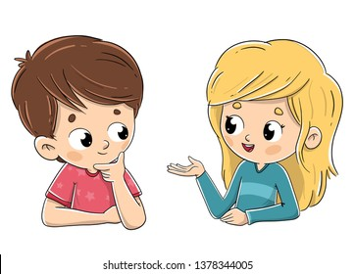
Listen and repeat
What are these?
តើទាំងនេះជាអ្វី?

Slide 6
Listen and repeat
These are my fingers.
ទាំងនេះគឺជាម្រាមដៃរបស់ខ្ញុំ។

Slide 7
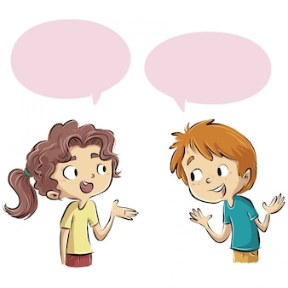
Pair work
What are these?
These are my fingers.

Slide 8
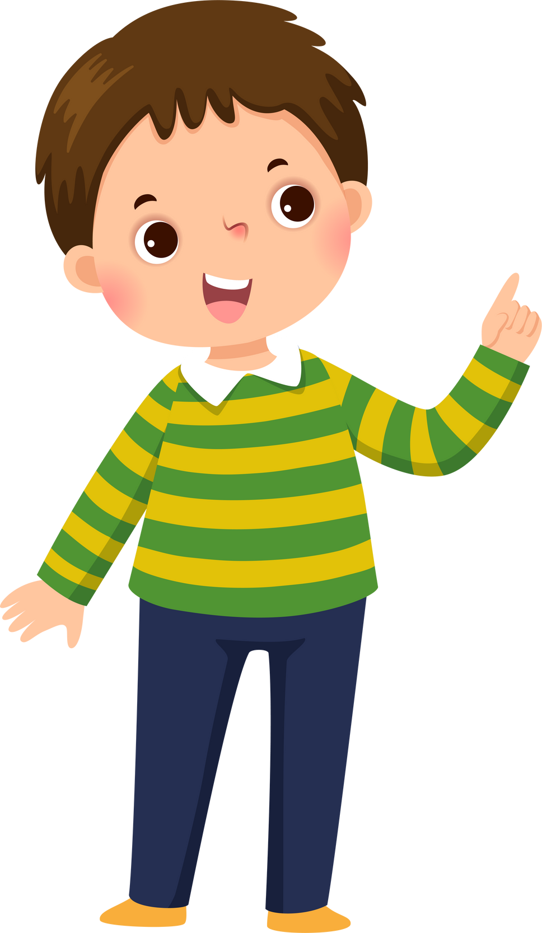

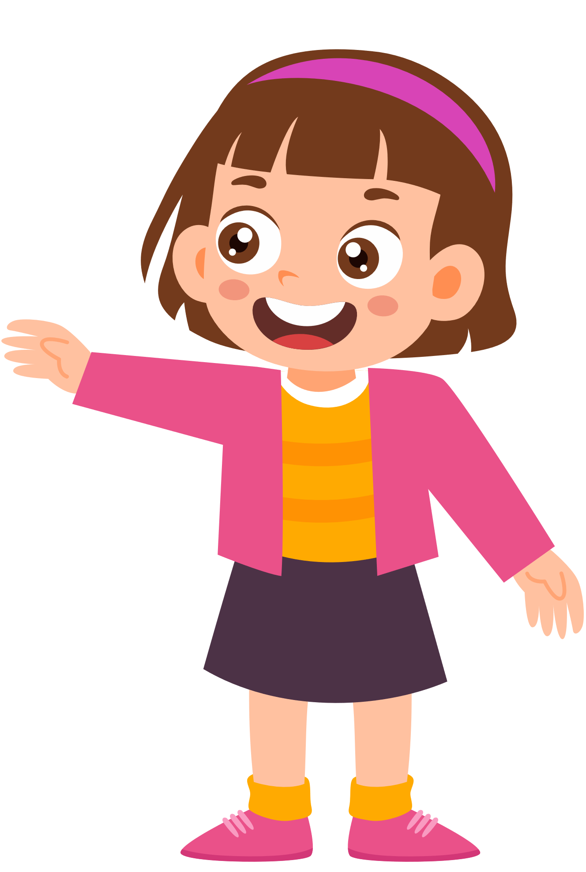
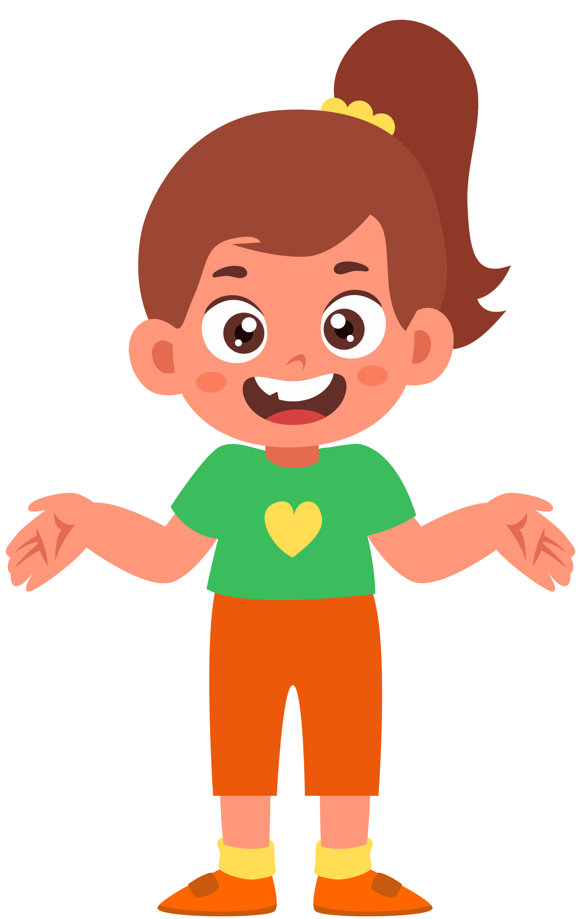
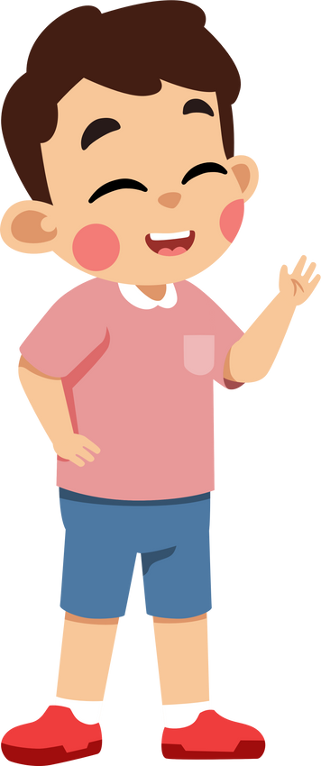
Group work
Arms hands legs feet fingers knees
1
What are these?
These are my …………….
What are these?
4
These are my fingers.
What are these?
2
These are my ……..…….
What are these?
3

Slide 9


By Hun chanseyha

