Slide 1

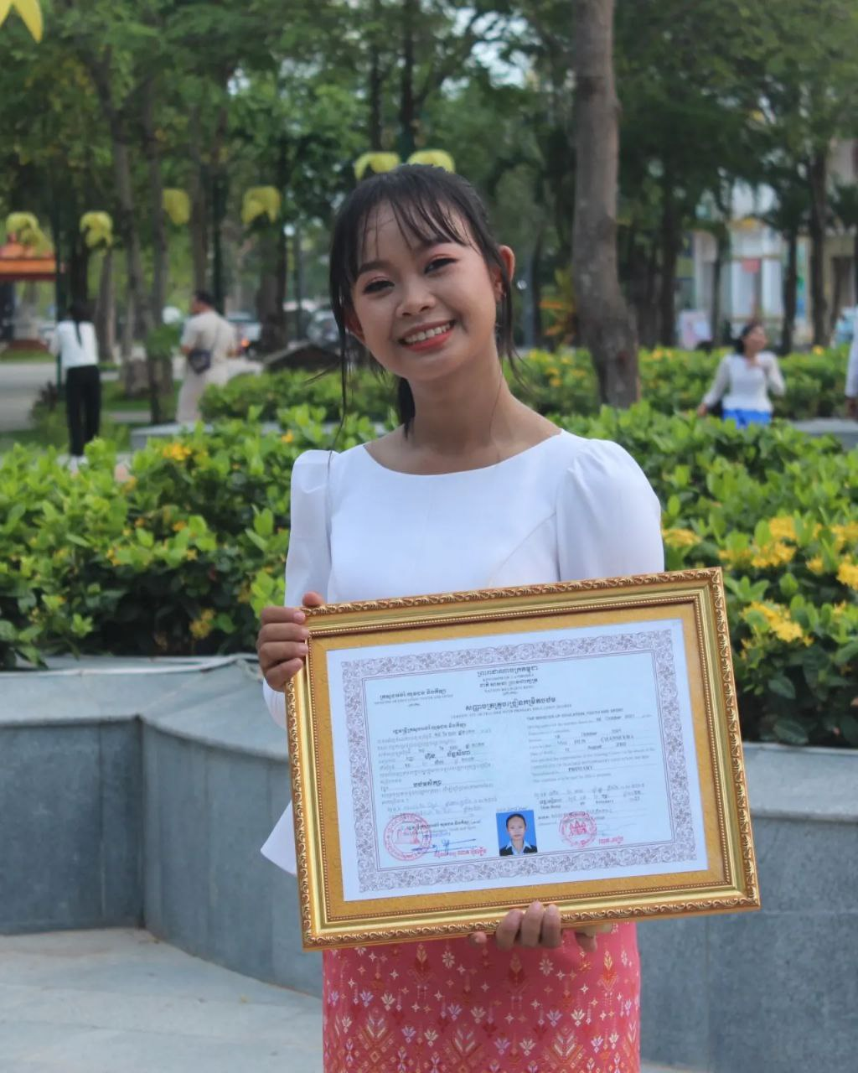
English grade 6
Chapter 3 My Body
Unit 4 Body Functions
What can your body do?

Slide 2


Hear
ស្ដាប់ឮ

Slide 3

Smell
ហិតក្លិន

Slide 4

See
មើលឃើញ

Slide 5

Listen and repeat
What can your eyes do?
តើភ្នែកអ្នកអាចធ្វើអ្វីបាន?

Slide 6
Listen and repeat
My eyes can see.
ភ្នែករបស់ខ្ញុំអាចមើលឃើញ។

Slide 7

Pair work
What can your eyes do?
My eyes can see.

Slide 8
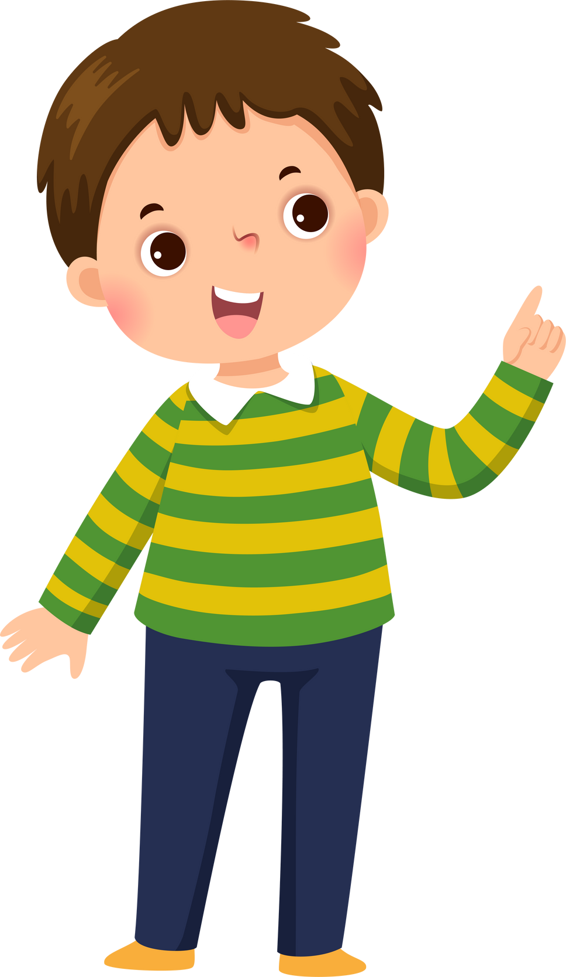


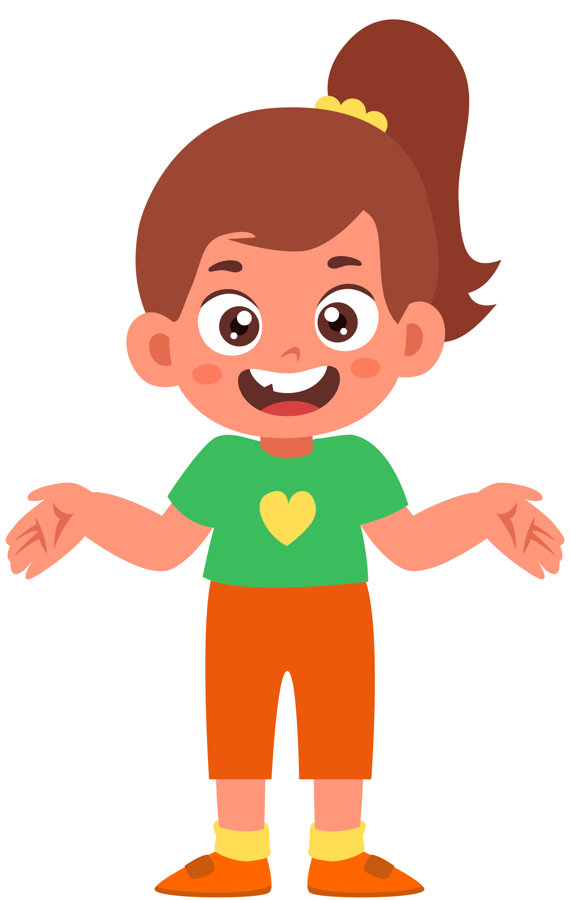

Group work Mouth-eyes-legs-ears-nose-hand
Eat-see-run-hear-smell-write
1
What can your eyes do?
My ……… can ……….
What can your …… do?
4
My eyes can see.
What can your …… do?
2
My ……… can ……….
What can your …… do?
3

Slide 9


By Hun chanseyha

