Slide 1

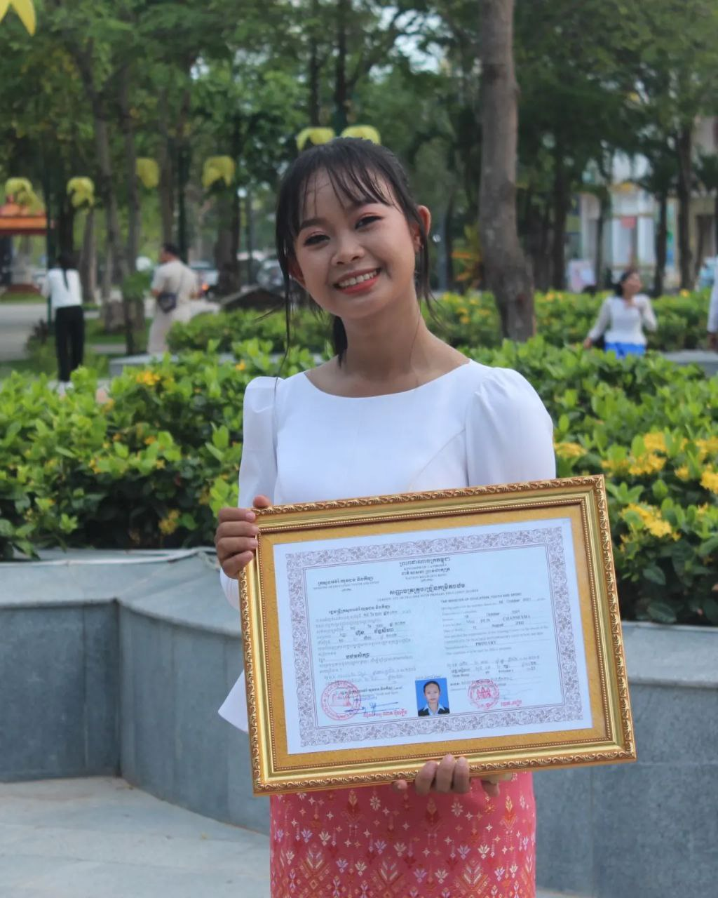
English grade 6
Chapter 4 My Home Town
Unit 1 Where do you live?
Province

Slide 2

Live
រស់នៅ

Slide 3
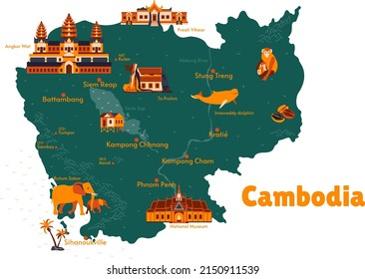
….Province
ខេត្ត

Slide 4

Listen and repeat
Where do you live?
តើអ្នករស់នៅឯណា?

Slide 5
Listen and repeat
I live in Siem Reap province.
ខ្ញុំរស់នៅក្នុងខេត្តសៀមរាប។

Slide 6

Pair work
Where do you live?
I live in Siem Reap province.

Slide 7



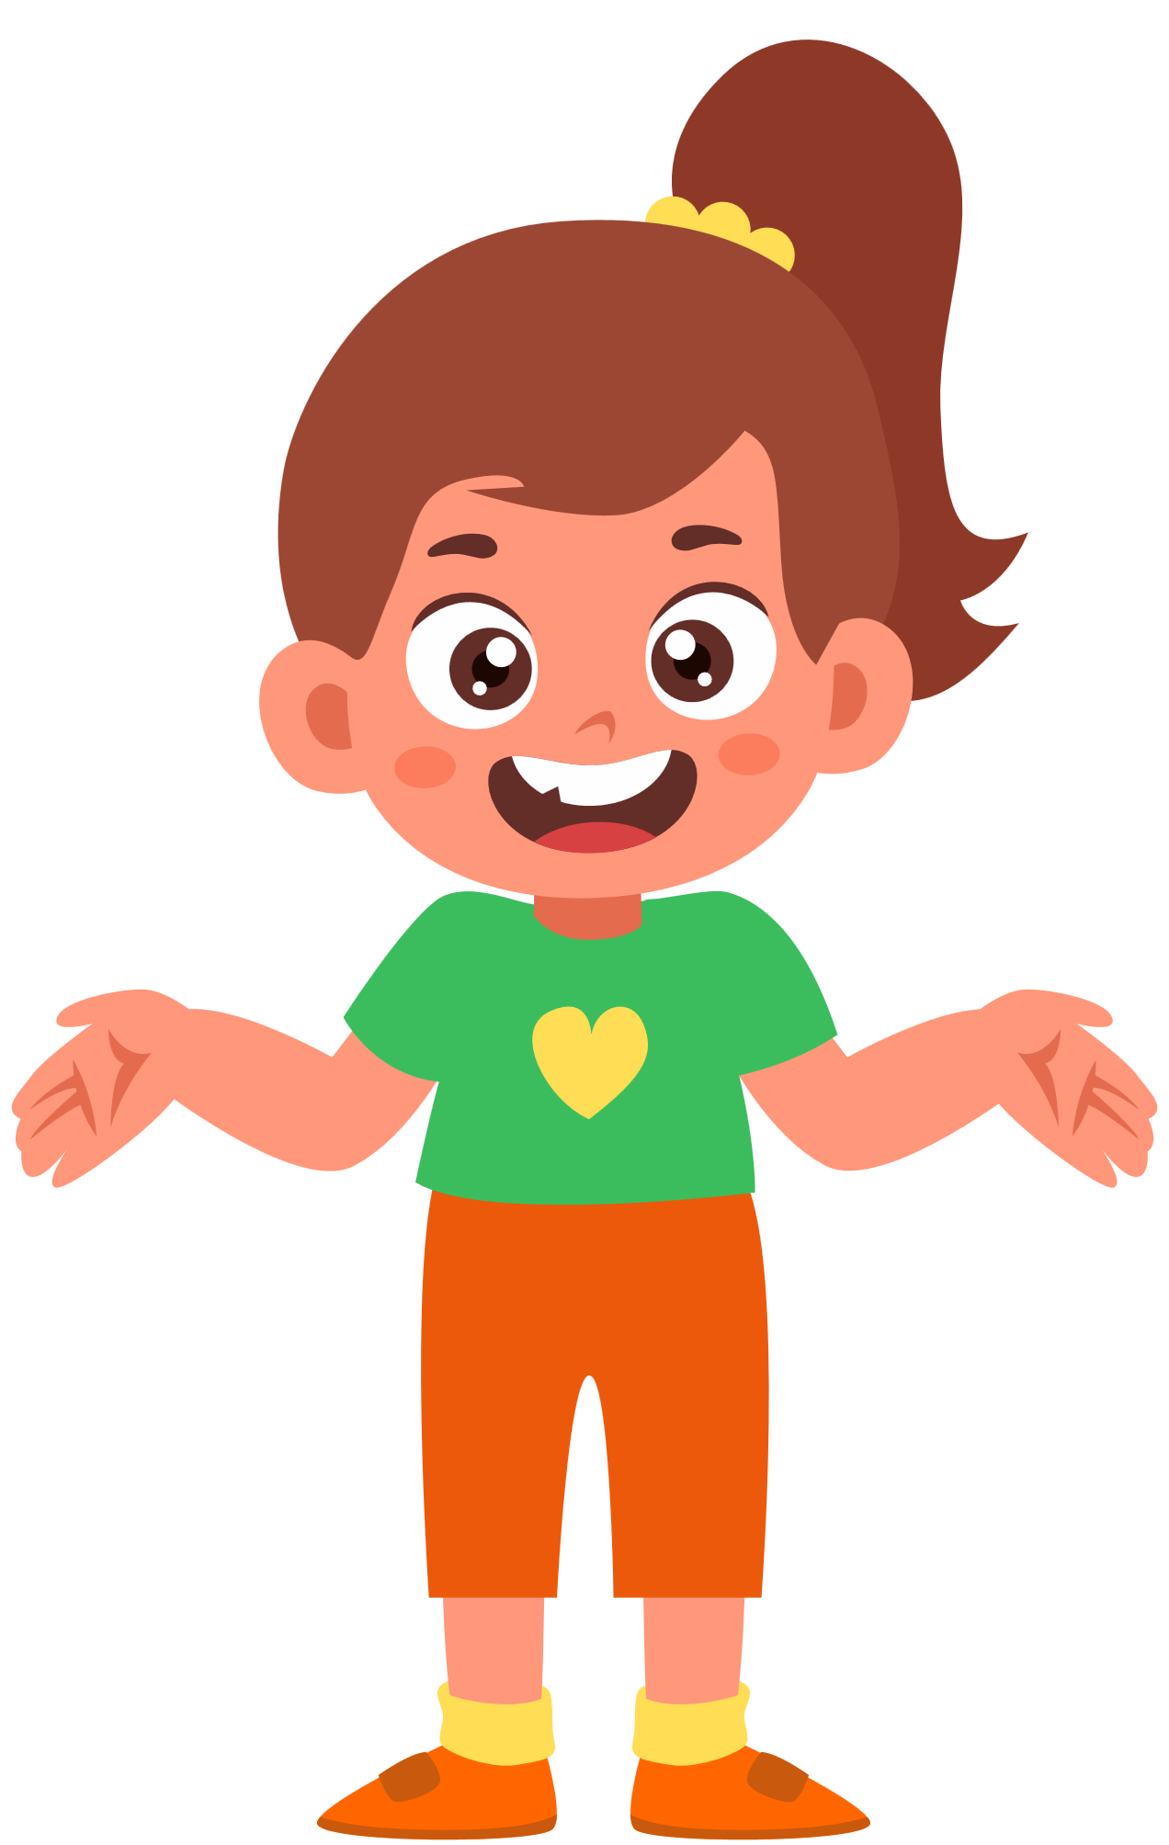

Group work
Siem Reap-Kampong Chhnang-Battambong
1
Where do you live?
I live in ………… province.
Where do you live?
4
I live in Siem Reap province.
Where do you live?
2
I live in ………… province.
Where do you live?
3

Slide 8


By Hun chanseyha

