Slide 1
Book : English Grade 4
Chapter 3 : Animal
Lesson : It is a cat.
What is this?

Slide 2
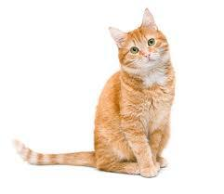
Vocabulary
Cat
សត្វឆ្មា

Slide 3
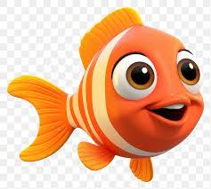
Vocabulary
Fish
សត្វត្រី

Slide 4
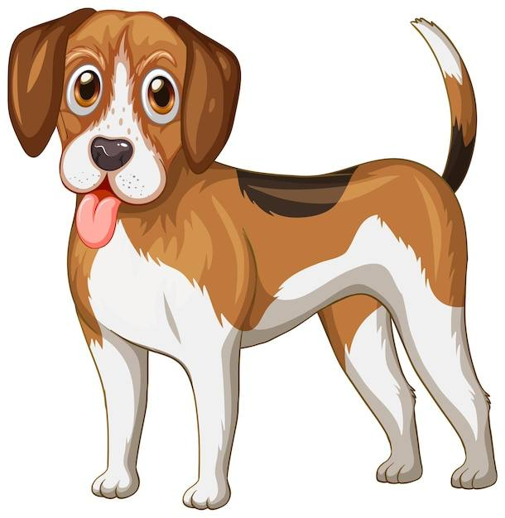
Vocabulary
Dog
សត្វឆ្កែ

Slide 5
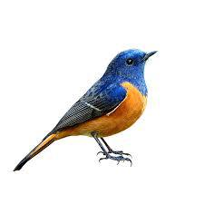
Vocabulary
Bird
បក្សី

Slide 6
Listen and repeat
What is it ?
តើនេះគឺជាអ្វី ?

Slide 7
Listen and repeat
It is a cat.
វាគឺជាសត្វឆ្មា​។

Slide 8
Pair works
What is it ? តើនេះគឺជាអ្វី ?
It is a cat. នេះគឺជាសត្វឆ្មា ។

Slide 9
Group Work
What is it ?
It is a cat.
What is it ?
It is a dog.
What is it ?
It is a bird.
What is it ?

