Slide 1
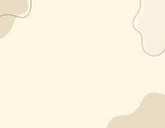
Book : English Grade 4
Chapter 5 : How many…?
Lesson 1 : There is a …
Teacher’s name: Le chanthlar

Slide 2
Vocabulary
There is
មាន
Cat
សត្វឆ្មា
Rat
សត្វកណ្ដុរ
Bed
គ្រែ

Slide 3
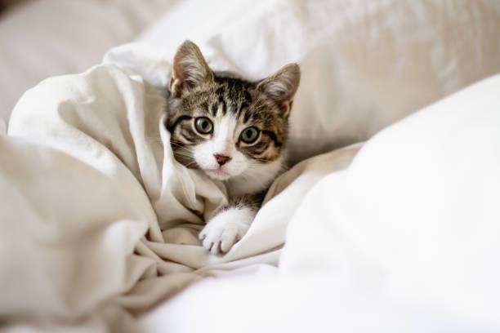
Sentence
There is a cat on my bed.
មានសត្វឆ្មាមួយនៅលើគ្រែរបស់ខ្ញុំ ។

Slide 4
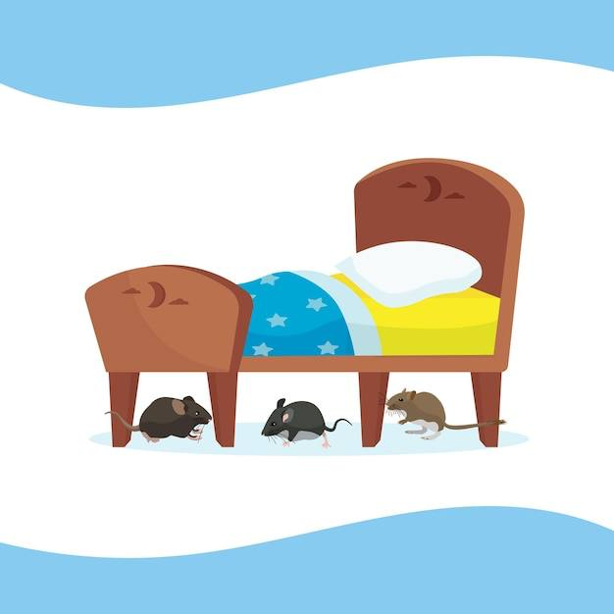
Sentence
There are 3 rats under my bed.
មានសត្វឆ្មា​ 3 នៅក្រោមគ្រែរបស់ខ្ញុំ។

Slide 5
Pair works

Slide 6
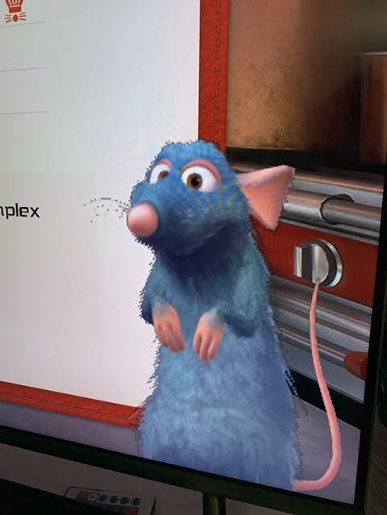
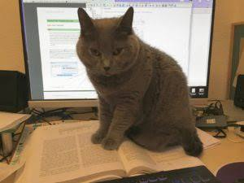
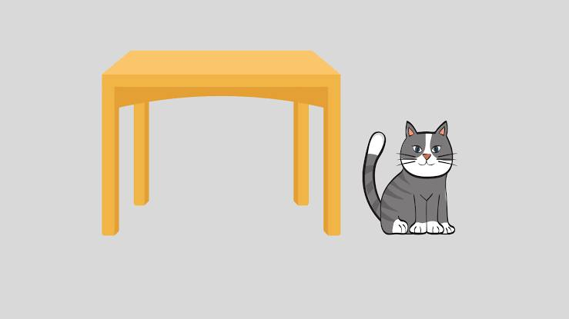
Group Work
There is a cat above my desk.
There is a rat on TV.
There is cat next to my table.
There is a rat behind my computer.

