Slide 1

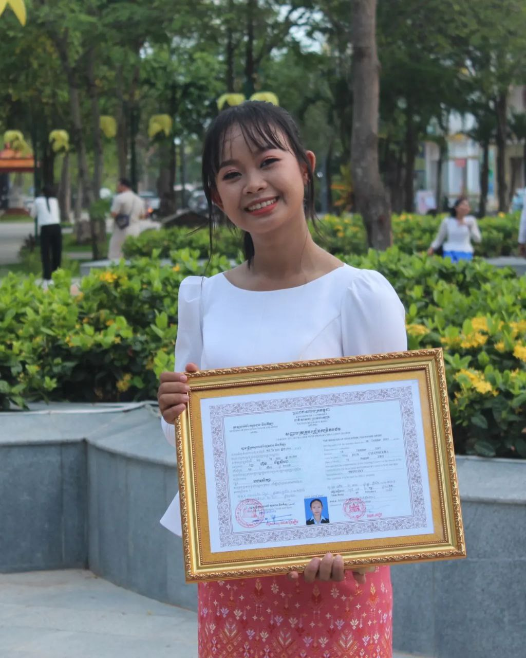
English grade 5
Chapter 1 Shops and Shopping
Unit 1 Selling food Part 2
What does she sell in her shop?
Student’s book page 11

Slide 2

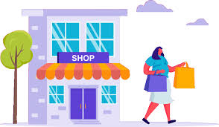
Shop
ហាង

Slide 3
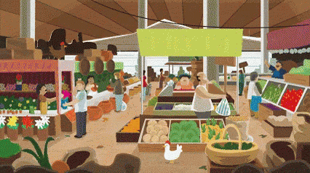
Sell
លក់

Slide 4
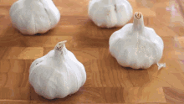
Garlic
ខ្ទឹមស

Slide 5
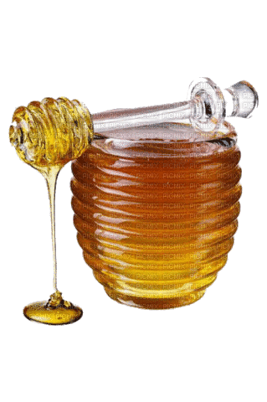
Honey
ទឹកឃ្មុំ

Slide 6

Ice cream
ការ៉េម

Slide 7
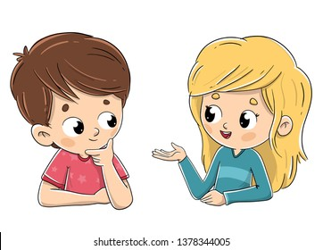
Listen and repeat
What does she sell in her shop?
តើនាងលក់អ្វីនៅក្នុងហាងរបស់នាង?

Slide 8
Listen and repeat
She sells garlic.
នាងលក់ខ្ទឹមស។

Slide 9
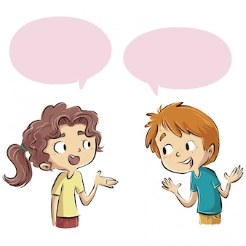
Pair work
What does she sell in her shop?
She sells garlic.
Fish-garlic-honey-jam-ice cream…..

Slide 10





Group work
Fish-garlic-honey-jam-ice cream…..
1
What does she sell in her shop?
She sells ………..
What does she sell in her shop?
4
She sells garlic.
What does she sell in her shop?
2
She sells ………..
What does she sell in her shop?
3

Slide 11


By Hun chanseyha

