Slide 1
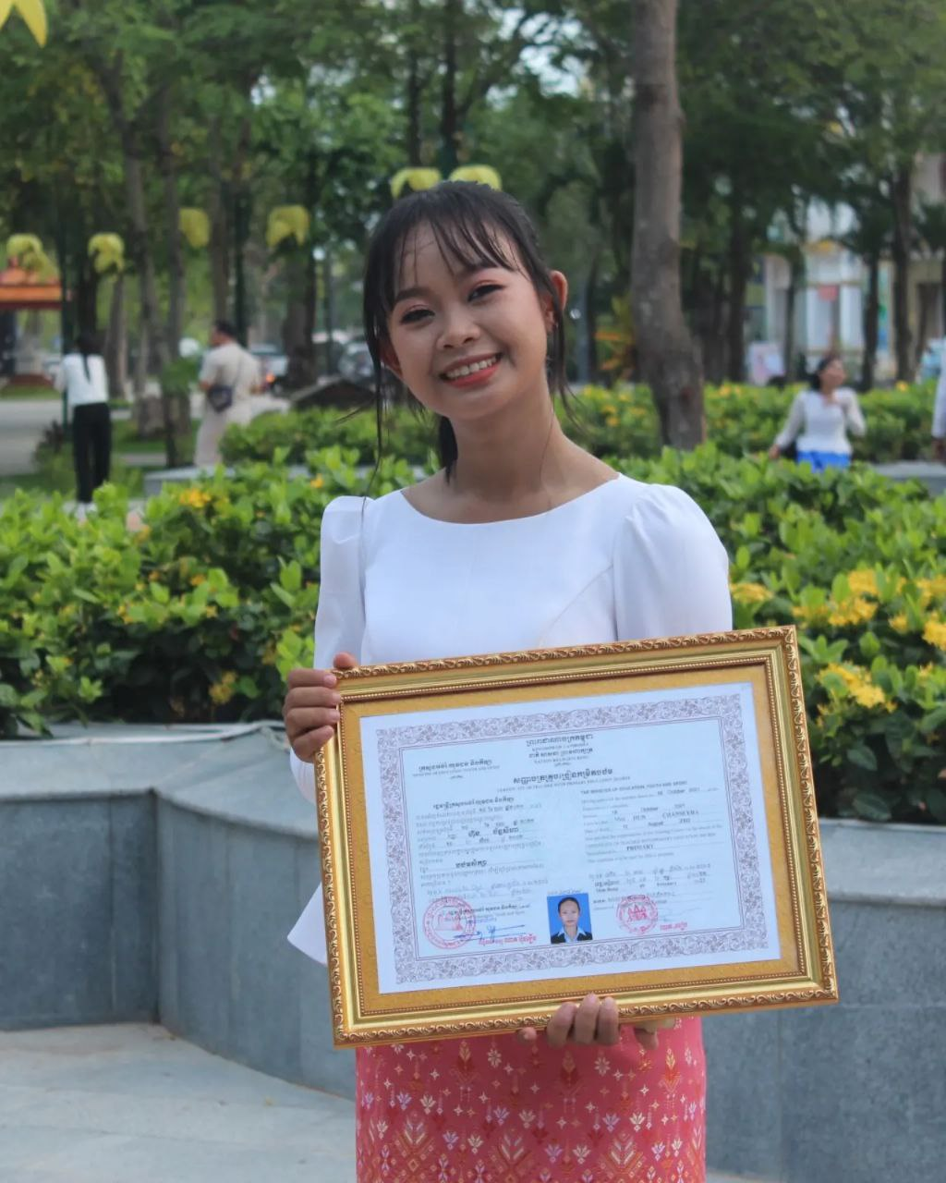
English grade 5
Chapter 1 Shops and Shopping
Unit 3 Selling Things By The Road
What do they sell?
Student’s book 19

Slide 2
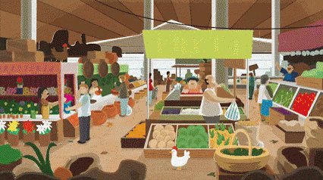
They
ពួកគេ

Slide 3
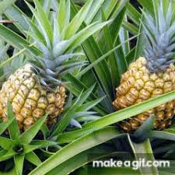
Pineapple
ផ្លែម្នាស់

Slide 4
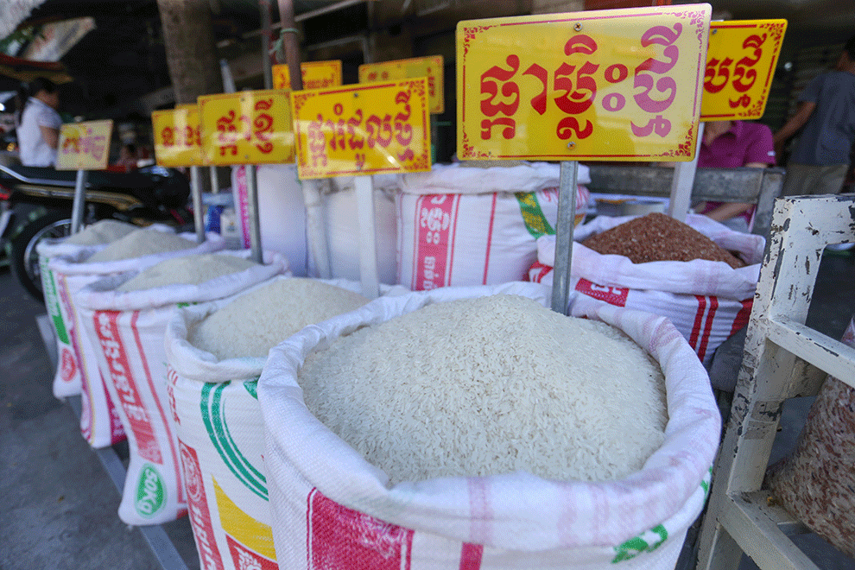
Rice
អង្ករ

Slide 5
Tea
តែ

Slide 6
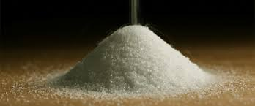
sugar
ស្ករ

Slide 7
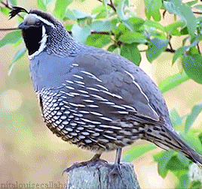
Quail
សត្វក្រួច

Slide 8
Listen and repeat
What do they sell?
តើពួកគេលក់អ្វីខ្លះ?

Slide 9
Listen and repeat
They sell rice.
ពួកគេលក់ អង្ករ

Slide 10
Pair work
What do they sell?
They sell rice.
Rice , tea, pineapple, sugar, quail…….

Slide 11
Group work
Rice , tea, pineapple, sugar, quail……..
1
What do they sell?
They sell …….
What do they sell?
4
They sell rice.
What do they sell?
2
They sell …….
What do they sell?
3

Slide 12
By Hun chanseyha

