Slide 1

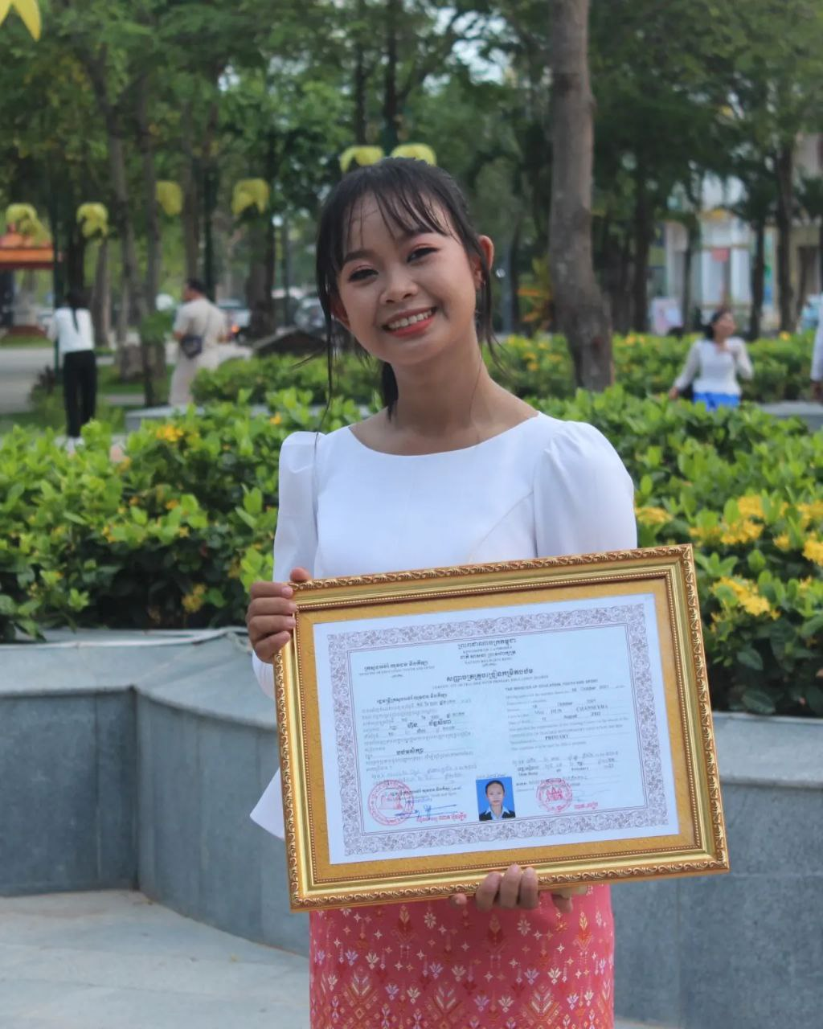
English grade 5
Chapter 1 Shops and Shopping
Unit 4 Shopping
What do they want to buy?
Student’s book 21

Slide 2


Umbrella
ឆ័ត្រ

Slide 3
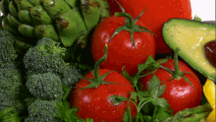
Vegetable
បន្លែ

Slide 4
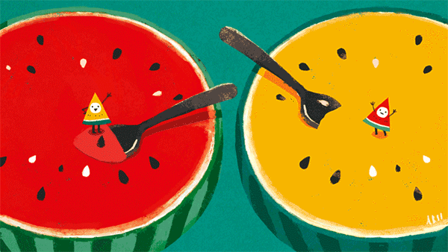
Watermelon
ផ្លែឪឡឹក

Slide 5
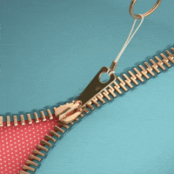
Zipper
រូត

Slide 6
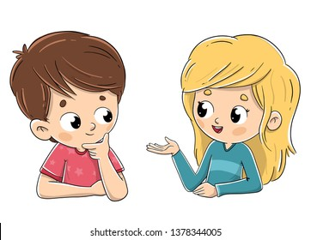
Listen and repeat
What do they want to buy?
តើពួកគេចង់ទិញអ្វី?

Slide 7
Listen and repeat
They want to buy an umbrella.
ពួកគេចង់ទិញ ឆ័ត្រ

Slide 8

Pair work
What do they want to buy?
They want to buy an umbrella.
An umbrella, a watermelon, zipper, vegetables, orange…..

Slide 9





Group work
Umbrella, watermelon, zipper, vegetables, orange
1
What do they want to buy?
They want to buy ……......
What do they want to buy?
4
They want to buy an umbrella.
What do they want to buy?
2
They want to buy ……......
What do they want to buy?
3

Slide 10


By Hun chanseyha

