Slide 1
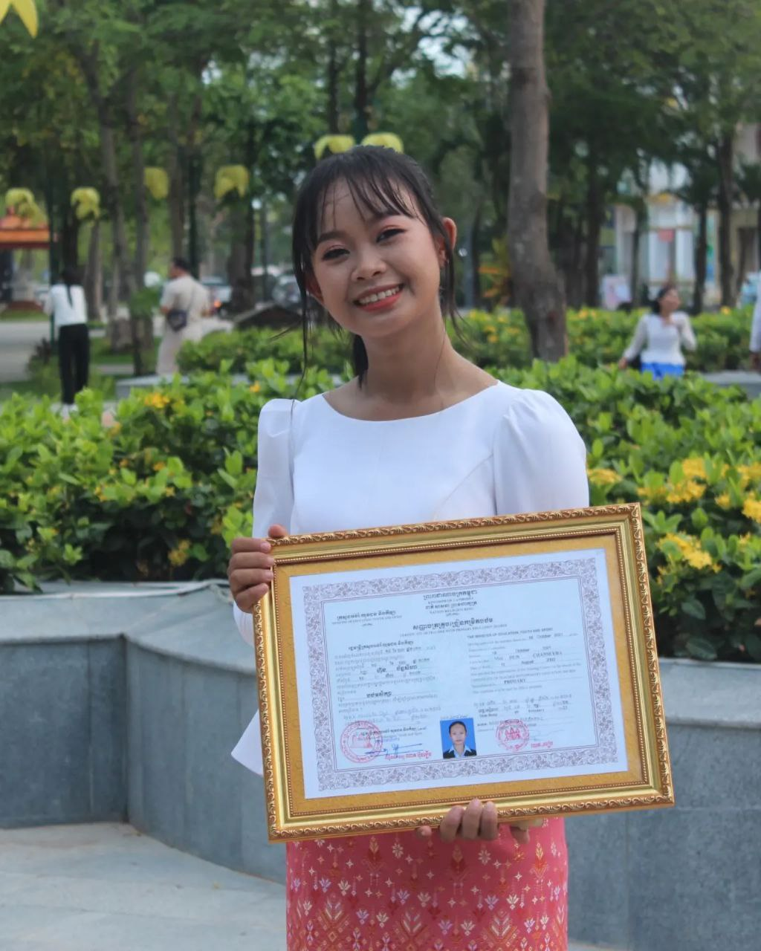
English grade 5
Chapter 1 Shops and Shopping
Unit 4 Shopping
How many watermelons do you want buy?
Student’s book 22

Slide 2
How many
ចំនួនប៉ុន្មាន

Slide 3
Umbrella
ឆ័ត្រ

Slide 4
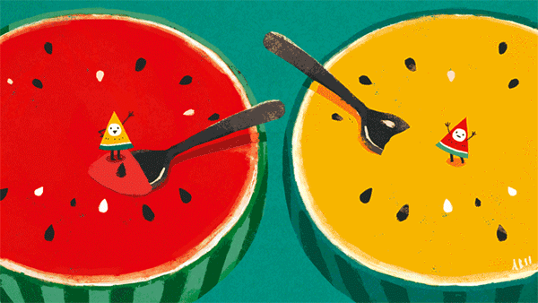
Watermelon
ផ្លែឪឡឹក

Slide 5
Listen and repeat
How many watermelons do you want to buy?
តើអ្នកចង់ទិញឪឡឹកប៉ុន្មាន?

Slide 6
Listen and repeat
I want to buy 2 watermelons.
ខ្ញុំចង់ទិញ ឪឡឹក ២ផ្លែ។

Slide 7
Pair work
How many watermelons do you want to buy?
I want to buy 2 watermelons.
An umbrella, a watermelon, zipper, vegetables, orange

Slide 8
Group work
Umbrella, watermelon, zip, vegetables, orange
1
How many watermelons do you want to buy?
I want to buy 2 ……......
How many ………… do you want to buy?
4
I want to buy 2 watermelons.
How many ………… do you want to buy?
2
I want to buy 2 ……......
How many ………… do you want to buy?
3

Slide 9
By Hun chanseyha

