Slide 1

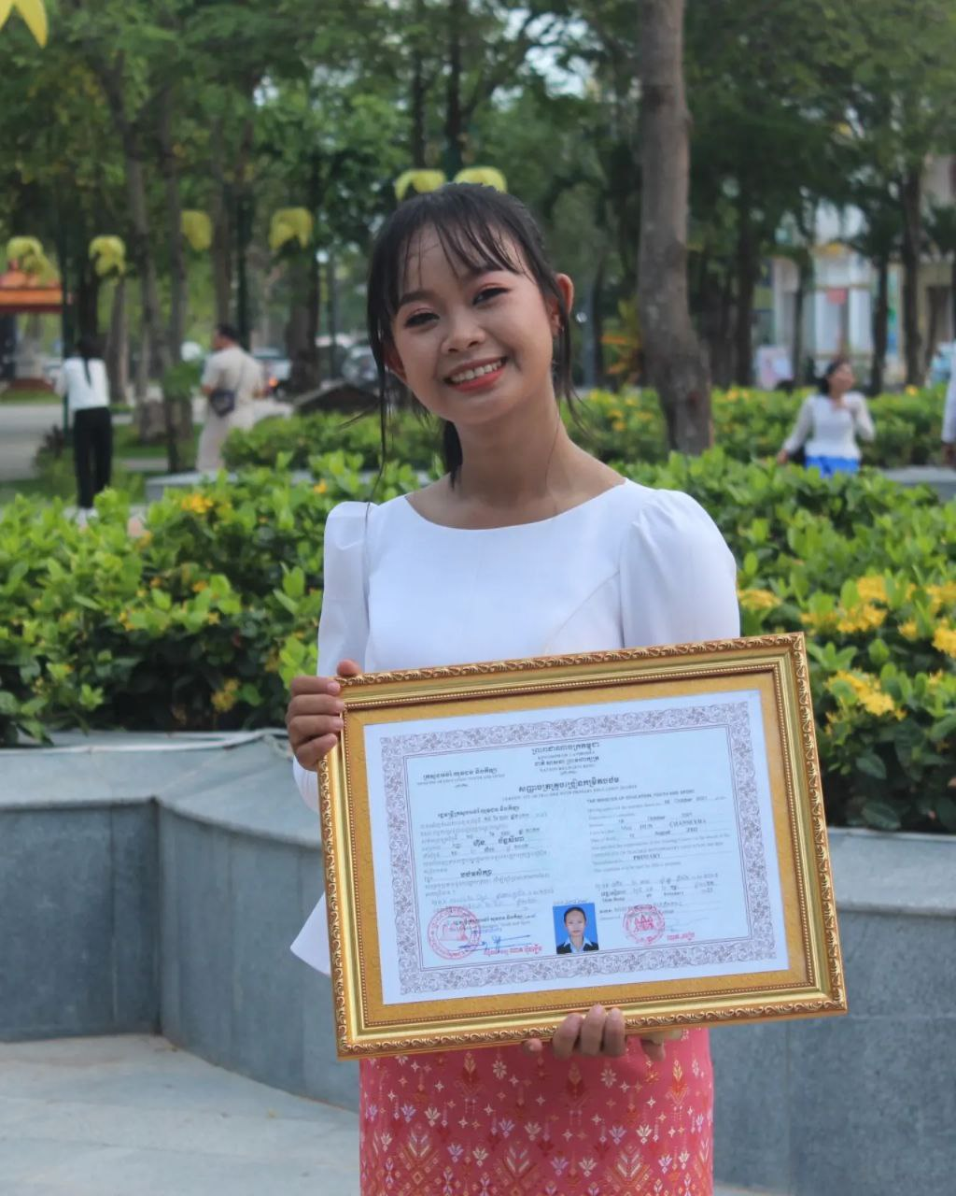
English grade 5
Chapter 2 Farm and Farming
Unit 1 Working On The Farm
What animals are there on the farm?
Student’s book page 28

Slide 2

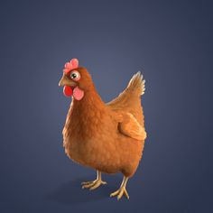
Chicken
សត្វមាន់ (មេ)

Slide 3
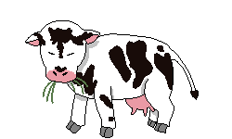
Cow
សត្វគោ(ញី)

Slide 4
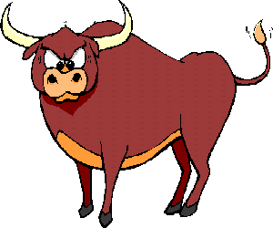
Ox
សត្វគោ(ឈ្មោល)

Slide 5
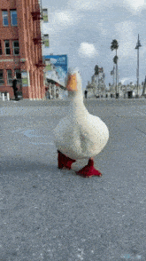
Duck
សត្វទា

Slide 6
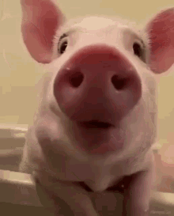
Pig
សត្វជ្រូក

Slide 7
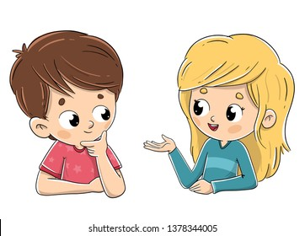
Listen and repeat
What animals are there in the farm?
តើនៅកសិដ្ឋានមានសត្វអ្វីខ្លះ?

Slide 8
Listen and repeat
There are chickens in the farm.
នៅកសិដ្ឋានមានសត្វមាន់

Slide 9

Pair work
What animals are there in the farm?
There are chickens in the farm.
Chickens, cows, oxen, ducks, pigs…..

Slide 10
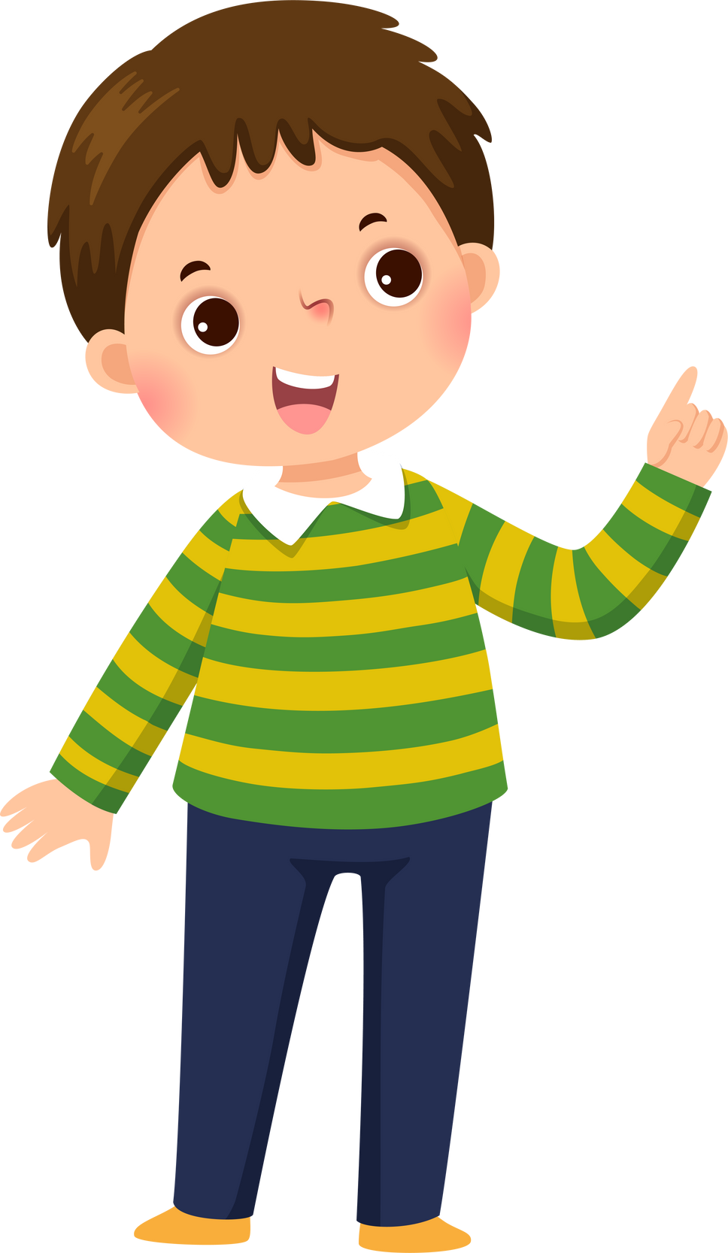

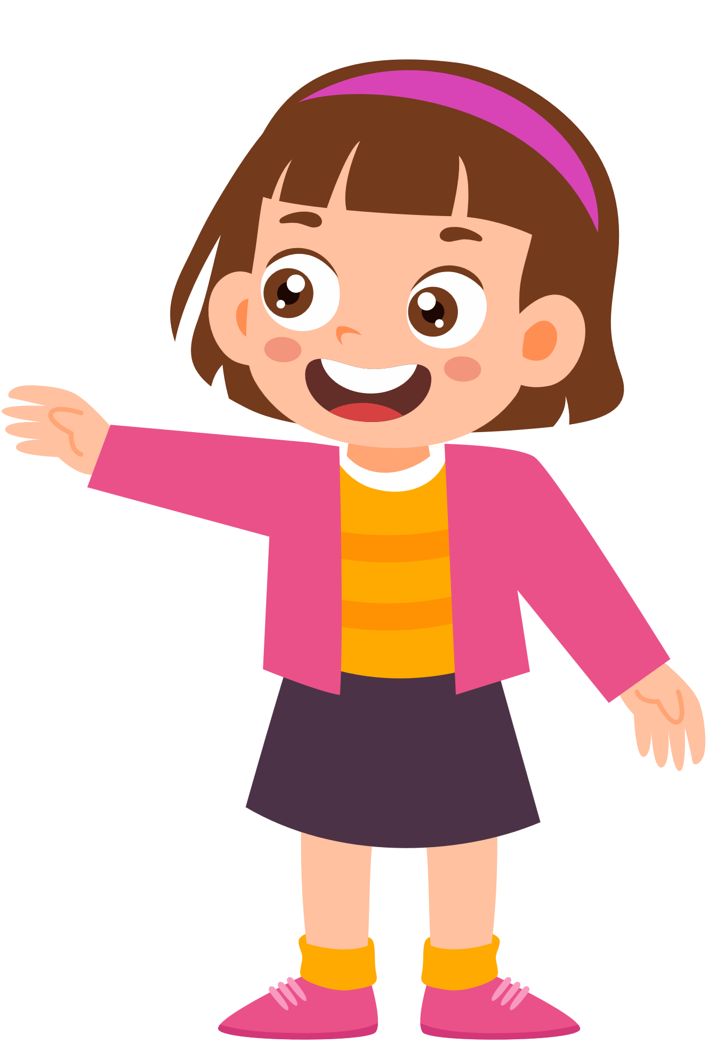
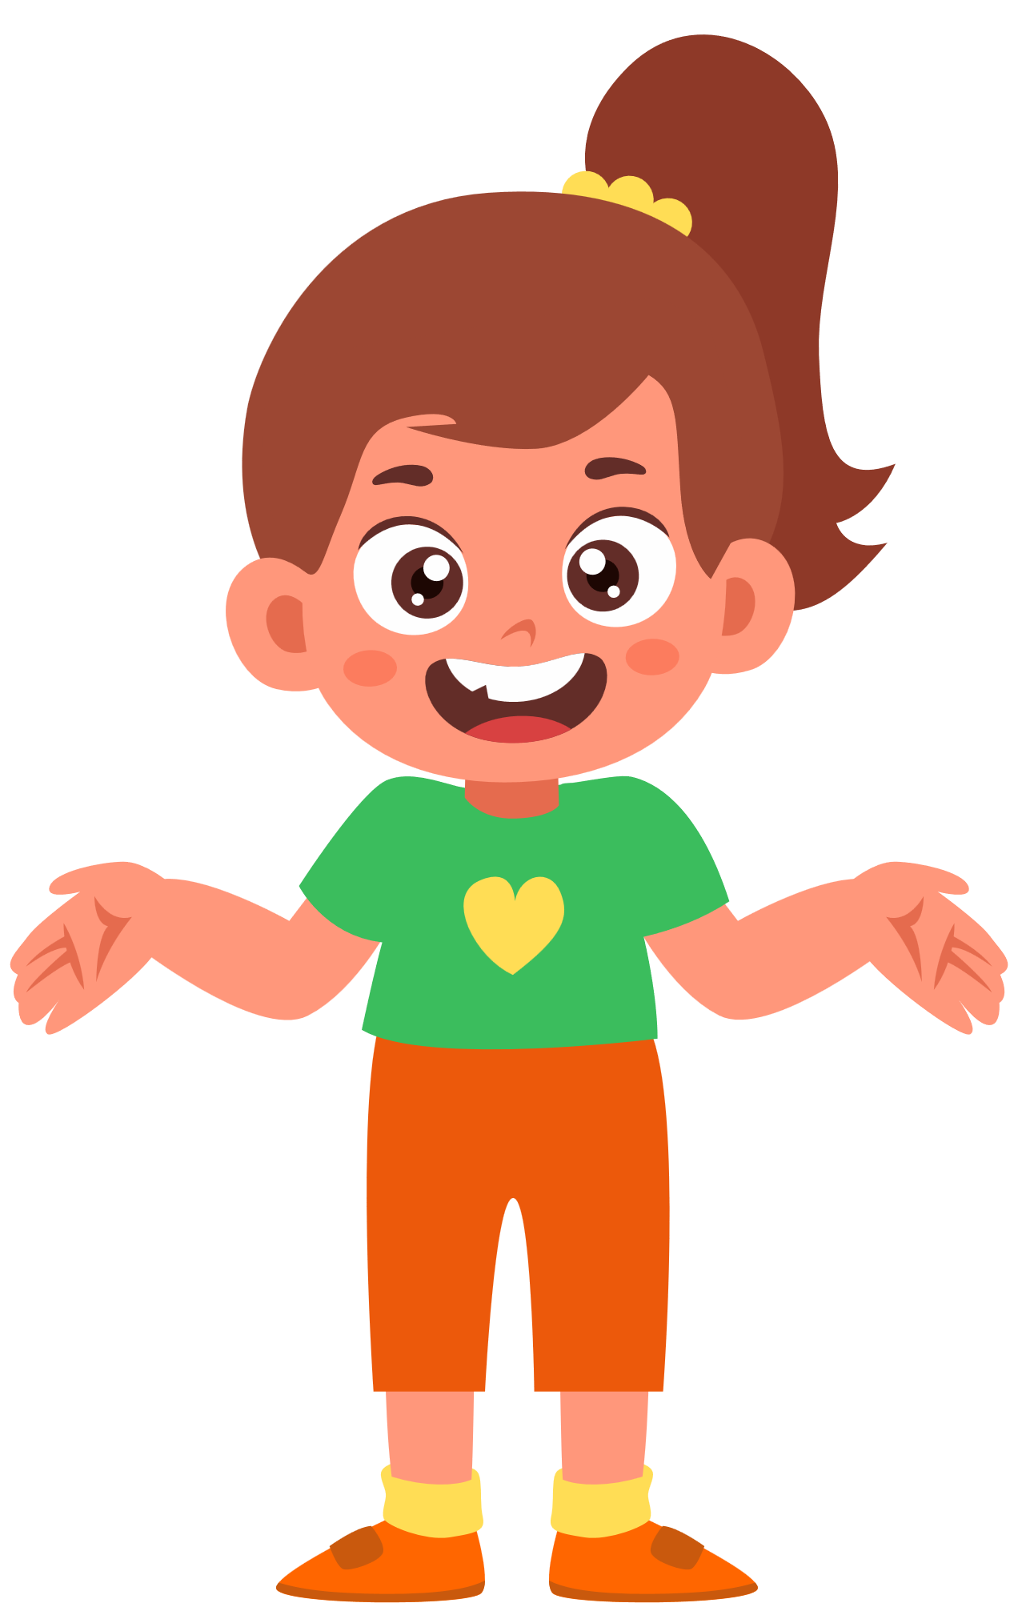

Group work
Chickens, cows, oxen, ducks, pigs…..
1
What animals are there in the farm?
There are …….. in the farm.
What animals are there in the farm?
4
There are chickens in the farm.
What animals are there in the farm?
2
There are …….. in the farm.
What animals are there in the farm?
3

Slide 11


By Hun chanseyha

