Slide 1
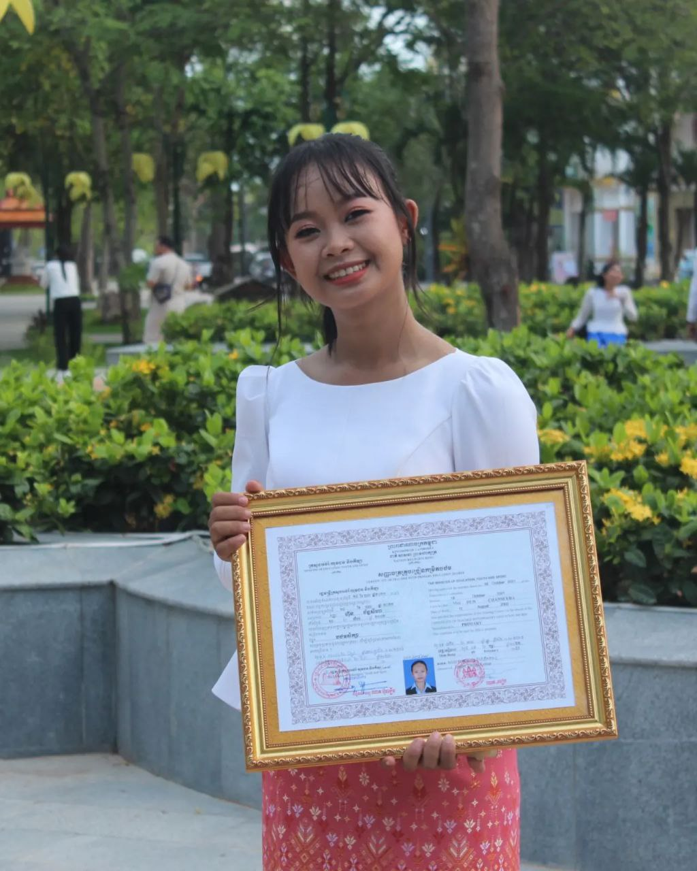
English grade 5
Chapter 2 Farm and Farming
Unit 2 Animals On The Farm
What does he plant on the farm?
Student’s book page 32

Slide 2
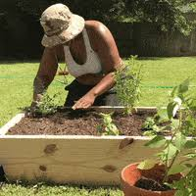
Plant
ដាំ

Slide 3
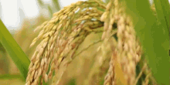
Rice
ស្រូវ

Slide 4
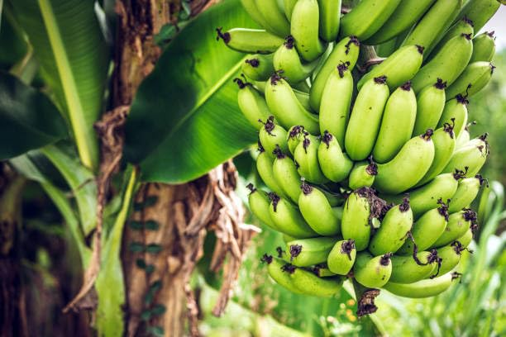
Banana
ចេក

Slide 5
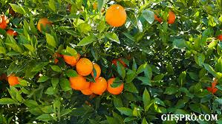
Orange
ក្រូច

Slide 6
Listen and repeat
What does he plant on the farm?
តើគាត់ដាំអ្វីខ្លះនៅកសិដ្ឋាន?

Slide 7
Listen and repeat
He plants rice and bananas.
គាត់ដាំស្រូវនិងចេក

Slide 8
Pair work
What does he plant on the farm?
He plants rice and bananas.
Rice, bananas, oranges, coconut, mango...

Slide 9
Group work
Rice, bananas, oranges, coconut, mango…..
1
What does he plant on the farm?
He plants ………and ……….
What does he plant on the farm?
4
He plants rice and bananas.
What does he plant on the farm?
2
He plants ………and ……….
What does he plant on the farm?
3

Slide 10
By Hun chanseyha

