Slide 1
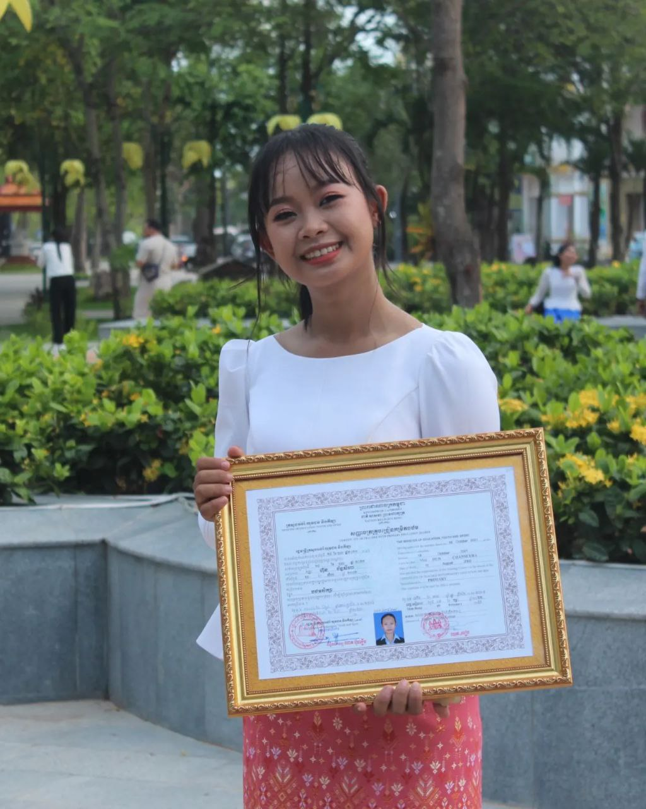
English grade 5
Chapter 2 Farm and Farming
Unit 4 At A Market
Do they sell clothes?
Student’s book page 40

Slide 2
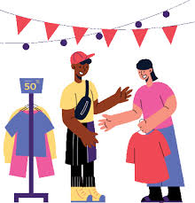
Sell
លក់

Slide 3
Clothes
សម្លៀកបំពាក់

Slide 4
Listen and repeat
Do they sell clothes?
តើពួកគេមានលក់សម្លៀកបំពាក់ឬទេ?

Slide 5
Listen and repeat
Yes, they do / No, they don’t
ចាស, ពួកគេលក់សម្លៀកបំពាក់
ទេ,​ ពួកគេមិនលក់សម្លៀកបំពាក់ទេ

Slide 6
Pair work
Do they sell clothes?
Yes, they do / No, they don’t

Slide 7
Group work
1
Do they sell clothes?
Yes, they do / No, they don’t
Do they sell …….?
4
Yes, they do / No, they don’t
Do they sell ……. ?
2
Yes, they do / No, they don’t
Do they sell …….?
3

Slide 8
By Hun chanseyha

