Slide 1
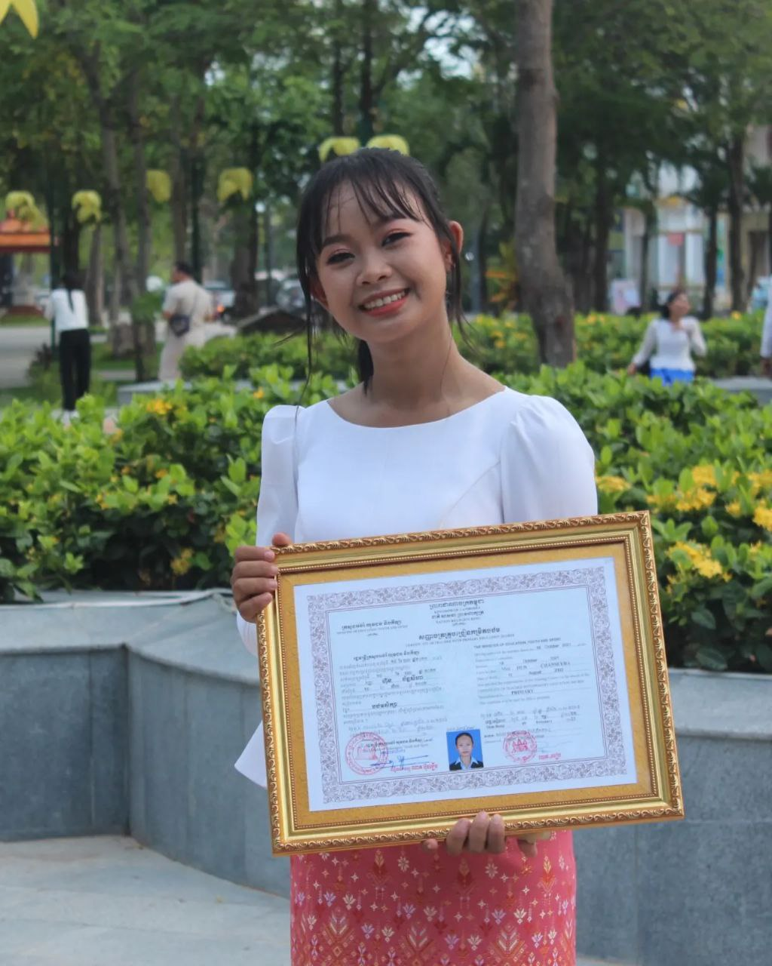
English grade 5
Chapter 2 Farm and Farming
Unit 5 Review
How many sheep does he raise?
Student’s book page 42

Slide 2
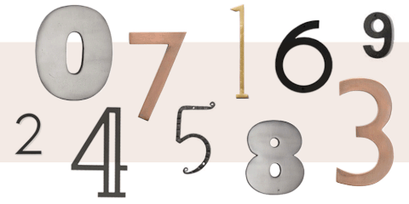
How many
ចំនួនប៉ុន្មាន

Slide 3
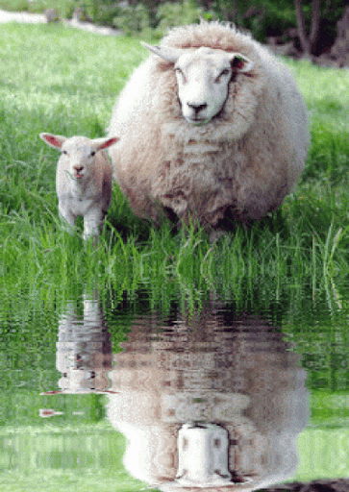
sheep
សត្វចៀម

Slide 4
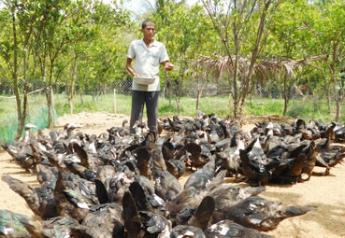
raise
ចិញ្ចឹម

Slide 5
Listen and repeat
How many sheep does he raise?
តើគាត់ចិញ្ចឹមសត្វចៀមប៉ុន្មានក្បាល?

Slide 6
Listen and repeat
He raises ten sheep.
គាត់ចិញ្ចឹមសត្វចៀមដប់ក្បាល

Slide 7
Pair work
How many sheep does he raise?
He raises ten sheep.
Sheep, cow, duck, fish, chicken, ox, pig……
1, 2, 3, 5, 6, 8, 10, 20…….

Slide 8
Group work
Sheep, cow, duck, fish, chicken, ox, pig……
1, 2, 3, 5, 6, 8, 10, 20…….
1
How many sheep does he raise?
He raises ……… ………...
How many pigs does he raise?
4
He raises ten sheep.
How many chickens does he raise?
2
He raises ……… ………...
How many ducks does he raise?
3

Slide 9
By Hun chanseyha

