Slide 1
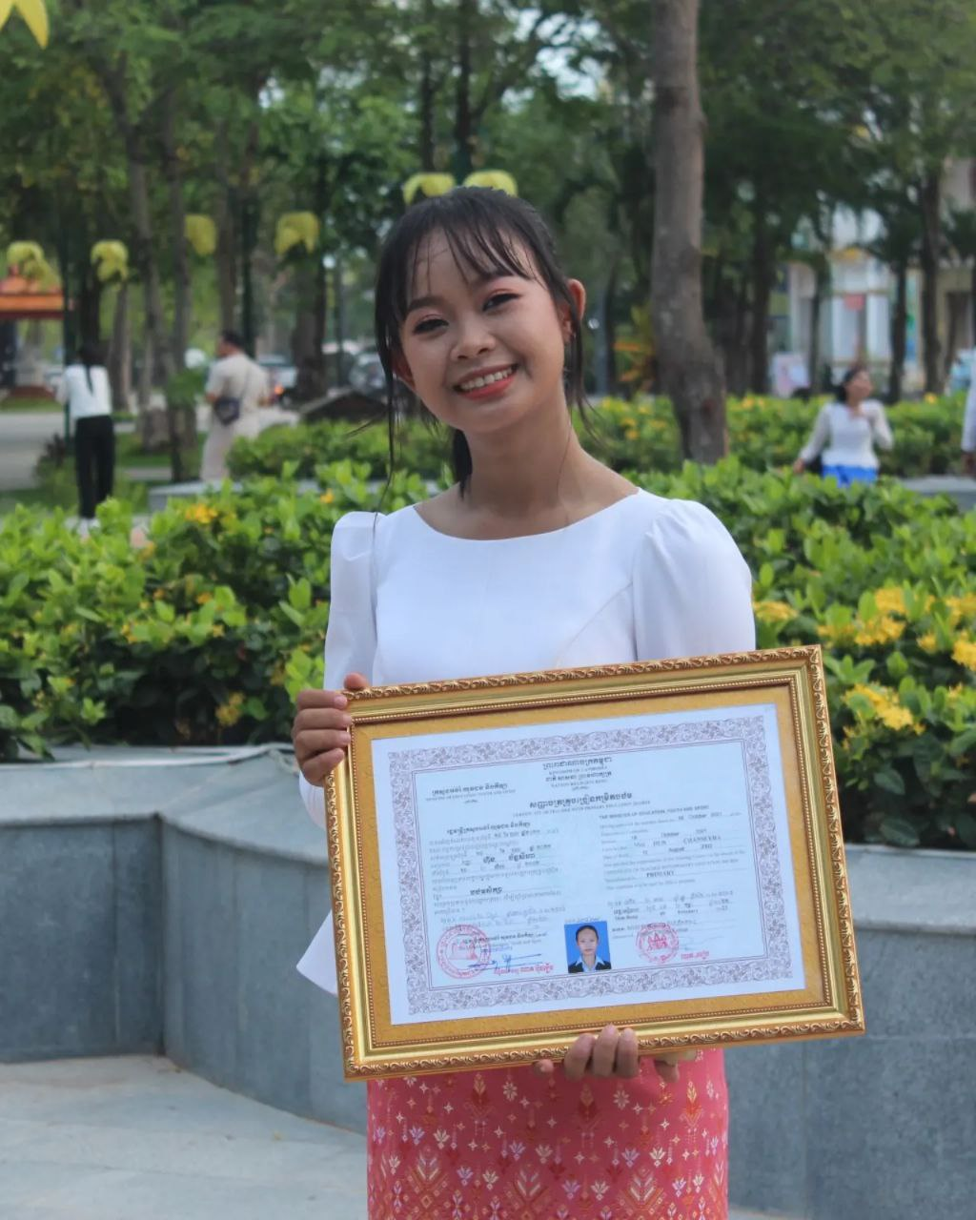
English grade 5
Chapter 3 School and Family
Unit 1 Family members
Who is your sister?
Student’s book 46

Slide 2
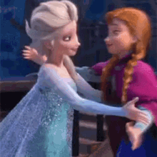
Sister
បងប្អូនស្រី

Slide 3
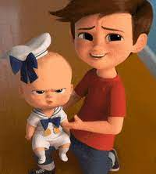
Brother
បងប្អូនប្រុស

Slide 4
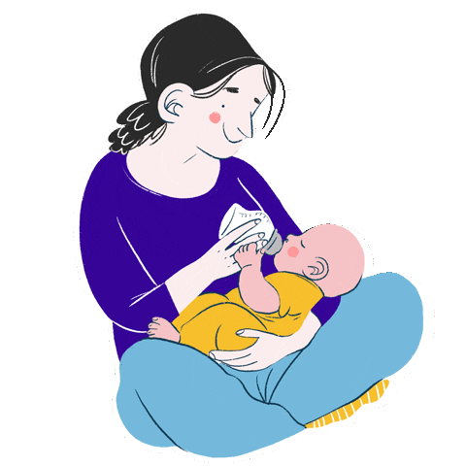
Mommy
ម៉ាក់

Slide 5
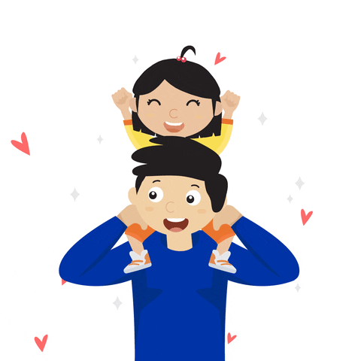
Daddy
ប៉ា

Slide 6
Listen and repeat
Who is your sister?
តើអ្នកណាជាបងប្អូនស្រីរបស់អ្នក?

Slide 7
Listen and repeat
My sister is Bopha.
បងស្រីរបស់ខ្ញុំ គឺបូផា។

Slide 8
Pair work
Who is your sister?
My sister is Bopha.
Sister, brother, mummy, daddy, teacher, parent, friend…….

Slide 9
Group work
Sister, brother, mommy, daddy, teacher, parent, friend…….
1
Who is your sister?
My teacher is Seyha.
Who is your friend?
4
My sister is Bopha.
Who is your brother?
2
My brother is Chork
Who is your teacher?
3

Slide 10
By Hun chanseyha

