Slide 1
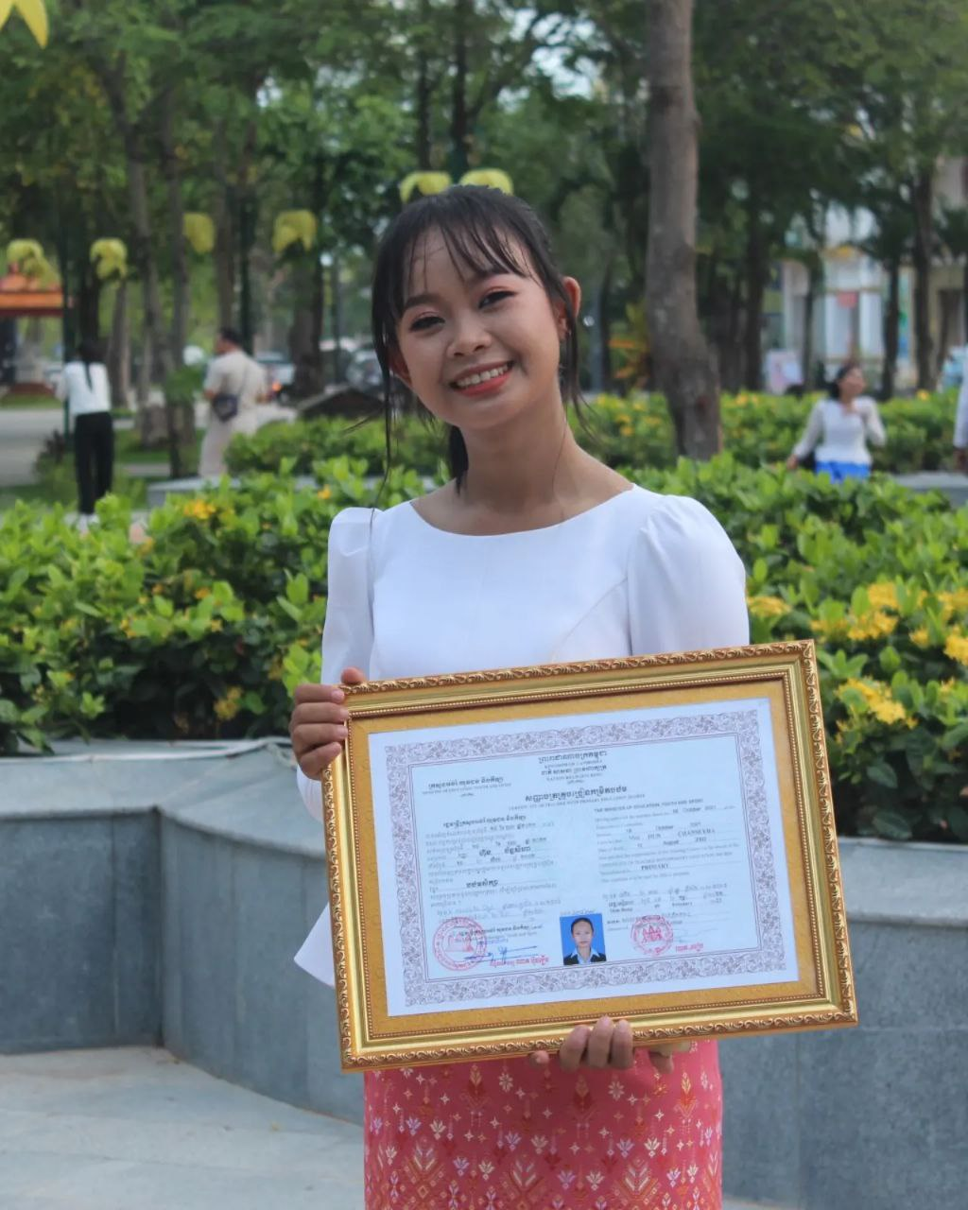
English grade 5
Chapter 3 School and Family
Unit 1 Family members
Who are your parents?
Student’s book 46

Slide 2
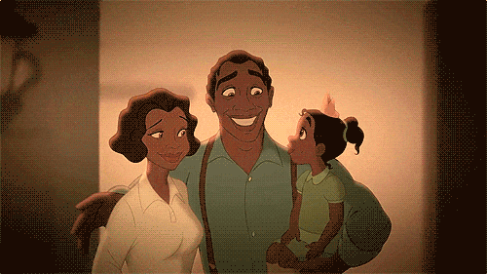
Parents
ឪពុកនិងម្ដាយ

Slide 3
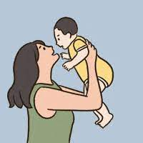
Parent
ឪពុកឬម្ដាយ

Slide 4
Listen and repeat
Who are your parents?
តើអ្នកណាជាឪពុកម្ដាយរបស់អ្នក?

Slide 5
Listen and repeat
My parents are Sok and Lina.
ឪពុកម្ដាយខ្ញុំគឺ សុខ និង លីណា។

Slide 6
Pair work
Who is your parents?
My parents are Sok and Lina.

Slide 7
Group work
1
Who are your parents?
My parents are ……. and ……..
Who are your parents?
4
My parents are Sok and Lina.
Who are your parents?
2
My parents are ……. and ……..
Who are your parents?
3

Slide 8
By Hun chanseyha

