Slide 1
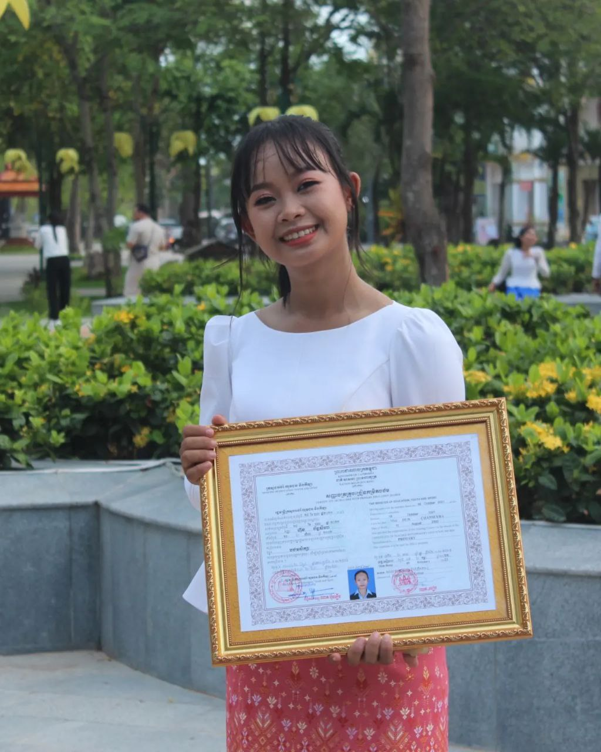
English grade 5
Chapter 3 School and Family
Unit 2 Going to school
Where are you going?
Student’s book 50

Slide 2
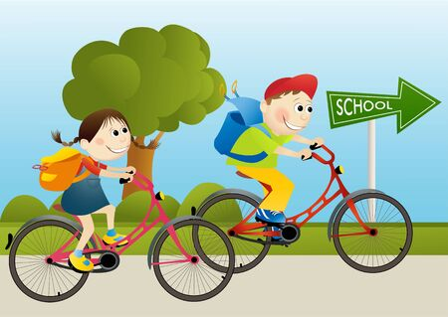
Go
ទៅ

Slide 3
School
សាលារៀន

Slide 4
Home
ផ្ទះ

Slide 5
Listen and repeat
Where are you going?
តើអ្នកកំពុងទៅណា?

Slide 6
Listen and repeat
I am going to school.
ខ្ញុំកំពុងទៅសាលារៀន។

Slide 7
Pair work
Where are you going?
I am going to school.
School, home, work, market, pagoda, field....

Slide 8
Group work
School, home, work, market, pagoda, field....
1
Where are you going?
I am going to ……...
Where are you going?
4
I am going to school.
Where are you going?
2
I am going to ……...
Where are you going?
3

Slide 9
By Hun chanseyha

