Slide 1
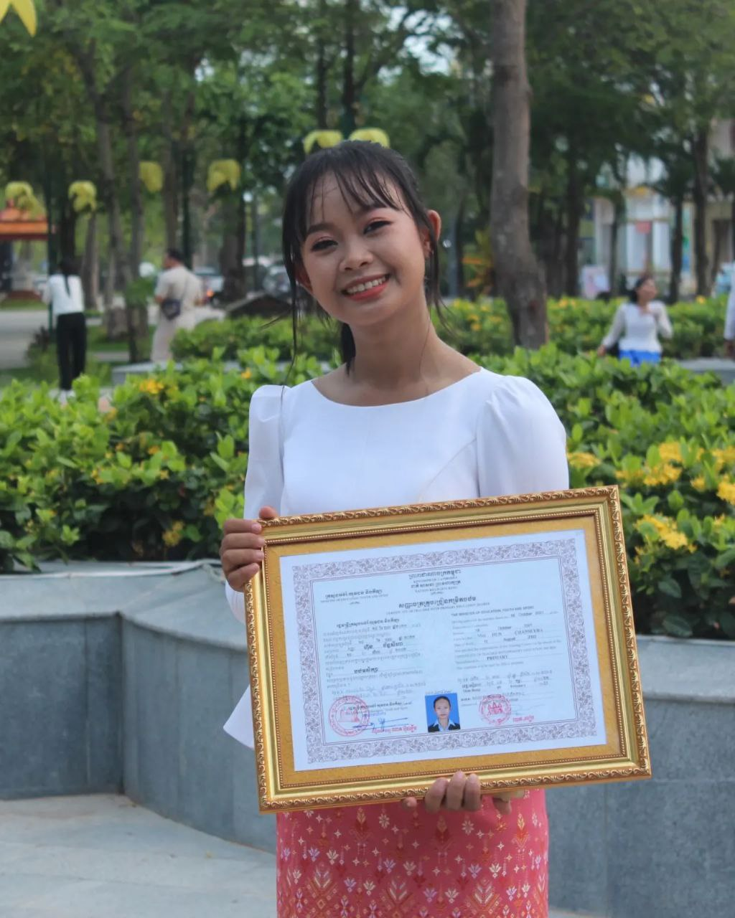
English grade 5
Chapter 3 School and Family
Unit 2 Going to school
What grade is she in?
Student’s book 50

Slide 2
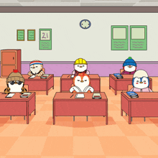
Grade
ថ្នាក់ទី

Slide 3
Listen and repeat
What grade is she in?
តើនាងរៀនថ្នាក់ទីប៉ុន្មាន?

Slide 4
Listen and repeat
She is in grade five.
នាងរៀនថ្នាក់ទីប្រាំ។

Slide 5
Pair work
What grade is she in?
She is in grade five.
She, he, Sokha, Bopha, Sok, …..
five, six, four, three, two, one…..

Slide 6
Group work
She, he, Sokha, Bopha, Sok,... five, six, four, three, two, one…..
1
What grade is she in?
…… is in grade …...
What grade is ….. in?
4
She is in grade five.
What grade is she in?
2
…… is in grade …...
What grade is ….. in?
3

Slide 7
By Hun chanseyha

