Slide 1
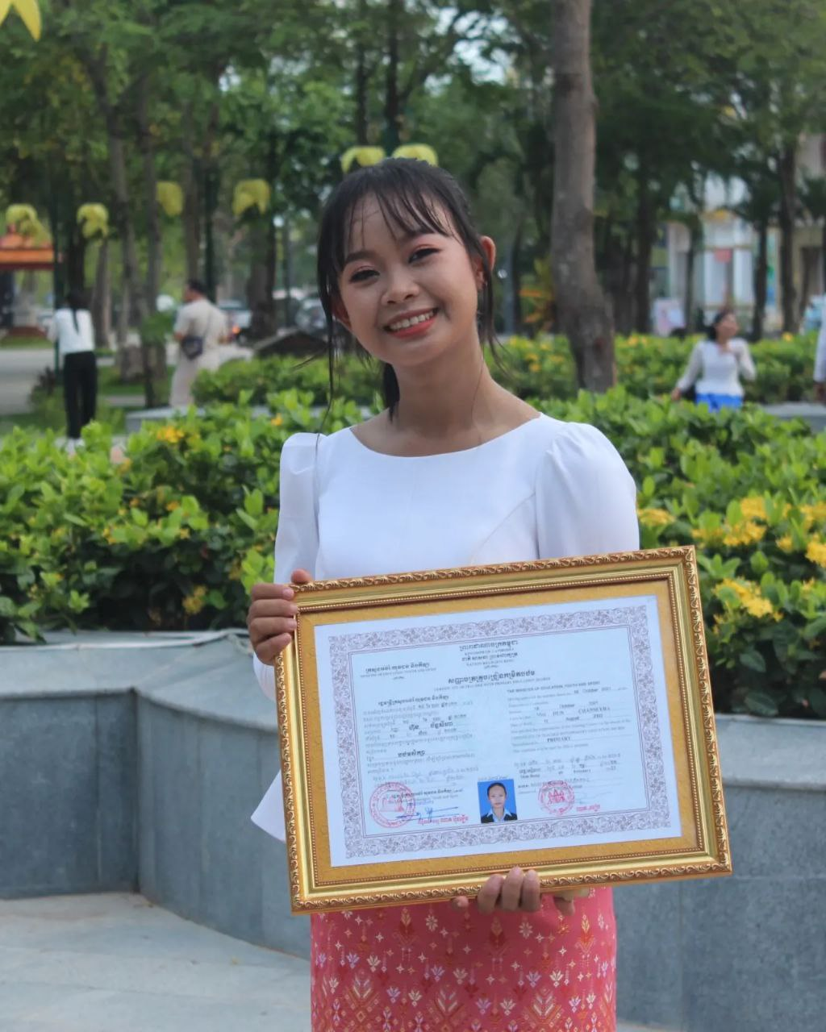
English grade 5
Chapter 3 School and Family
Unit 5 In The Morning
When do you get up in the morning?
Student’s book 54

Slide 2
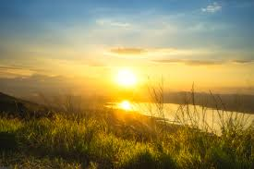
Morning
ពេលព្រឹក

Slide 3
When
ពេលណា

Slide 4
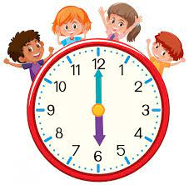
6 o’clock
ម៉ោង ៦

Slide 5
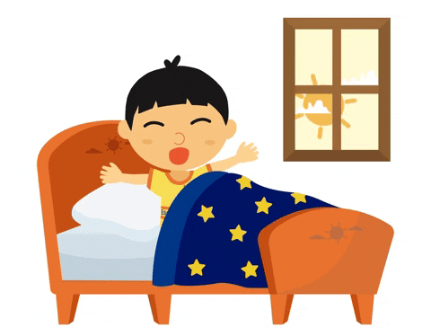
get up
ក្រោក (ពីគេង)

Slide 6
Listen and repeat
When do you get up in the morning?
តើអ្នកក្រោកពីគេងនៅពេលណា?

Slide 7
Listen and repeat
I get up at 6 o’clock
ខ្ញុំក្រោកពីគេងនៅម៉ោង៦។

Slide 8
Pair work
When do you get up in the morning?
I get up at 6 o’clock
6 o’clock, 4 o’clock, 5 o’clock, 7 o’clock.......

Slide 9
Group work
6 o’clock, 4 o’clock, 5 o’clock, 7 o’clock.......
1
When do you get up in the morning?
I get up at ……… o’clock
When do you get up in the morning?
4
I get up at 6 o’clock
When do you get up in the morning?
2
I get up at ……… o’clock
When do you get up in the morning?
3

Slide 10
By Hun chanseyha

