Slide 1
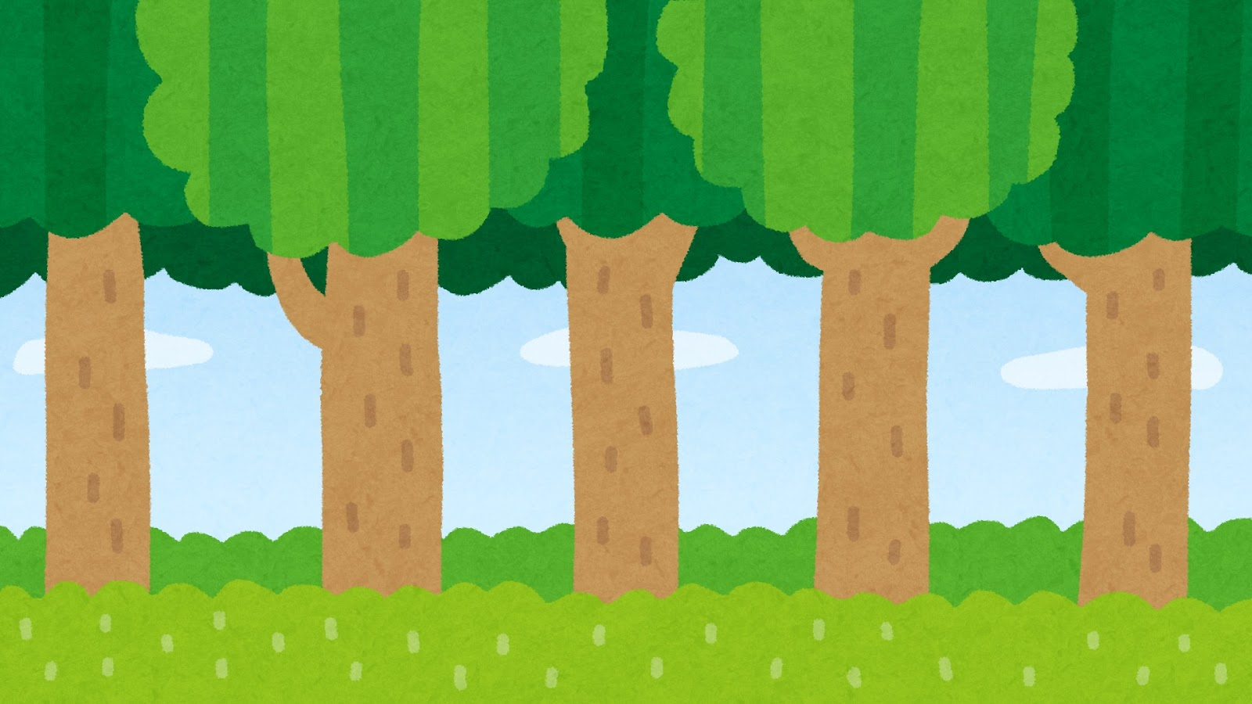
LESSON
Do you like apples?
Yes, I do. / No, I don’t.

Slide 2
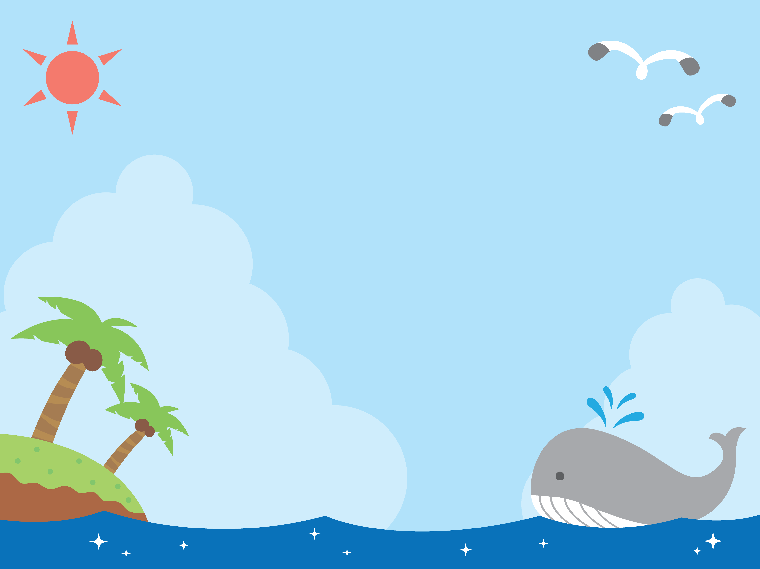
Warming Up
“Hello SONG”

Slide 4
Target Sentence
・Do you like apples ?
Yes, I do.
No, I don’t

Slide 5
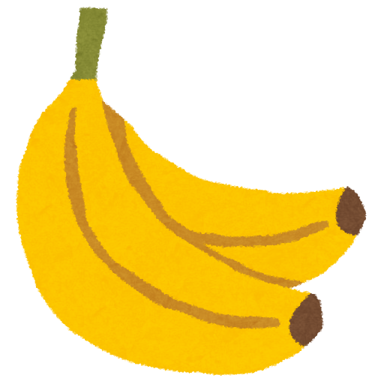
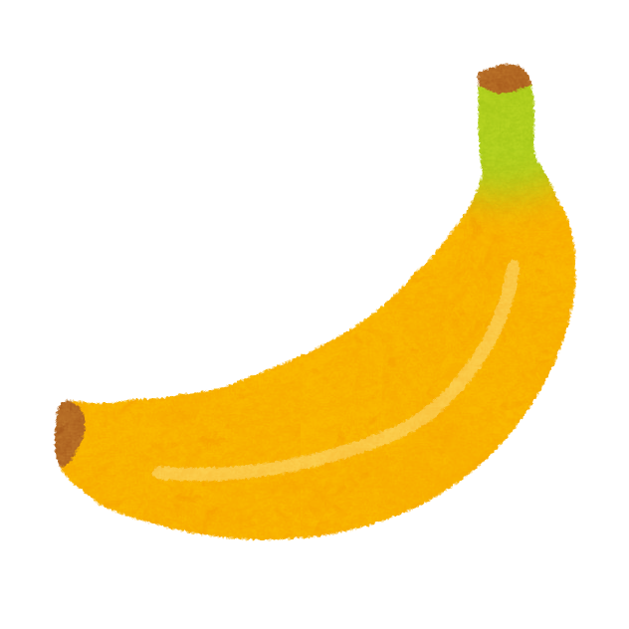
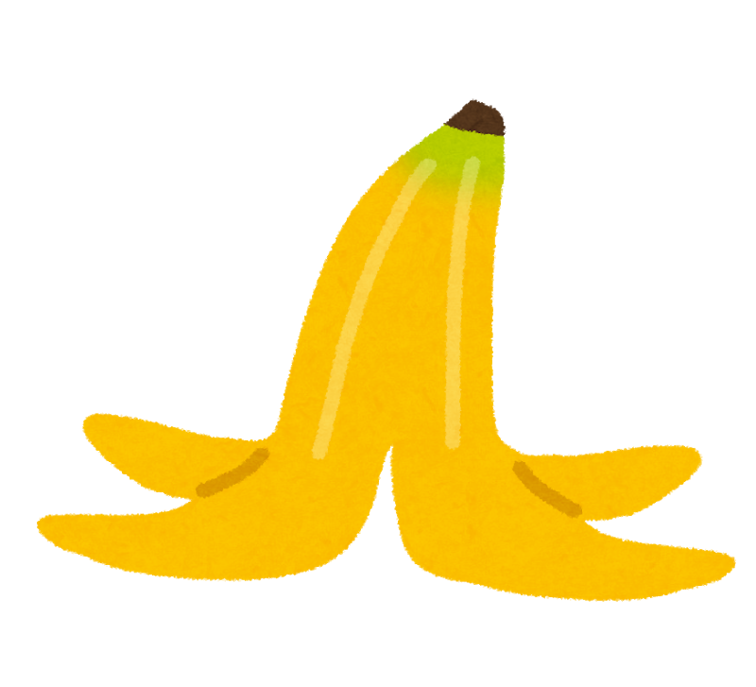
Target Sentence
・Do you like bananas ?
Yes, I do.
No, I don’t

Slide 6
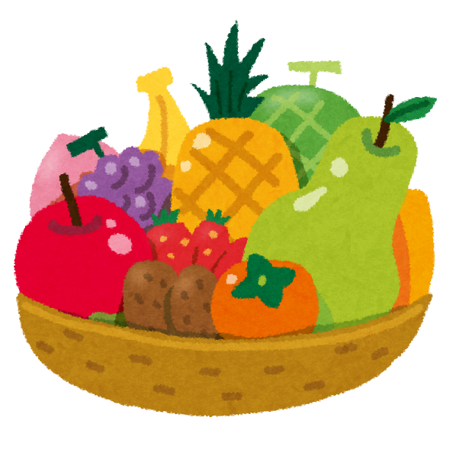
Vocabulary
Fruit
apple

Slide 7
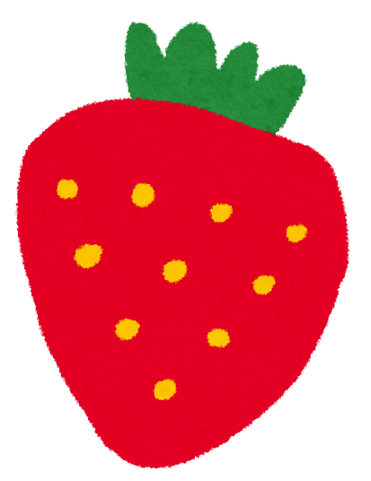
Vocabulary
Fruit
strawberry

Slide 8
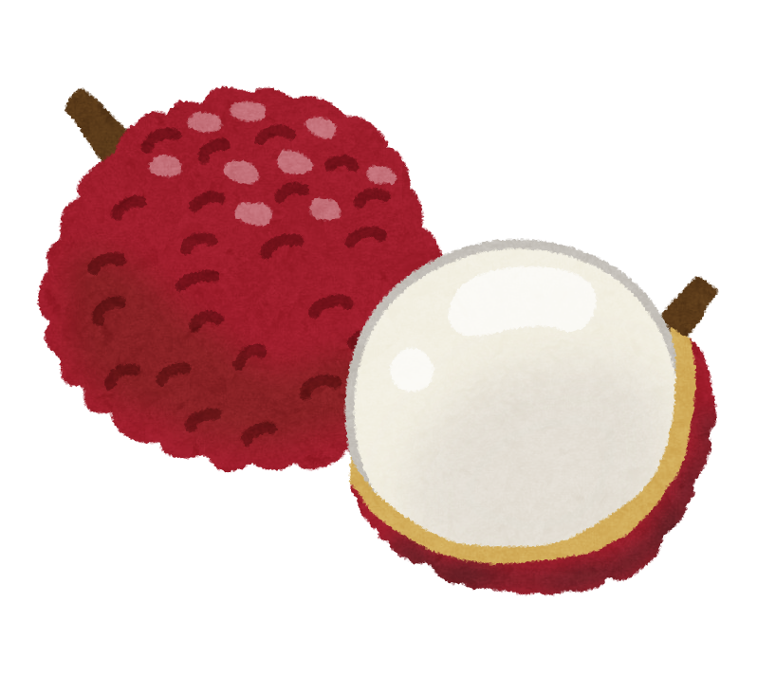
Vocabulary
Fruit
litchi

Slide 9
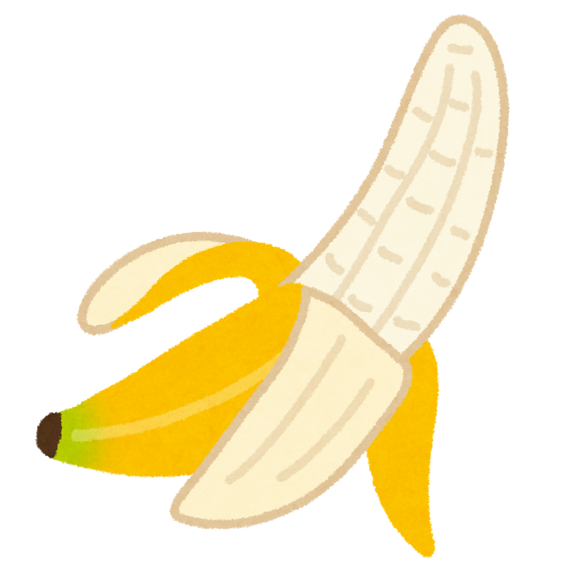
Vocabulary
Fruit
banana

Slide 10
Vocabulary
Fruit
mango

Slide 11
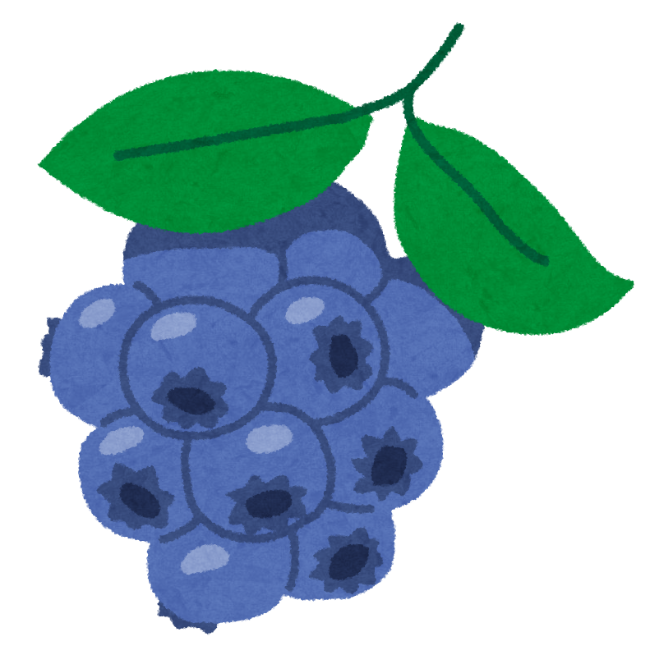
Vocabulary
Fruit
blueberry

Slide 12
Vocabulary
Fruit
peach

Slide 13
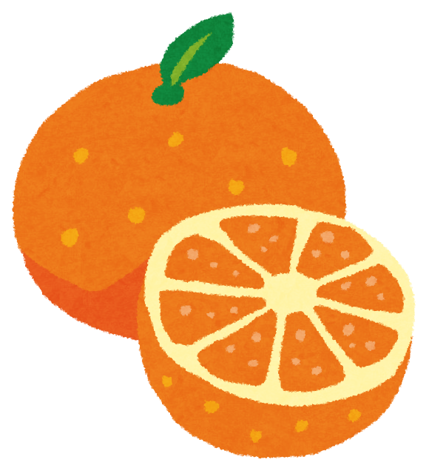
Vocabulary
Fruit
orange

Slide 14
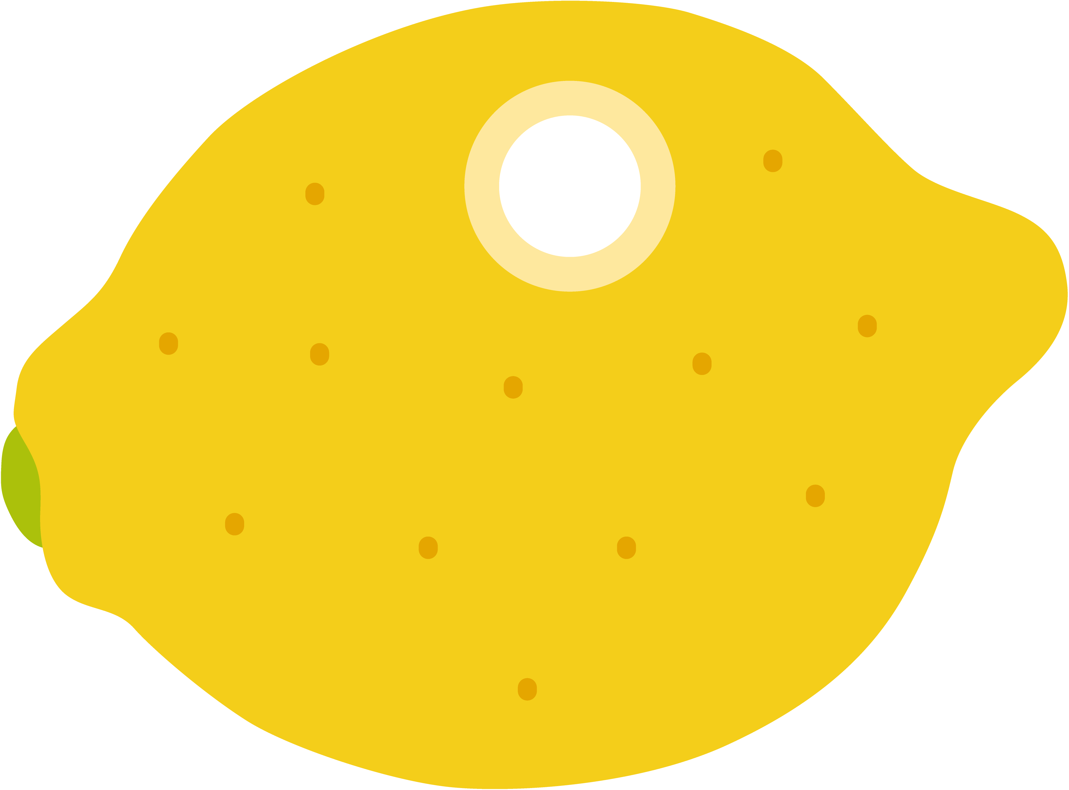
Vocabulary
Fruit
lemon

Slide 15
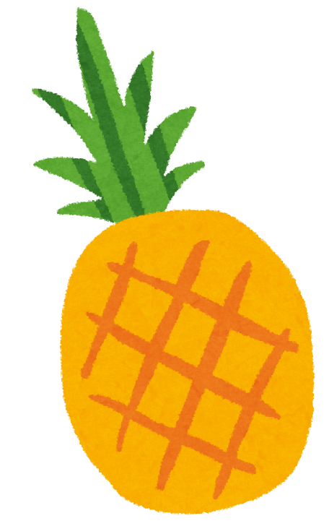
Vocabulary
Fruit
pineapple

Slide 16
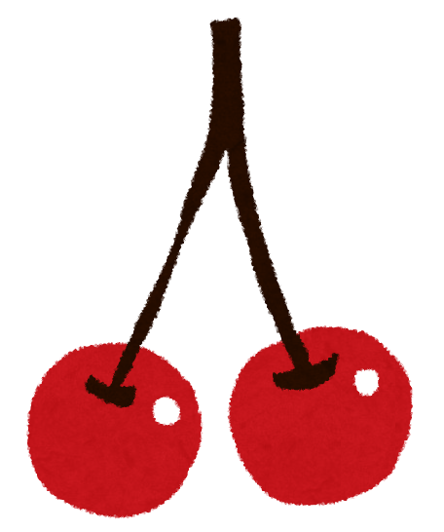
Vocabulary
Fruit
cherry

Slide 17
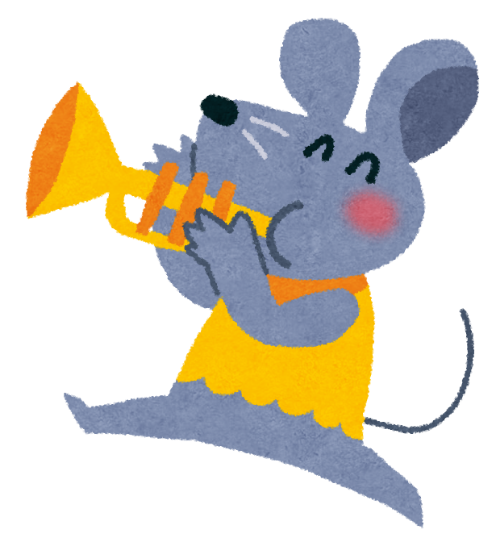
Basic Word
English | Khmer
You | អ្នក
like | ដូចជា
apples | ផ្លែប៉ោម
Yes | បាទ
No | ទេ

Slide 18
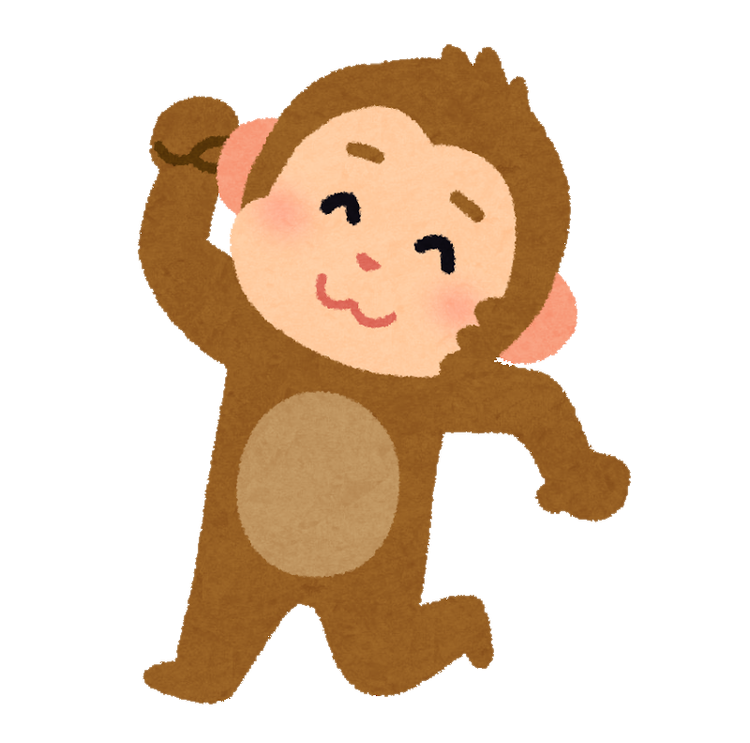
Conversation
I like apples.
Do you like apples?
Excuse me.
Yes.
Yes, I do.

Slide 19
Conversation
No, I don’t.
I like banana.
Do you like bananas?

Slide 20
Practice
A : Excuse me.
B : Yes.
A: I like . Do you like ?
B : Yes, I do./No, I don’t.
B : I like . Do you like ?
A : Yes, I do./No, I don’t.
A
A
B
B

