Slide 1
Greeting and Self Introduction

Slide 2
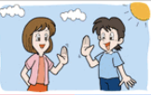
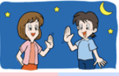
Greeting☀︎
Good morning
Good afternoon
Good evening
Good night
Hello
How are you?
---when you wake up / In the morning
---about after 12 o’clock pm
---about after 4 or 5 pm
---when you go to bed
---whenever you meet someone
---Ask someone conditions
Answer example – I’m fine/sleepy/happy/tired etc.
↪︎ So you say your feeling

Slide 3
How are you?☺︎
Ken: Good morning Anne!
How are you?
Anne: Good morning.
I’m fine thank you, and you?
Ken: I’m great

Slide 4
Self introduction
Hello. My name is Ken.
I’m 9 years old.
Nice to meet you.

Slide 5
Hello. My name is ____.
I’m ___years old.
Nice to meet you.

Slide 6
Bye Bye✌︎

