Slide 1
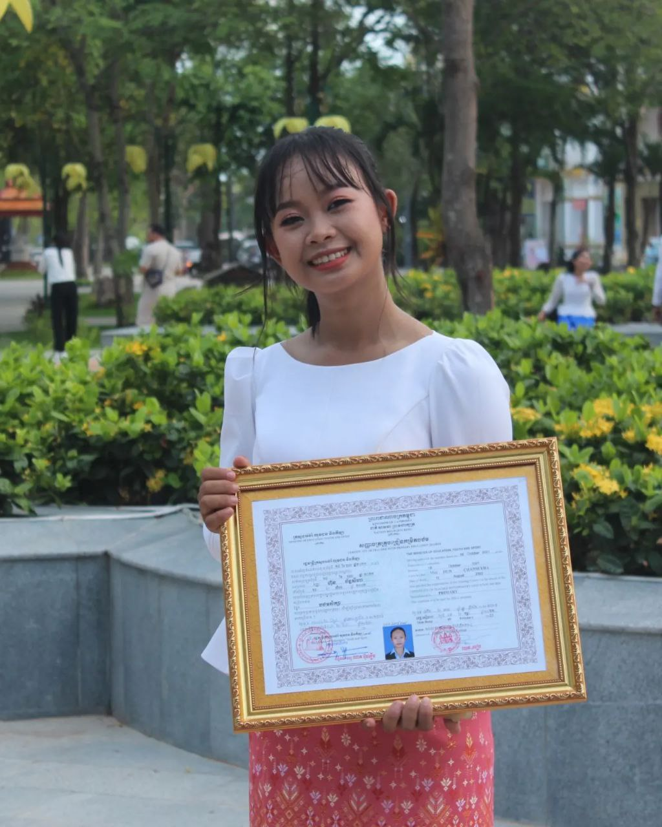
English grade 5
Chapter 5 Magic E
Unit 2 Magic e sound i
How old are you?
Student’s book page 101

Slide 2
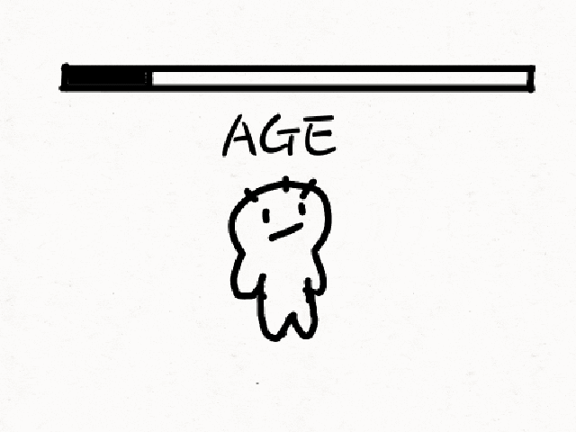
How old…..?
អាយុប៉ុន្មាន

Slide 3
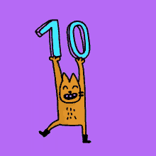
Ten
ដប់

Slide 4
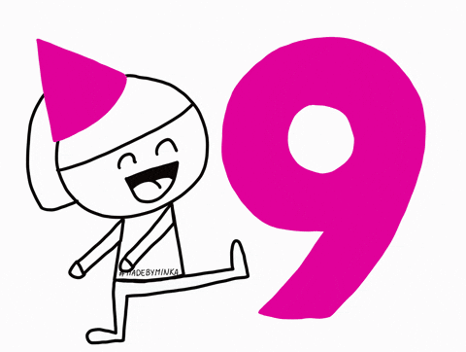
Nine
ប្រាំបួន

Slide 5
Listen and repeat
How old are you?
តើអ្នកមានអាយុប៉ុន្មាន?

Slide 6
Listen and repeat
I am ten years old.
ខ្ញុំមានអាយុដប់ឆ្នាំ។

Slide 7
Pair work
How old are you?
I am ten years old.
ten, nine, eight, seven, eleven, twelve…….

Slide 8
Group work
ten, nine, eight, seven, eleven, twelve…….
1
How old are you?
I am ……….. years old.
How old are you?
4
I am ten years old.
How old are you?
2
I am ……….. years old.
How old are you?
3

Slide 9
By Hun chanseyha

