Slide 1

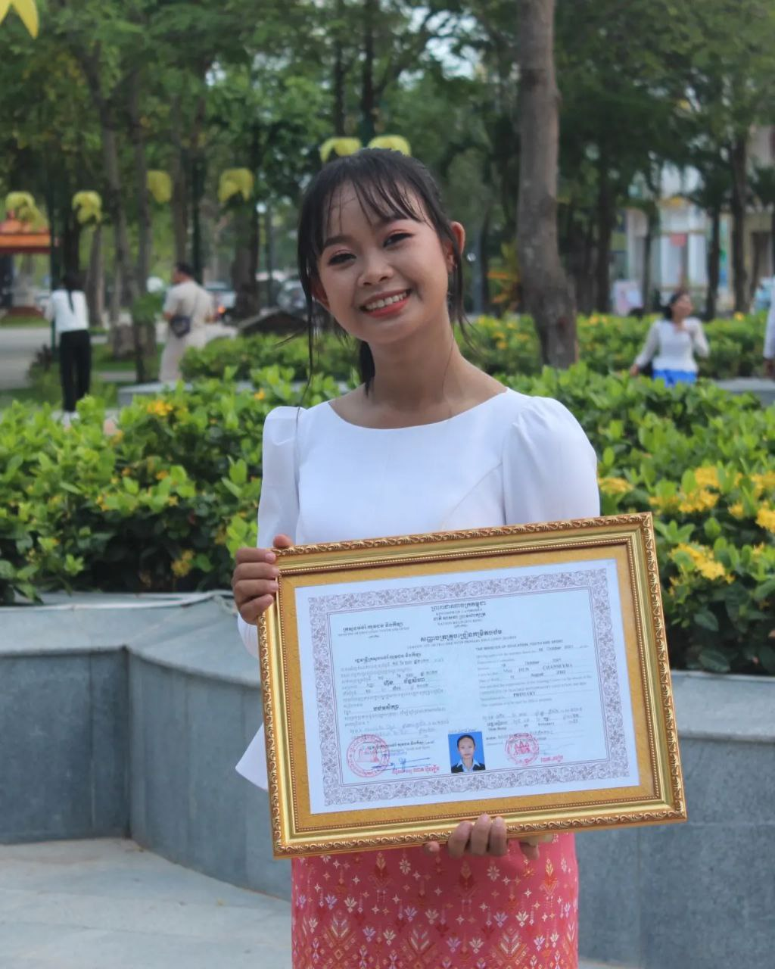
English grade 5
Chapter 5 Magic E
Unit 4 Magic e sound u
When is your birthday?
Student’s book page 109

Slide 2

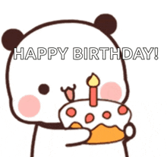
Birthday
ថ្ងៃកំណើត

Slide 3

June
ខែមិថុនា

Slide 4

May
ខែឧសភា

Slide 5
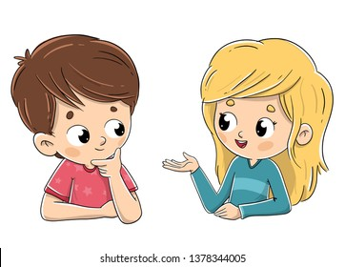
Listen and repeat
When is your birthday?
តើថ្ងៃកំណើតអ្នកនៅពេលណា?

Slide 6
Listen and repeat
My birthday is in June.
ថ្ងៃកំណើតខ្ញុំគឺនៅខែមិថុនា។

Slide 7
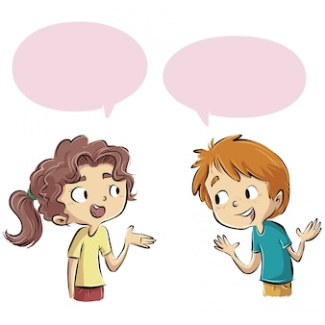
Pair work
When is your birthday?
My birthday is in June.
January, February, March, April, May, June, July, August, September, October, November, December

Slide 8
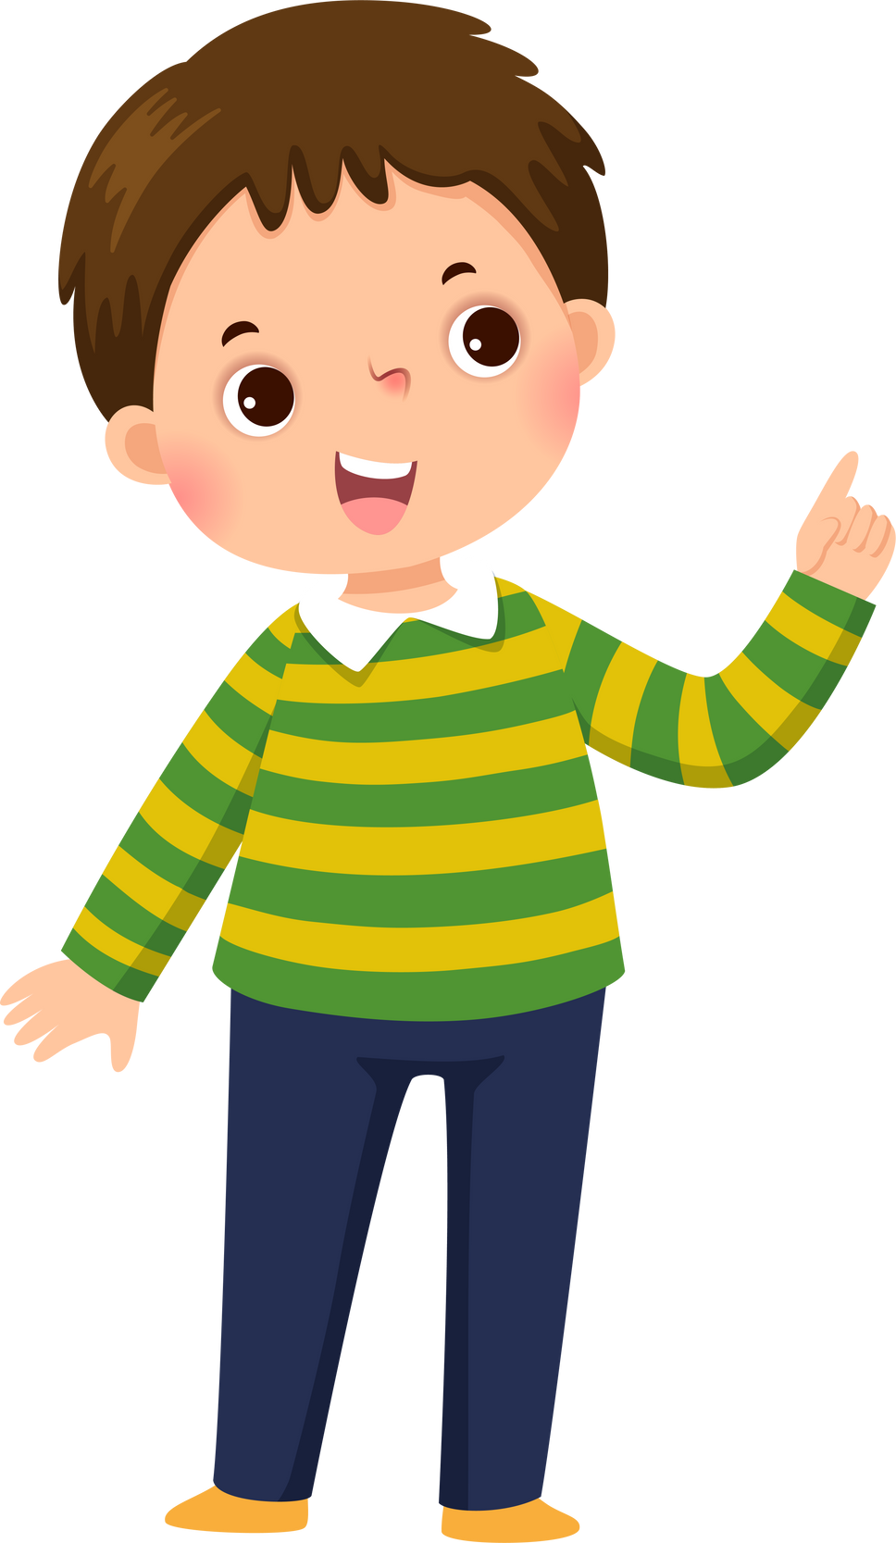

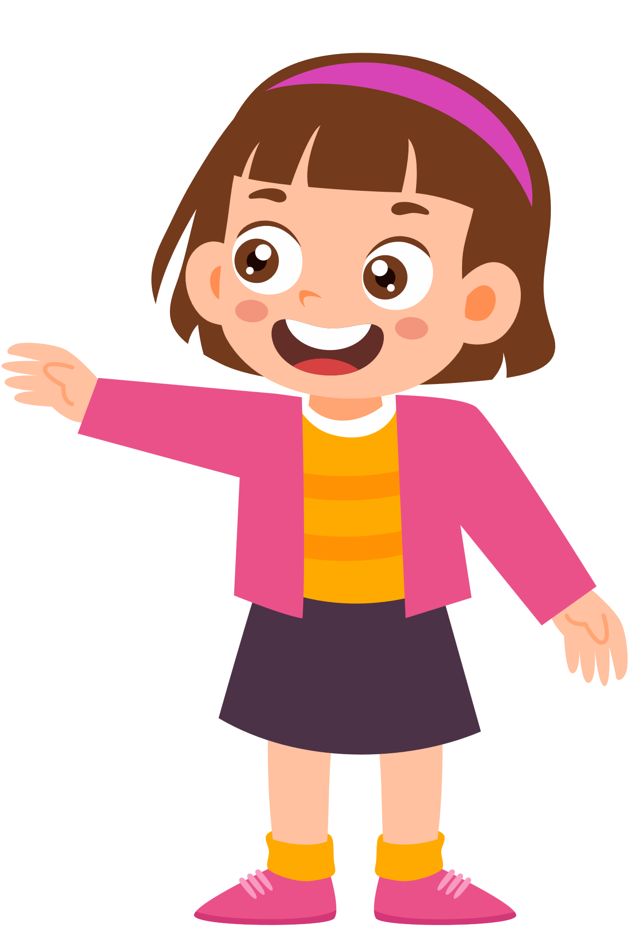
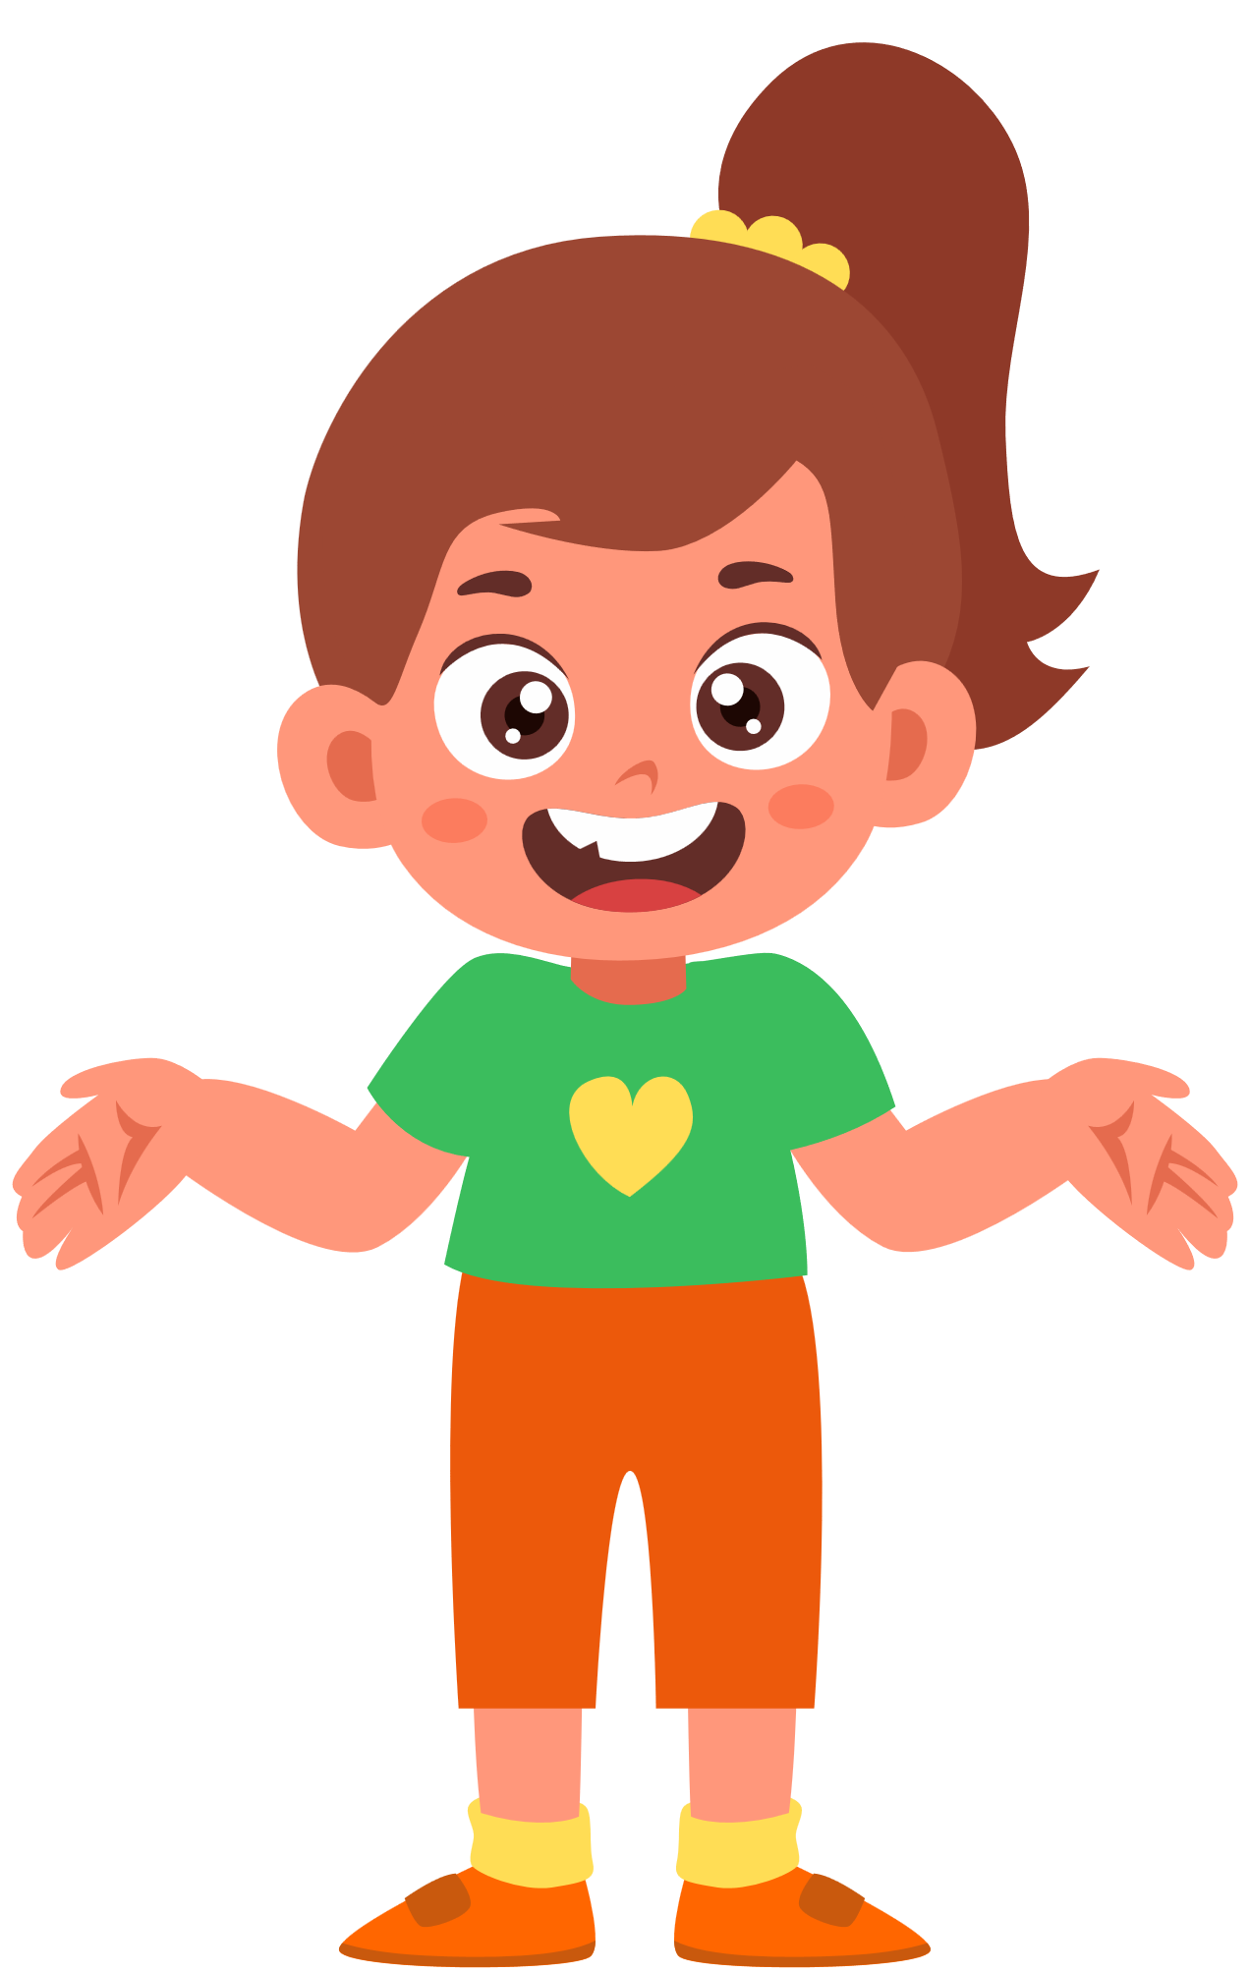
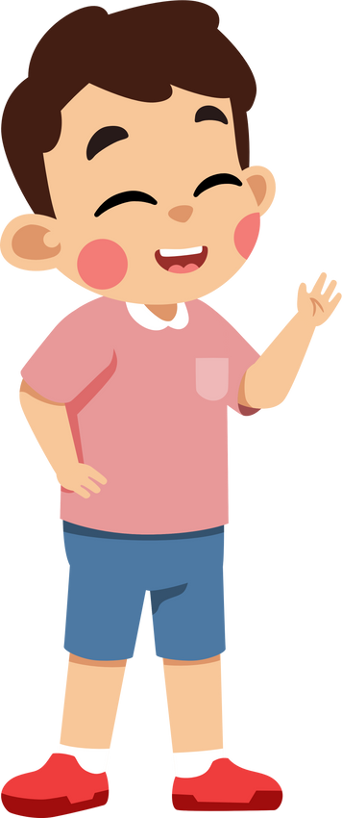
Group work
January, February, March, April, May, June, July, August, September, October, November, December
1
When is your birthday?
My birthday is in ………..
When is your birthday?
4
My birthday is in June.
When is your birthday?
2
My birthday is in ………..
When is your birthday?
3

Slide 9


By Hun chanseyha

