Slide 1

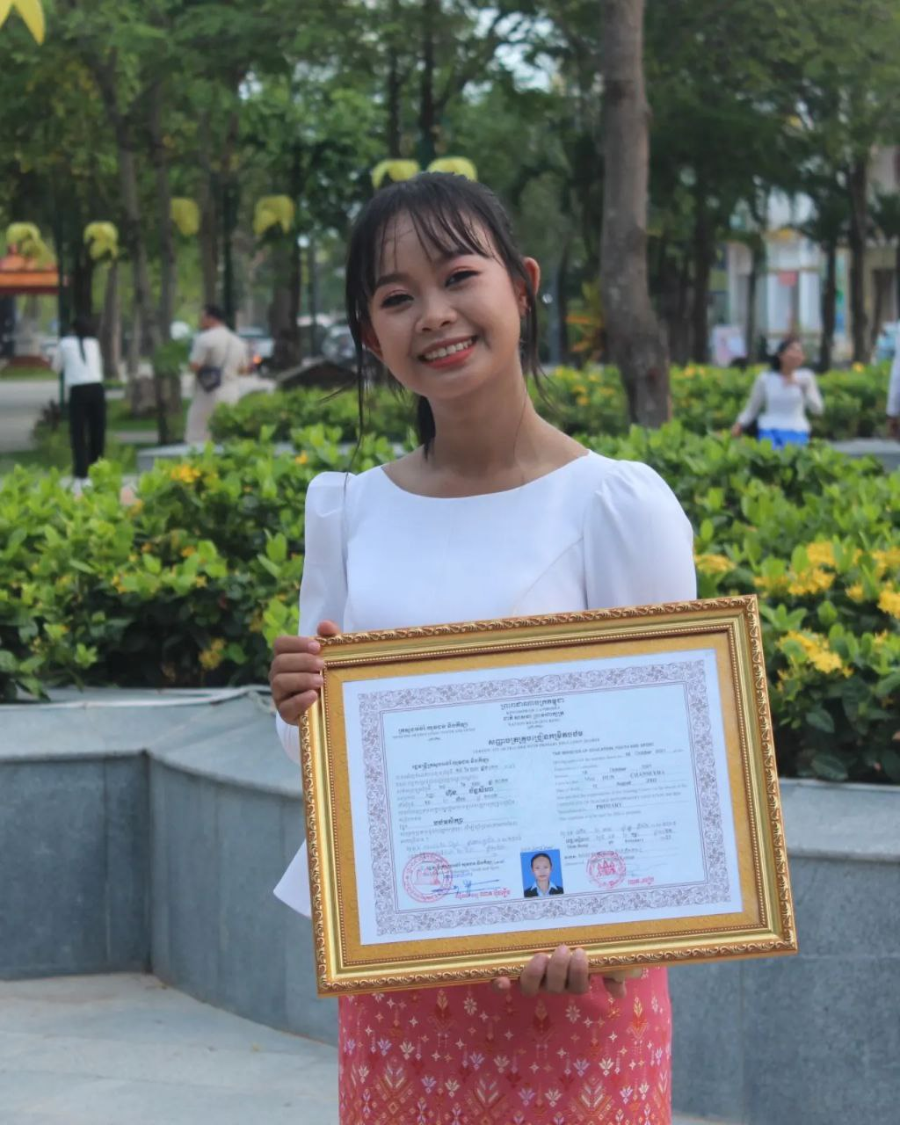
English grade 5
Chapter 5 Magic E
Unit 3 Magic e sound u
Can you use a computer?
Student’s book page 110

Slide 2
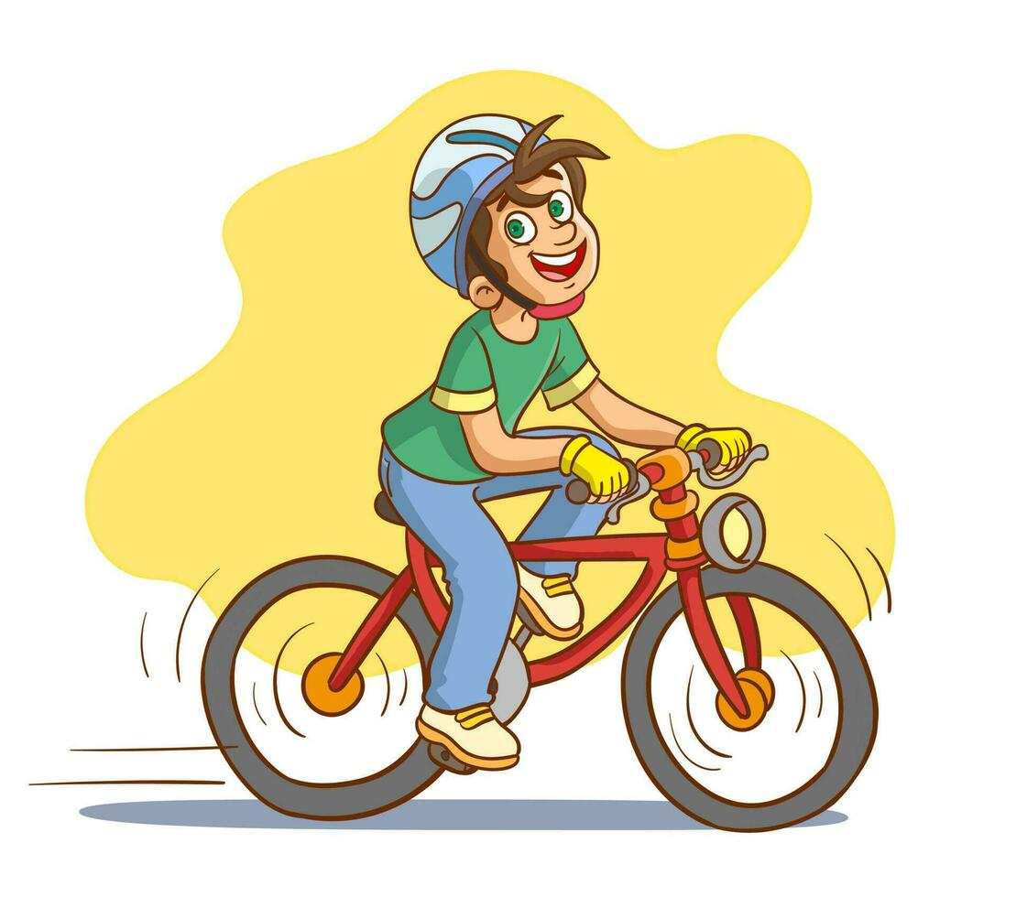

Can
អាច

Slide 3
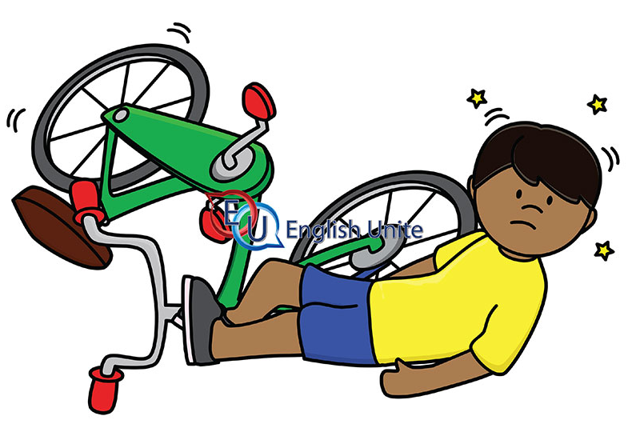
Can’t / cannot
មិនអាច

Slide 4
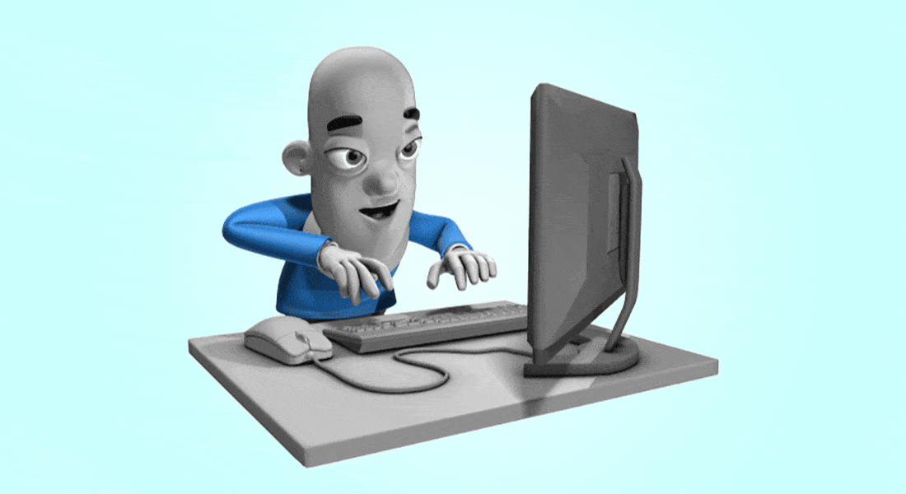
Use
ប្រើប្រាស់

Slide 5

Computer
កុំព្យូទ័រ

Slide 6
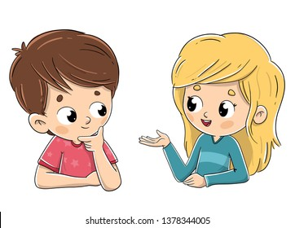
Listen and repeat
Can you use a computer?
តើអ្នកអាចប្រើកុំព្យូទ័រឬទេ?

Slide 7
Listen and repeat
Yes, I can / No, I can’t
ចាស, ខ្ញុំអាច
ទេ,​ ខ្ញុំមិនអាចទេ

Slide 8
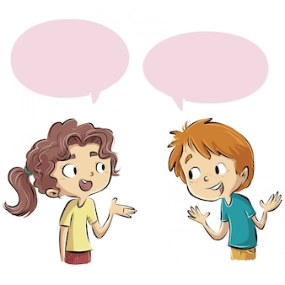
Pair work
Can you use a computer?
Yes, I can / No, I can’t
Computer, cube, flute, tube, phone, TV, ……..

Slide 9
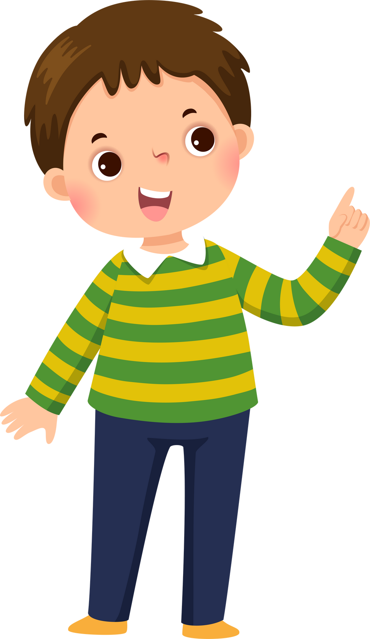


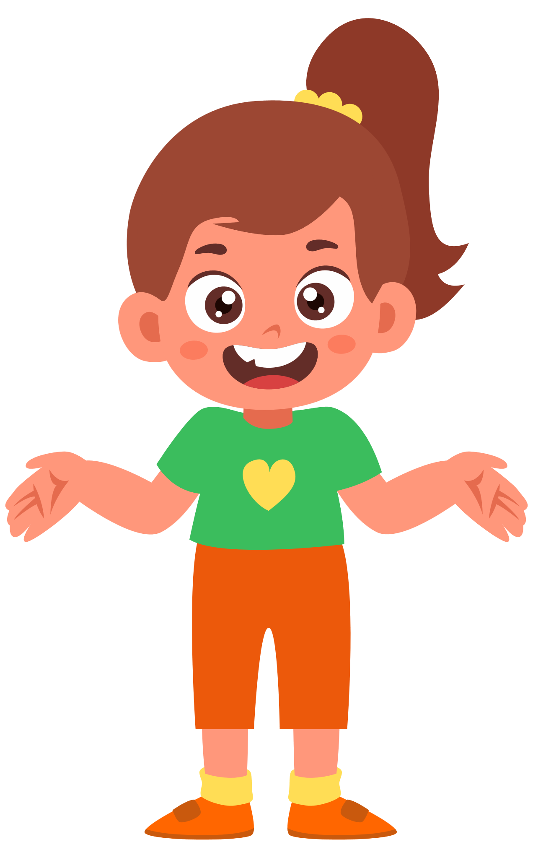

Group work
Computer, cube, flute, tube, phone, TV, ……..
1
Can you use a computer?
Yes, I can / No, I can’t
Can you use a ?
4
Yes, I can / No, I can’t
Can you use a ?
2
Yes, I can / No, I can’t
Can you use a ?
3

Slide 10


By Hun chanseyha

