Slide 1
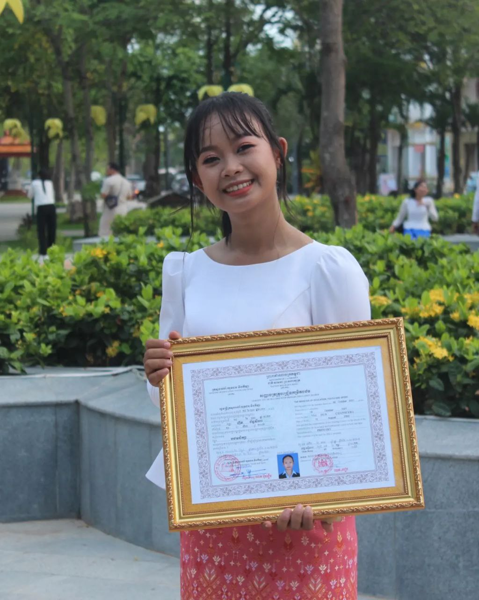
English grade 5
Chapter 5 Magic E
Unit 3 Magic e sound u
What can you use?
Student’s book page 111

Slide 2
Can
អាច

Slide 3
Use
ប្រើប្រាស់

Slide 4
Computer
កុំព្យូទ័រ

Slide 5
Tube
បំពង់

Slide 6
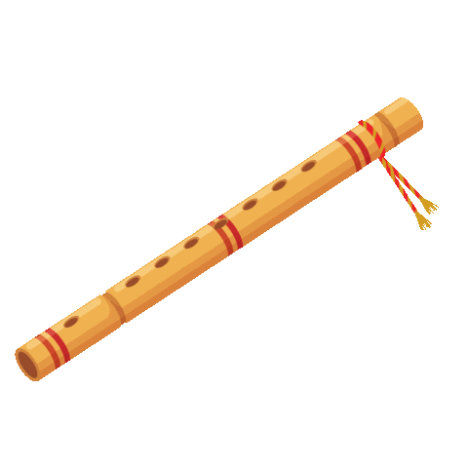
flute
ខ្លុយ

Slide 7
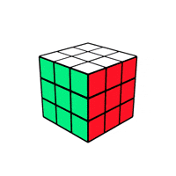
Cube
ប្រអប់គូប

Slide 8
Listen and repeat
What can you use?
តើអ្នកអាចប្រើអ្វីខ្លះ?

Slide 9
Listen and repeat
I can use a computer.
ខ្ញុំអាចប្រើ កុំព្យូទ័រ។

Slide 10
Pair work
What can you use?
I can use a computer.
Computer, cube, flute, tube, phone, TV, ……..

Slide 11
Group work
Computer, cube, flute, tube, phone, TV, ……..
1
What can you use?
I can use ………….
What can you use?
4
I can use a computer.
What can you use?
2
I can use ………….
What can you use?
3

Slide 12
By Hun chanseyha

