Slide 1
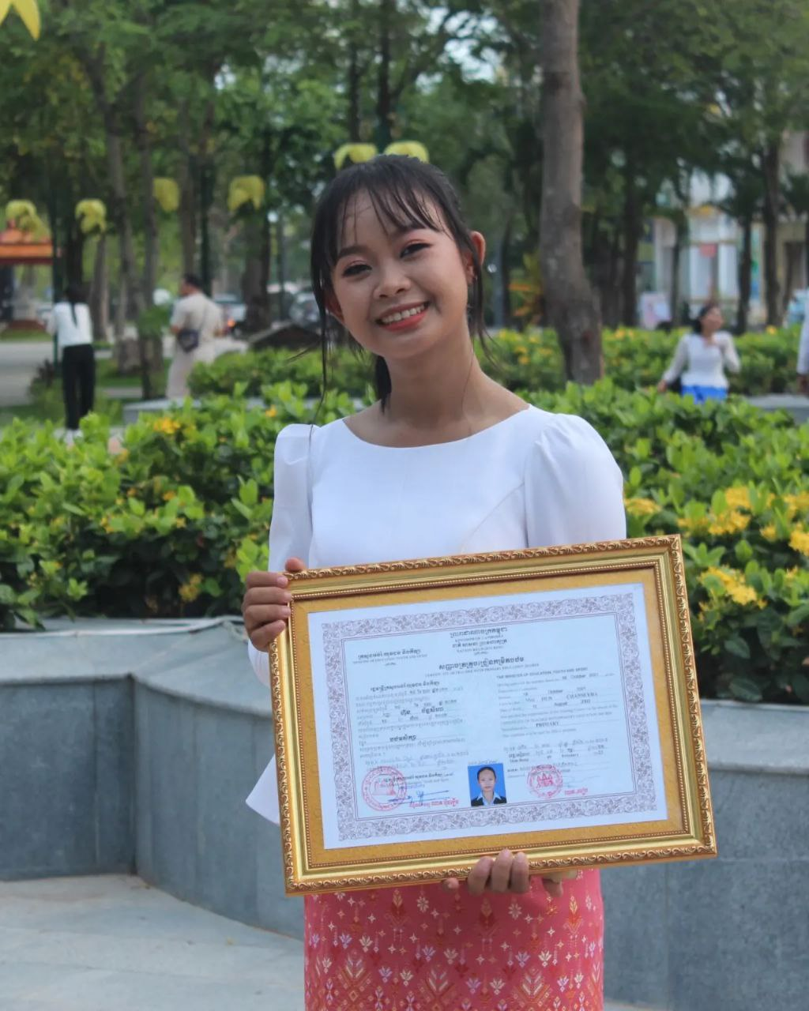
English grade 5
Chapter 6 The weather
Unit 1 Today’s Weather
What’s weather like today?
Student’s book 114-115

Slide 2
Weather
អាកាសធាតុ

Slide 3
Sunny
បើកថ្ងៃ

Slide 4
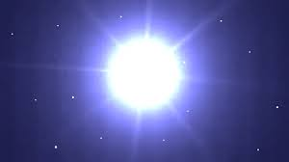
Bright
ភ្លឺ(ចាំងថ្ងៃ)

Slide 5
Cloudy
ពពក (ច្រើន)

Slide 6
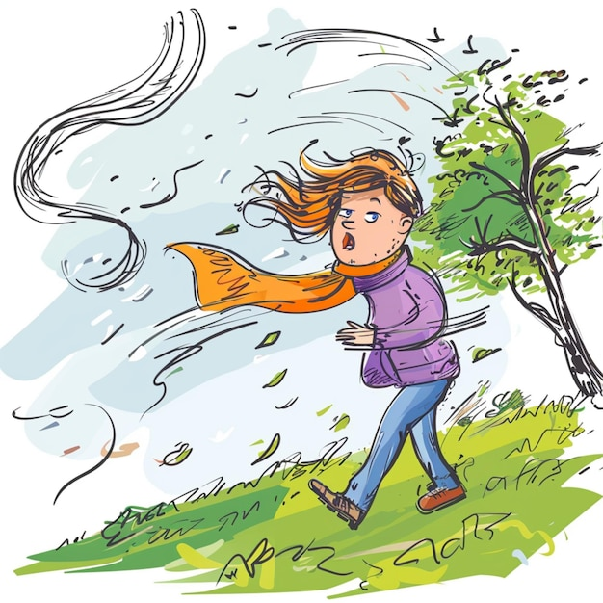
Windy
ធ្លាក់ខ្យល់

Slide 7
Listen and repeat
What’s the weather like today?
តើថ្ងៃនេះអាកាសធាតុយ៉ាងមិចដែរ?

Slide 8
Listen and repeat
It’s cloudy and windy.
ថ្ងៃនេះមានពពកច្រើននិងធ្លាក់ខ្យល់។

Slide 9
Pair work
What’s the weather like today?
It’s cloudy and windy.
Cloudy, windy, sunny, bright, hot……

Slide 10
Group work
Cloudy, windy, sunny, bright, hot……
1
What’s the weather like today?
It’s ………. and ………...
What’s the weather like today?
4
It’s cloudy and windy.
What’s the weather like today?
2
It’s ………. and ………...
What’s the weather like today?
3

Slide 11
By Hun chanseyha

