Slide 1
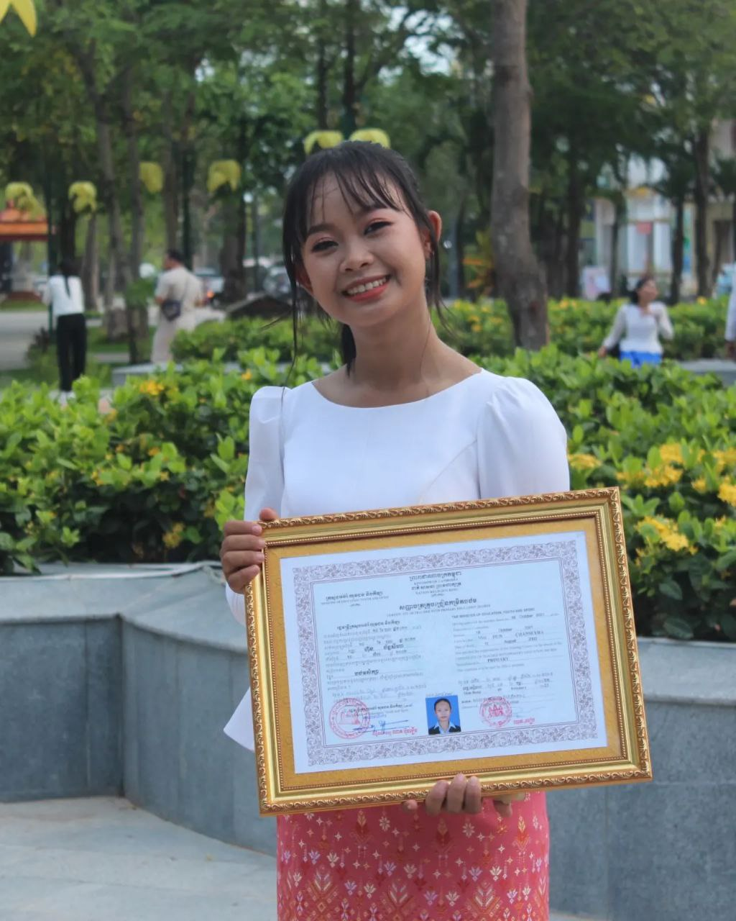
English grade 5
Chapter 6 The weather
Unit 3 The Dry Season
Do you like dry season?
Student’s book 122-125

Slide 2
Season
រដូវ

Slide 3
Dry season
រដូវប្រាំង

Slide 4
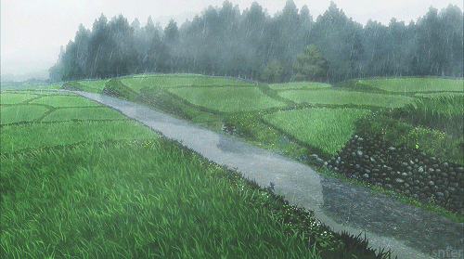
Rainy season
រដូវវស្សា

Slide 5
Listen and repeat
Do you like dry season?
តើអ្នកចូលចិត្តរដូវប្រាំងឬទេ?

Slide 6
Listen and repeat
Yes, I do / No, I don’t
ចាស, ខ្ញុំចូលចិត្ត
ទេ,​ ខ្ញុំមិនចូលចិត្តទេ

Slide 7
Pair work
Do you like dry season?
Yes, I do / No, I don’t
Rainy season, dry season……

Slide 8
Group work
Rainy season, dry season……
1
Do you like dry season?
Yes, I do / No, I don’t
Do you like ……………
4
Yes, I do / No, I don’t
Do you like ………..?
2
Yes, I do / No, I don’t
Do you like ……………
3

Slide 9
By Hun chanseyha

