Slide 1
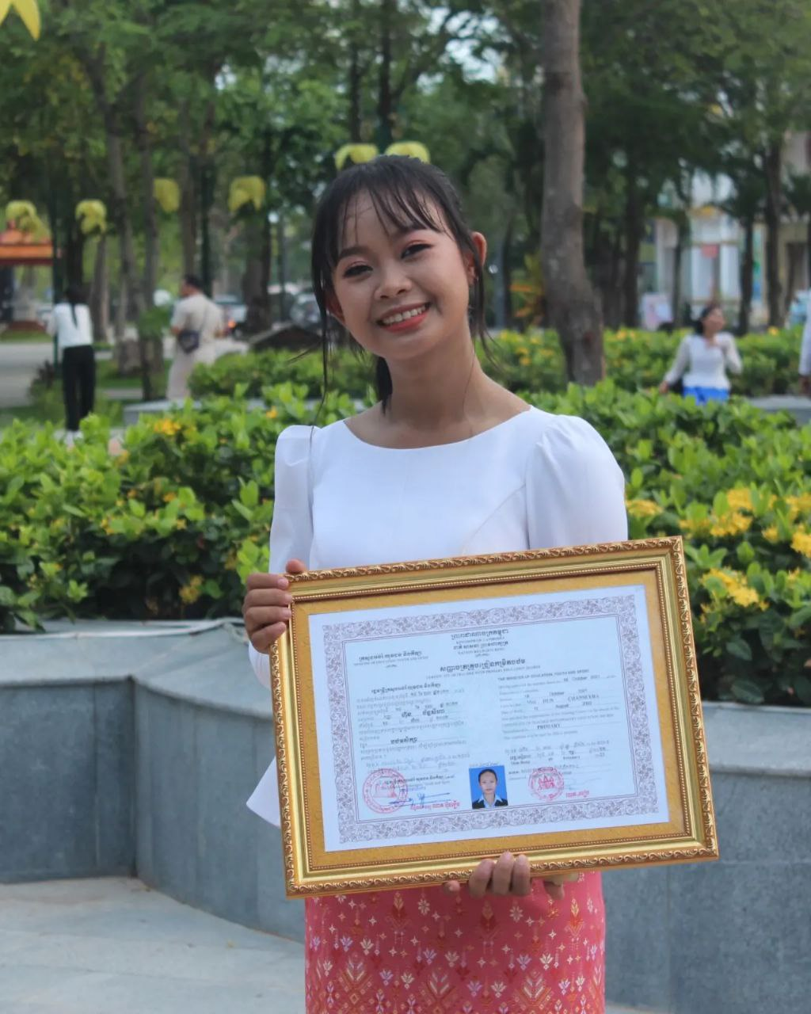
English grade 5
Chapter 2 Farm and Farming
Unit 3 Farming
Who plants rice in the field?
Student’s book page 36

Slide 2
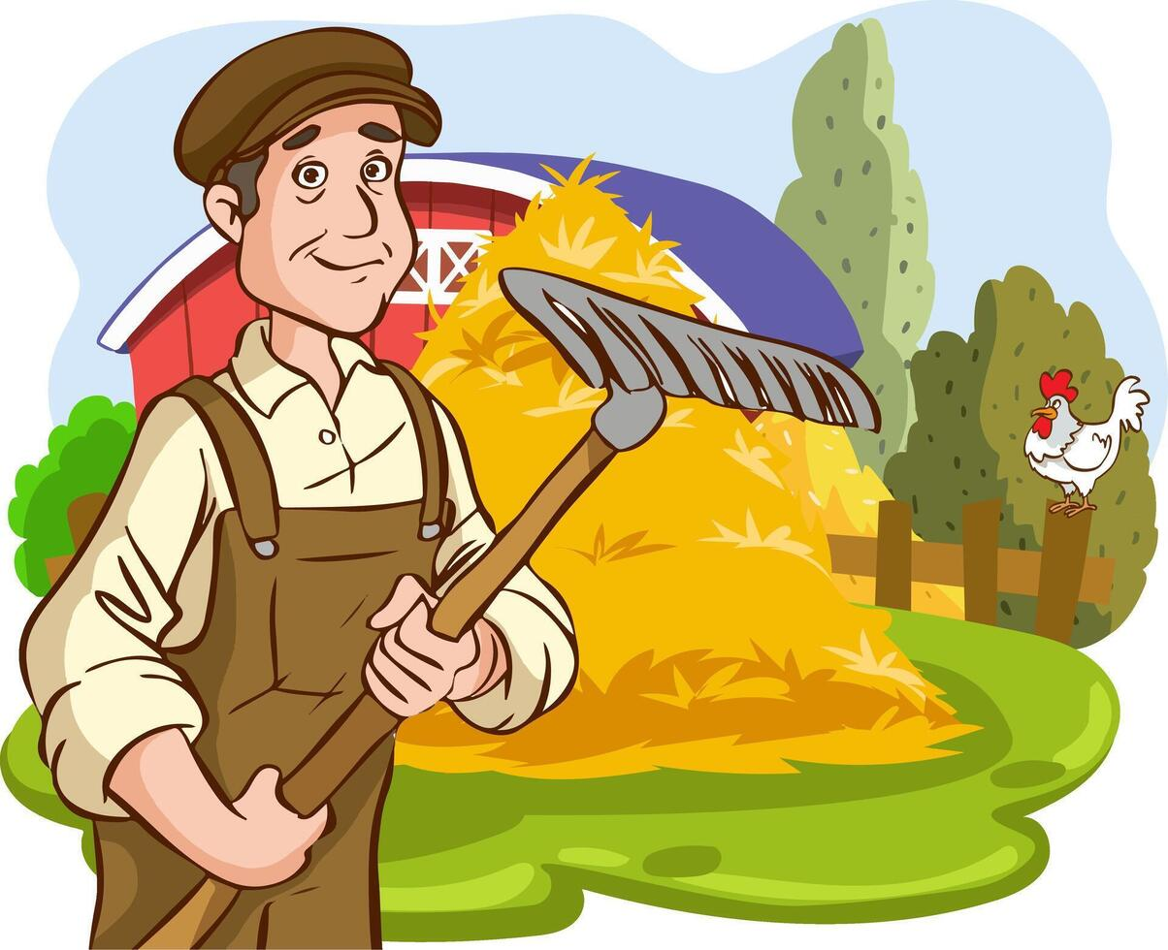
Farmer
កសិករ

Slide 3
Parent
ឪពុកម្ដាយ

Slide 4
Listen and repeat
Who plants rice in the field?
តើអ្នកណាដាំស្រូវនៅឯស្រែ?

Slide 5
Listen and repeat
Farmers plant rice in the field.
កសិករដាំស្រូវនៅឯស្រែ

Slide 6
Pair work
Who plants rice in the field?
Farmers plant rice in the field.
Farmers, my parents, I and my sisters, my father, my brothers ……

Slide 7
Group work
Farmers, my parents, I and my sisters, my father, my brothers …
1
Who plants rice in the field?
…………… plant rice in the field.
Who plants rice in the field?
4
Farmers plant rice in the field.
Who plants rice in the field?
2
…………… plant rice in the field.
Who plants rice in the field?
3

Slide 8
By Hun chanseyha

