Slide 1
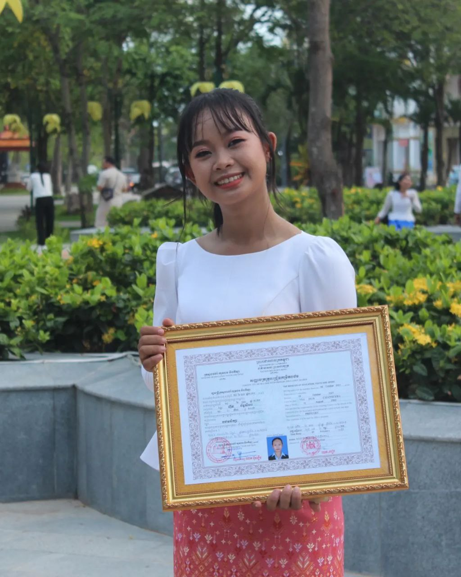
English grade 5
Chapter 3 School and Family
Unit 2 Going to school
Where is Bopha going?
Student’s book 50

Slide 2
Sea
សមុទ្រ

Slide 3
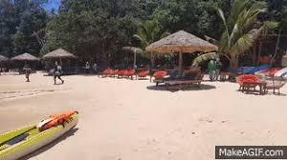
Beach
ឆ្នេរសមុទ្រ

Slide 4
is going to
កំពុងទៅ

Slide 5
Listen and repeat
Where is Bopha going?
តើបូផាកំពុងទៅណា?

Slide 6
Listen and repeat
Bopha is going to the sea.
បូផា កំពុងទៅសមុទ្រ

Slide 7
Pair work
Where is Bopha going?
Bopha is going to the sea.
Bopha, she, he, it, Neary,……
sea, beach, school, home, market,....

Slide 8
Group work
Bopha, she, he, it, Neary,…the sea, the beach, school, home, market,....
1
Where is Bopha going?
……. is going to ……..
Where is …….. going?
4
Bopha is going to the sea.
Where is …….. going?
2
……. is going to ……..
Where is …….. going?
3

Slide 9
By Hun chanseyha

